Slide 1
Sun Space
Winter Garden
Conservatory
B12 Conservatories
Source of free heat, overheating,
a drain on energy or all of the above?

Slide 2
This Presentation on GBE:
Find this file on GBE website at:
https://GreenBuildingEcyclopaedia.uk/?P=294

Slide 3
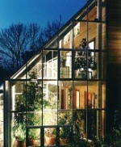
Conservatories:

Slide 4
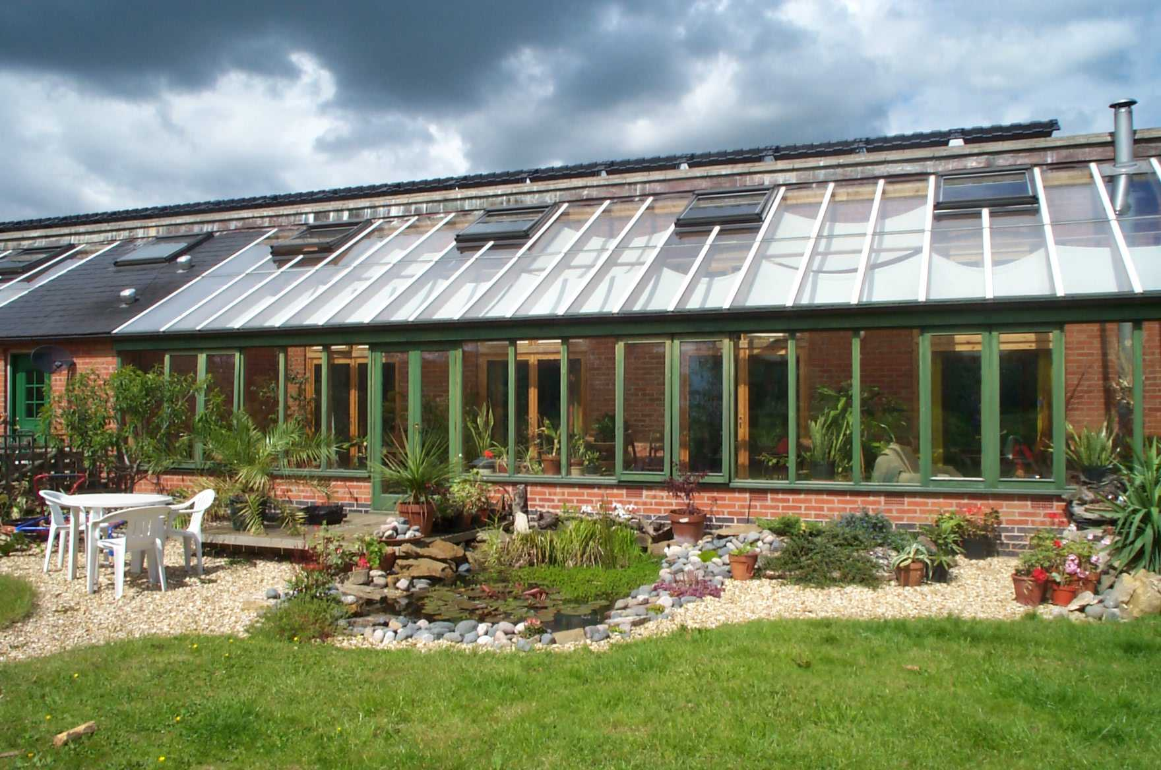
HHP Hockerton Housing Project, Newark, Nottinghamshire

Slide 5
GreenSpec CPD Seminar Series
Educational Objective:
  Comprehensive introduction to subject: Conservatories and thermal mass
  emphasis on environmentally sustainable solutions
  design primer: addressing principles and solutions
  technically rich: materials, construction, services & testing
  Related GreenSpec CPD Seminars indicated
  Questions and answers for each subtopic in file 10
Audience:
  Architecture Students Part 1 Year 2, Part 2 Year 1
  CPD update for all levels of experience & knowledge
Delivery:
  20 minutes depending upon audience participation
  Reading 10 minutes

Slide 6
Air Movement in Buildings: 18 of 25
Principles of Element Design
Climate Change
Wind
Wind Tunnel Testing
Wind Turbines
Natural Ventilation
Moisture Vapour & Condensation
Thermal Insulation
Breathing Construction
Airtightness
Wind & Airtightness Testing
Building Elements
Passive Ventilation
Active Ventilation
Stack Effect
Atrium
Solar Orientation & Solar Gain
Conservatories
Thermal mass
Conduction, Convection, Radiation
Solar Shading
Thermal mass, Passive and active cooling
Fluid dynamics
Mechanical Ventilation
Air-Conditioning
Questions and Answers

Slide 7
Commercial Green
Another GBE CPD seminar on the website to read

Slide 9
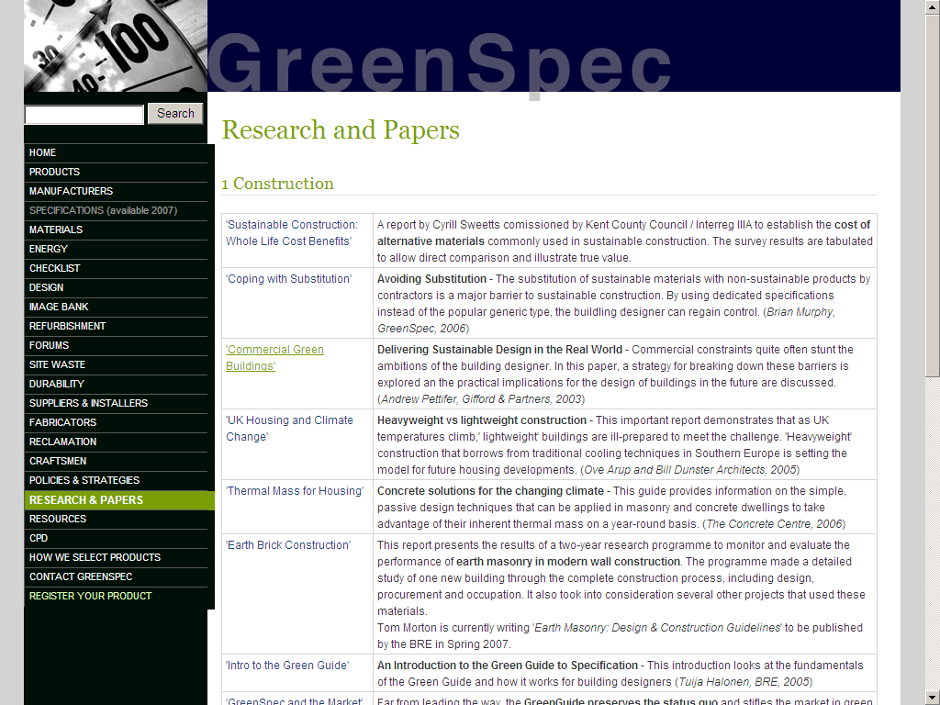

Slide 10
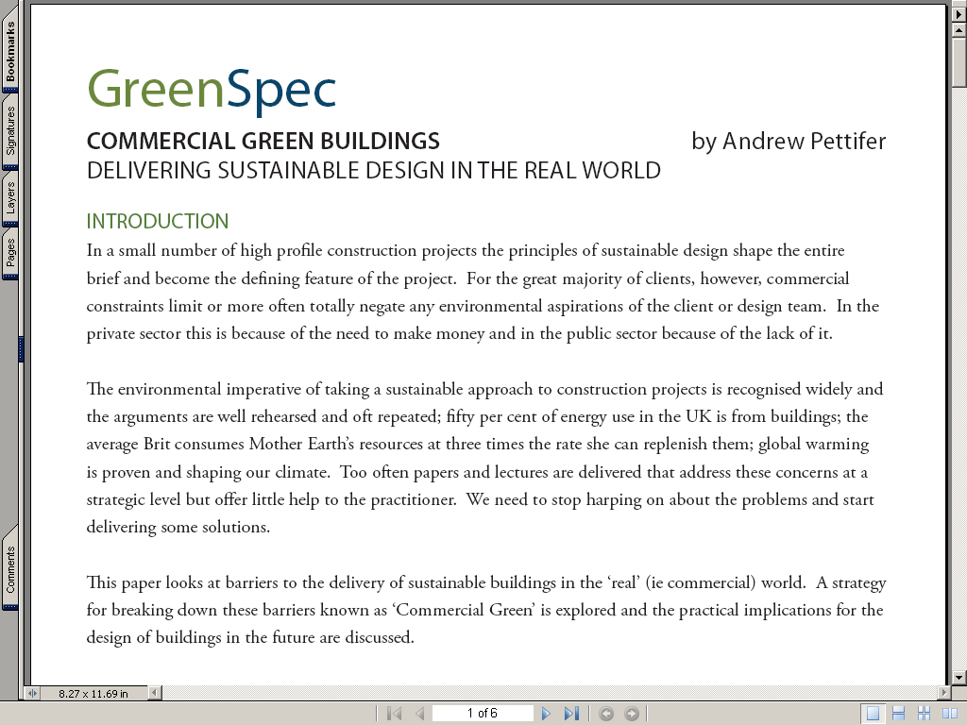

Slide 11
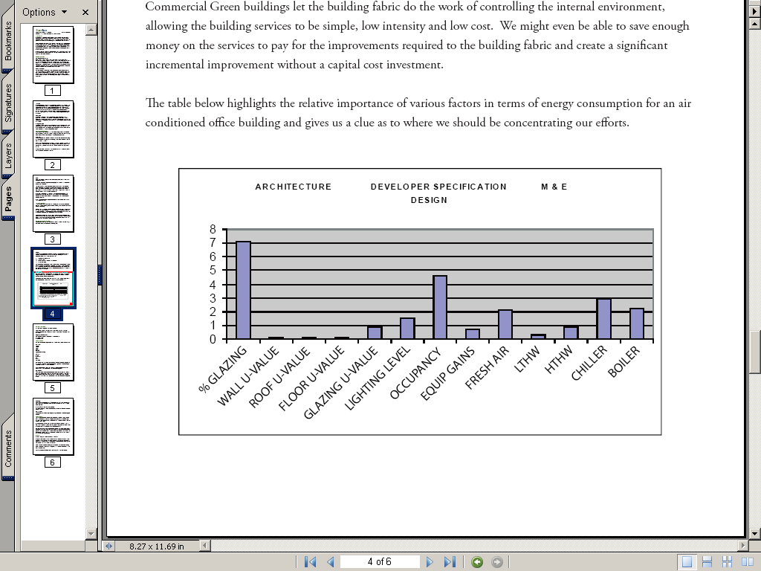

Slide 12
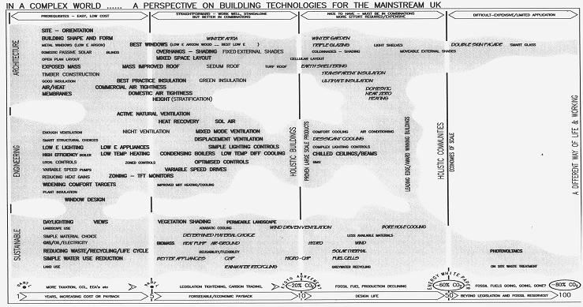

Slide 14
Prerequisites, easy, low costs Straightforward, work well, standalone, better communal Nice to have, more effort required, expensive difficult
Site – Orientation
Building shape and form
Metal windows Low E Argon
Domestic Passive Solar
Open Plan Layout
Exposed Mass
Timber Construction
0.00 Insulation
Air/Heat
Membranes
Winter Atria Winter Garden
Best Windows: Low E Argon Wood Triple Glazing Light Shelves Double skin facades Smart Glass
Overhangs – Shading Fixing external Shades Colour _____ Shading Moveable external shades
Mixed space Layout Cellular Layout
Mass Improved Roof Sedum Roof Turf Roof Earth Sheltering
Transparent Insulation
Best Practice Insulation Green Insulation Ultimate Insulation
Commercial Air tightness
Domestic Air tightness Domestic near-zero heating
Height (Stratification)
Active Natural Ventilation
Heat Recovery Sol Air
Night Ventilation Mixed Mode Ventilation Comfort cooling Air Conditioning
Displacement Ventilation Desicant cooling
Low E Appliances Simple Light Controls Complex lighting controls
Low Temp Heating Condensing Boilers Low Temp Diff Cooling Chilled ceiling / beams
Zoned Controls Optimised Controls BMS
Variable Speed Drives
Zoning TFT Monitors (arrived sooner)
Improved ____ Heating/Cooling
Vegetation Shading Permeable Landscape
______ Cooling Wind Driven Ventilation Poke Hole Cooling
Determined Materials Choices Mixed available materials
BioMass Heat Pump Air-Ground Hydro Wind
_______________ Solar Thermal Photovoltaics
Better Applicance CHP Micro – CHP Fuel Cells
Rainwater Harvesting ________ Recycling On site waste ________
Draught Ventilation
Functional Checks
Low E Lighting
High Efficiency Boiler
Local Controls
Variable Speed Pumps
Reducing Heat gains
Widening Comfort Targets
Plant Insulation
Window Design
Sustainable Engineering Architecture
Holistic Buildings
Proven Large Scale Technology
Holistic Communities
Daylighting Views
Landscape Use
Simple Material Choices
Gas/Oil/Electricity
Redyucing Waste/Recycling/Life Cycle
Simple Water Use Reduction
Land Use
Now +5years +10 +50
Part L & CfSH Kyoto Targets CfSH Energy White Paper
-20% CO2 -60% CO2

Slide 15
Green Houses & Conservatories: Summer Ventilation
Glass permit the passage of the rays from the sun to warm the interior
This can be:
  trapped in winter by closing windows
  released in summer by ventilation
Victorians understood the need for opening vents low in the walls and high in the roofs to release the heat in the summer, high enough to exploit the stack effect, catch any breeze and ensure heads do not cook.
Most PVC conservatories only have windows in the sides, a real problem
  New offering is to have opaque roof replace the existing glazing

Slide 16
Green Houses & Conservatories:
Winter Solar gains
Glass permit the passage of the rays from the sun to warm the interior
Close all opening vents, doors and windows capture the heat
This can be exploited in winter
  Grow plants that would otherwise perish
  Dry clothing
  Indoor workspace/living room/playroom

Slide 17
Green Houses and Conservatories: Exploiting heat
Thermal mass is where the construction materials are usually dense, close to the surface have large surface area, can absorb and store heat, insulated from the ground
Conservatories can capture heat in sunny but cold weather
Intelligent use of thermal mass in floors and rear walls can exploit the captured heat by storing it and saving it until the sun has disappeared and release it to warm the occupants of the conservatory.

Slide 18
Hockerton & BedZED
Conservatories are double glazed and Low Emissivity coated to allow the heat in, prevent it escaping and trap the heat for use
Doors and windows from conservatory to house are triple glazed Low E for the same reason
The doors and windows are closed not letting any heat from building out into conservatory
Until the conservatory is hot enough then windows and doors are opened to let a burst of heat into the building to heat up the fabric

Slide 19
Hockerton HHP
Conservatories

Slide 20
Zero Energy Development
Reduce demand for artificial light and heating:
Outdoor living
Conservatory life
Sunny warm cave to retreat into from the cold of night
Hockerton Newark Nottinghamshire

Slide 21
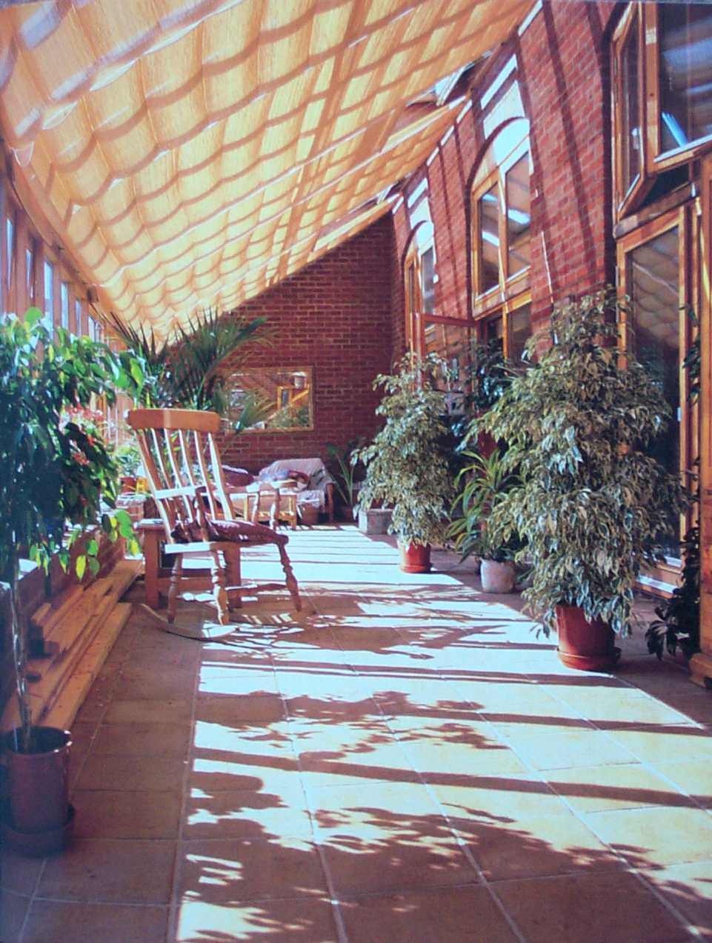
Low level windows and doors
HL roof light Ventilation
for summer
No heating
Solar gain
Exposed
thermal mass
Windows and
Doors to house

Slide 22
Hot house
in the middle
of winter on sunny days
Wind free
work place all year round
Clothes drying
No-underfloor heating (radiant heat)
Wood stove

Slide 23
Lean-to Conservatories: warm the house
Once a conservatory attached to a building is warmed
it can than be used to heat the interior of the attached building by opening doors and windows between them to let the heat into the building
The building’s thermal mass can be warned and heat stored for release into the building later after the sun has gone

Slide 24
BedZED
Sun Spaces

Slide 25
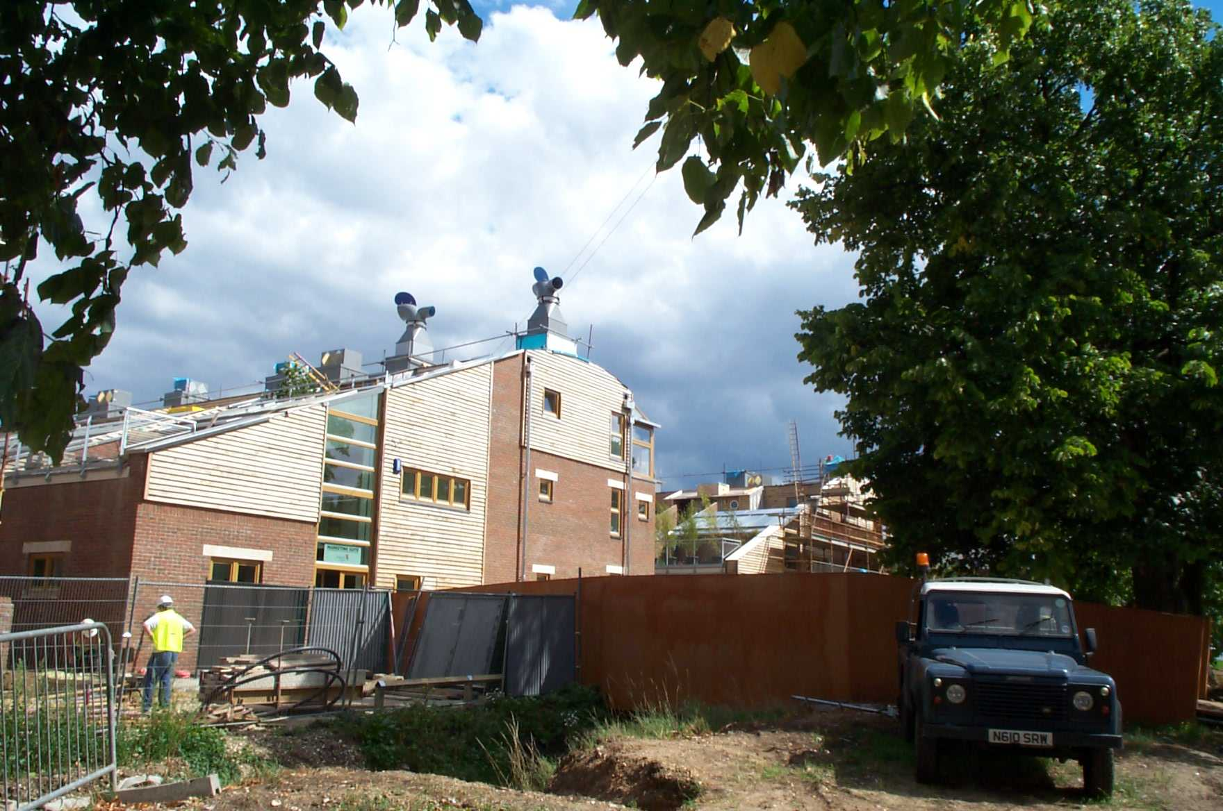
Zero (Fossil Fuel)
Energy Development
BedZED Beddington Sutton Architect: Dr Bill Dunster

Slide 26
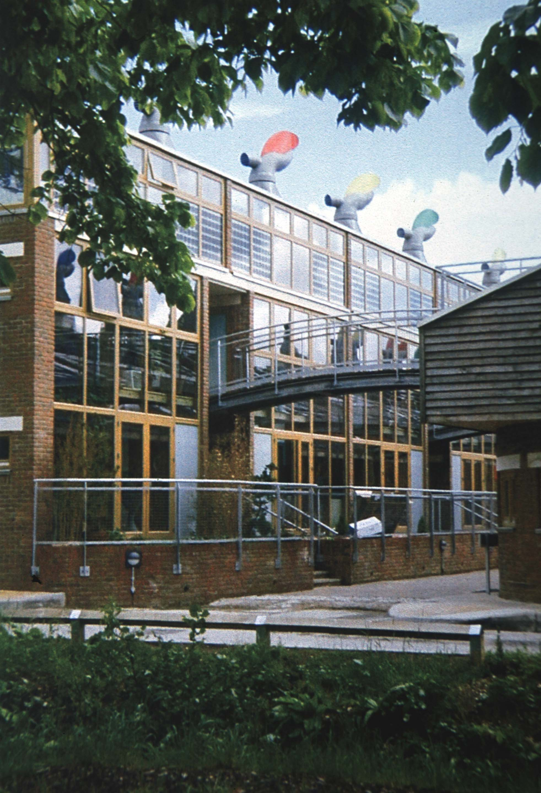
South elevation 100% glazed Concrete Floors between flats act as solar shading and work exceptionally well

Slide 27
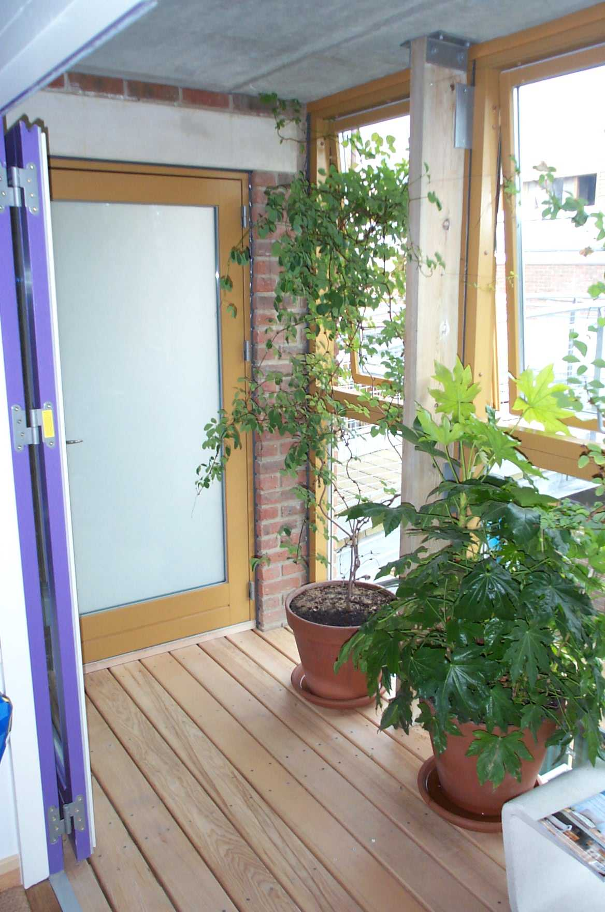
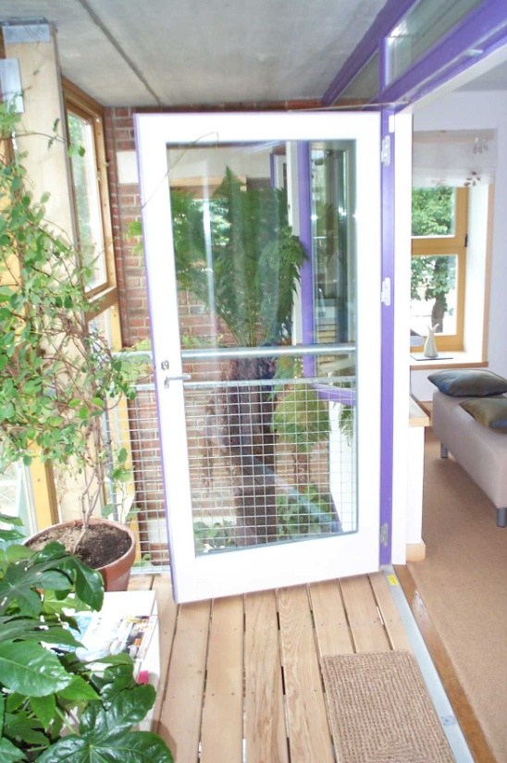
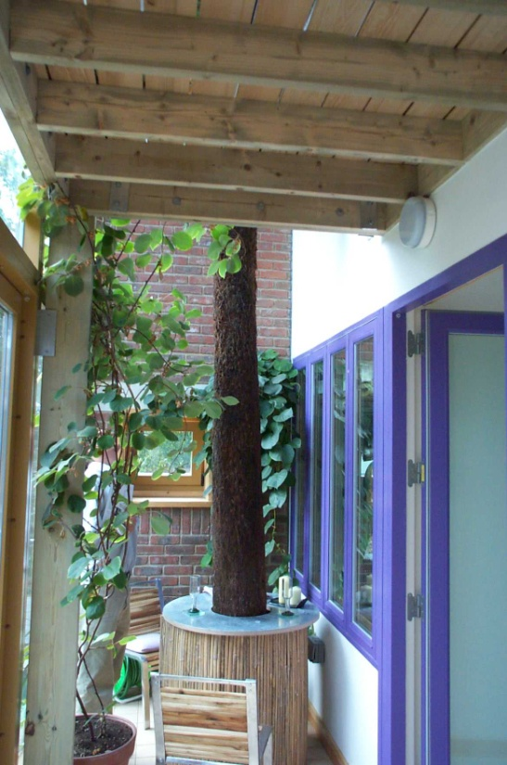
Heavy building elements
store the heat
and release it later
Sunroom on
South face
captures the sun

Slide 28
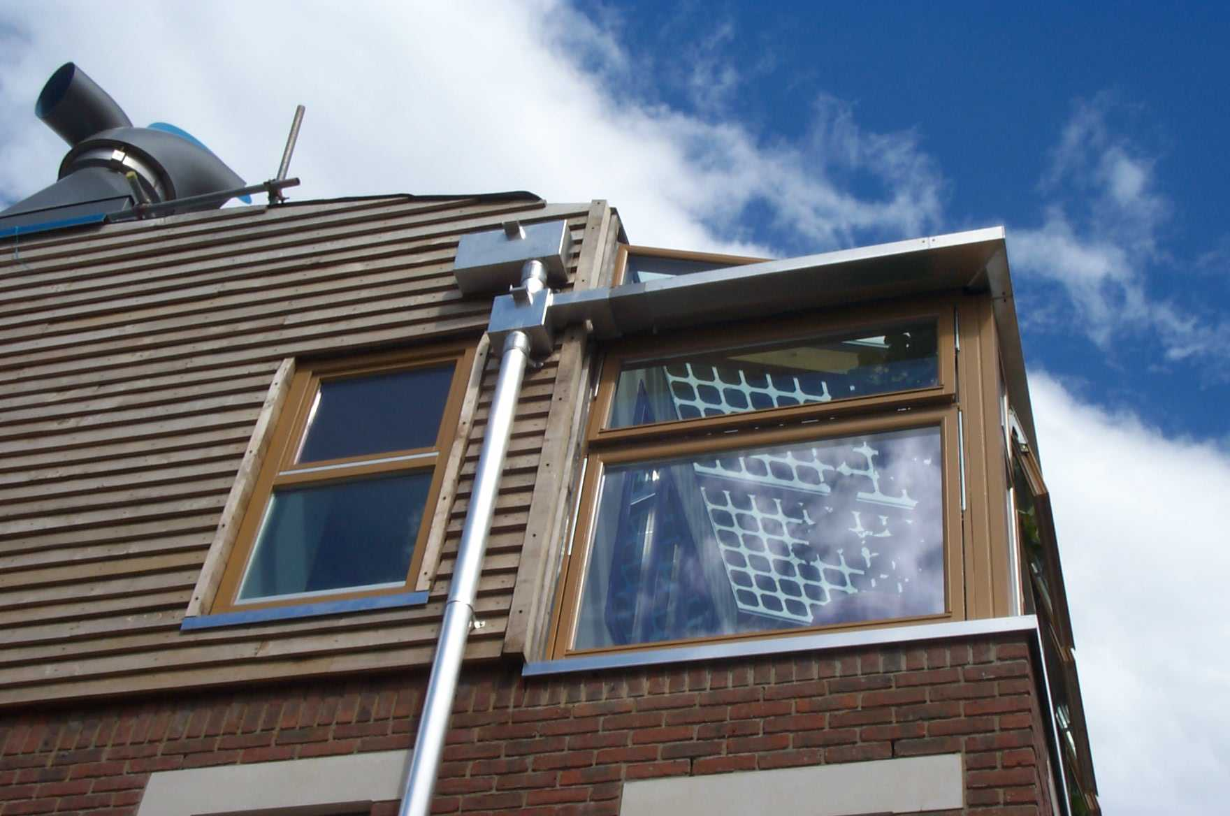
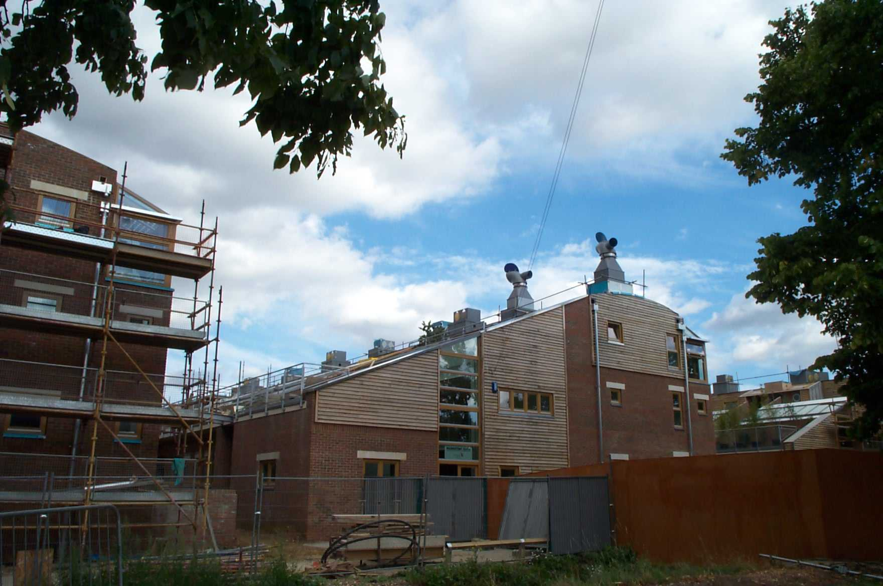
Profile:
to ensure sun penetration
over roofs reaches sill
of office space windows
Sun rooms on south side
Thermally massive floors walls
and roofs store heat until required

Slide 29
Top floor glass roof lets in too much heat top floor overheats

Slide 30
Thermal Mass
Ventilation, warmth and coolth

Slide 31
Heat movement in buildings
ARUP/B Dunster Report on need for Thermal mass in buildings to cope with climate change global warming
Recommend internal doors are self closing to hold heat energy where it is created or collected
All partitions to be insulated
Then actively move heat wherever you may want it or leave it where it is

Slide 32
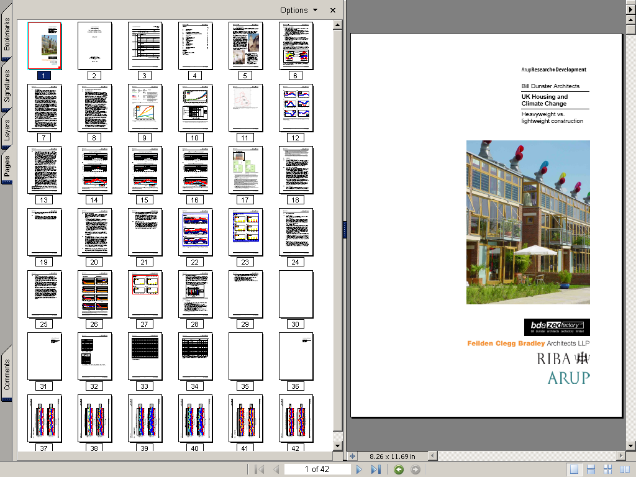

Slide 33
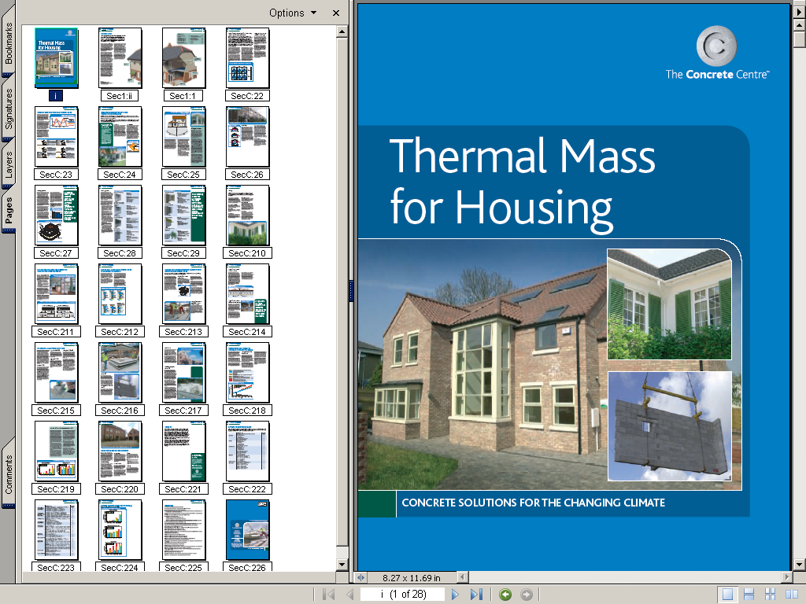
http://www.greenspec.co.uk/documents/whitepapers/MB_Thermal%20Mass%20for%20Housing.pdf#search='passive%20ventilation'

Slide 34
Exploiting thermal mass
If the building has high thermal mass and its surfaces are exposed
they can be exploited in both heating and cooling
In winter the mass can be heated in the day the heat stored for exploitation in the night
In summer the mass can be cooled in the night and exploited in the day

Slide 35
Thermal mass
Large surface areas are best
Thickness closest to surface is used in daily cycles,
Full thicknesses and more used over annual cycles
Higher density material is best
Exposed to the space not hidden above ceilings or below floors
Exposed to the sun’s rays is good
Embedded pipes can be exploited to move warmth and coolth around building or into storage

Slide 37
Heavy building elements
store the heat
and release it later
Sunroom on
South face
captures the sun

Slide 38
Gallions HA
Conservatories

Slide 39
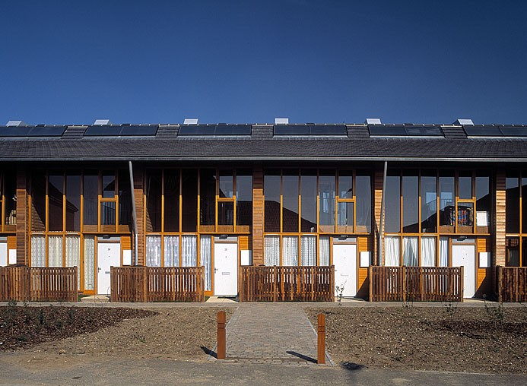
Gallions Housing Association:
Tenants would not choose the conservatory but now they have it would not give it up

Slide 40
Conservatories
Gone Wrong
In the real world

Slide 41
Conservatories gone wrong
Heated Conservatories (why not Solar?)
Radiant Heated Conservatories (under floor heating) radiates upwards to warm objects
If there is nothing to hit, the heat goes up and out the glass roof
Electrically Heated Conservatories (+++CO₂)
Conservatories open to remainder of building (Heat gain or heat loss)
Conservatories without ventilation (over-heating)

Slide 42
National Botanic Gardens of Wales
Glass roof

Slide 43
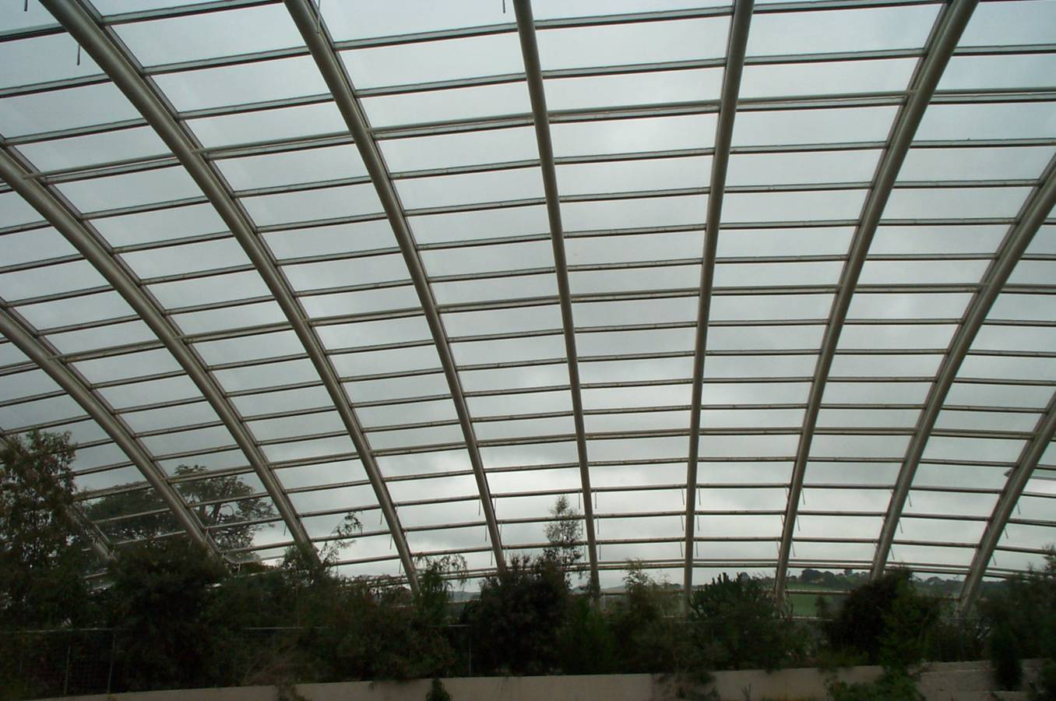
Glass Roof: gain & loose heat no solar gain or heat loss control

Slide 44
GLA Head Quarters
North Facing Conservatory

Slide 45
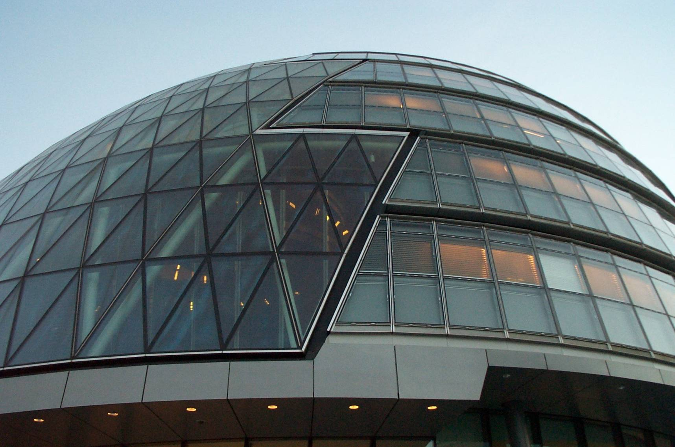
North facing conservatory
No solar gains just heat losses

Slide 46
90% UK conservatories heated
Underfloor Radiant heating
In terms of fuel use they are like a gushing tap over a gulley
Significant number have no doors or windows to separate from the rest of the house
Despite the Building Regulations
  Winter: Heat loss from house
  Summer: Heat gain to house
No hope then

Slide 47
Conservatory Gone Wrong
No boundary between conservatory and accommodation beyond
No thermal mass wall or floor to hold the heat
No entry or exit ventilation in glazed roof
No Solar shading (externally is best)
Tenant fitted Air Conditioning

Slide 48
Swaffham
Wind Turbine
Visitors Centre
Conservatory design gone wrong

Slide 49
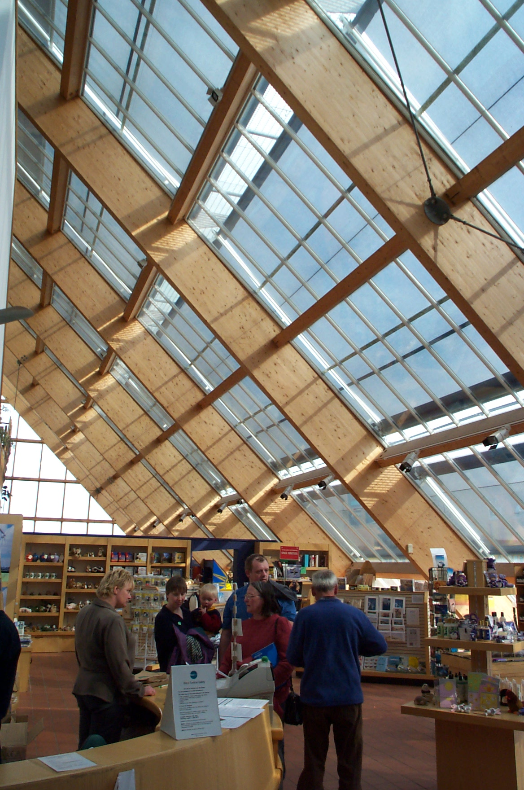
South facing lean-to solar heat gain
External shading helps
No ventilation Thermal mass flooring on show between furniture

Slide 50
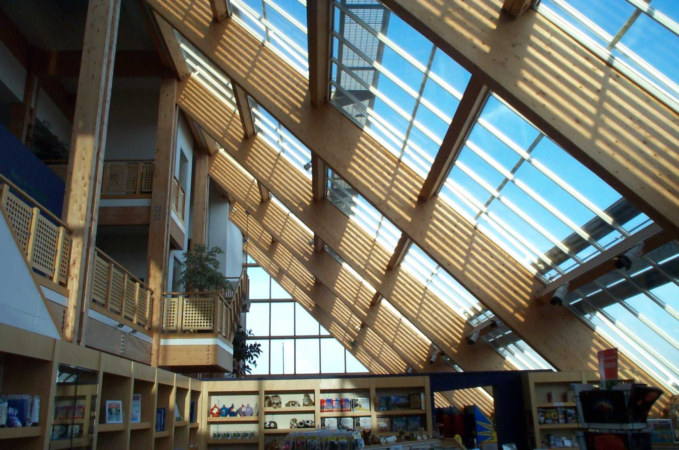
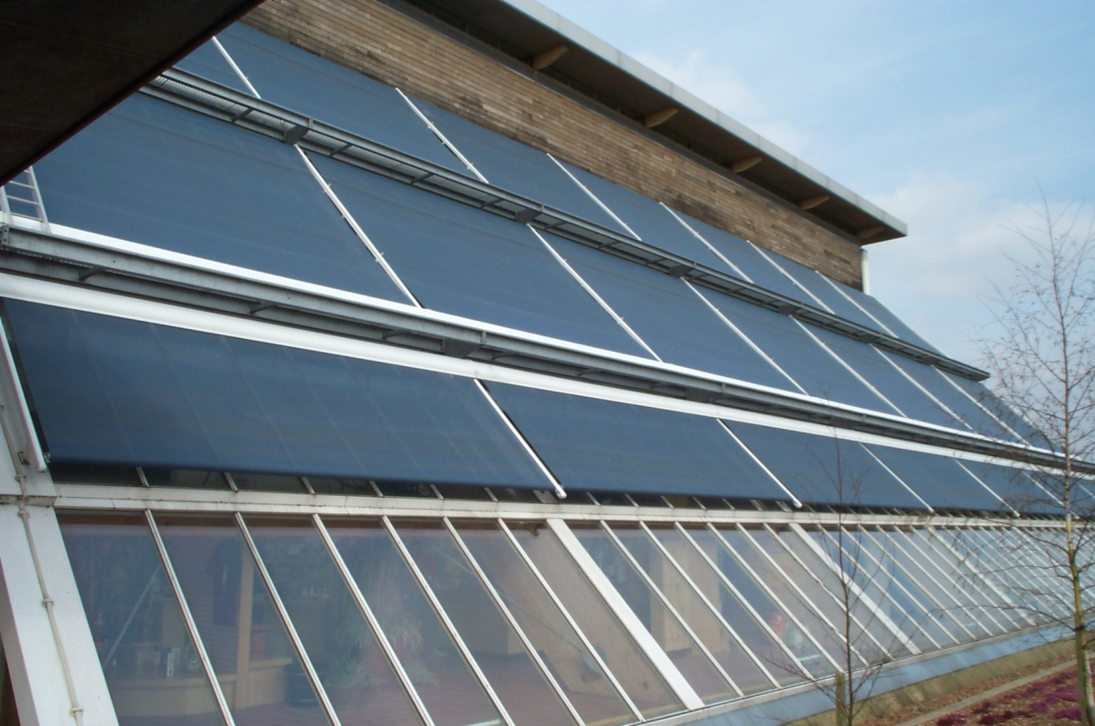
No thermal mass in back wall plasterboard partitions
No ventilation
Tenant fitted
Air-conditioning

Slide 51
1NTEGER @ BRE
Intelligent & green
Not very intelligent Conservatory:
Secure all-weather garden
single glazed and double to house but open at top floor
Some solar shading, some planting

Slide 52
1NTEGER house conservatory at BRE is not all that it could be
Single glazed
No thermal mass back wall, open to living accommodation on top floor.
Just sheltered outdoor space

Slide 53
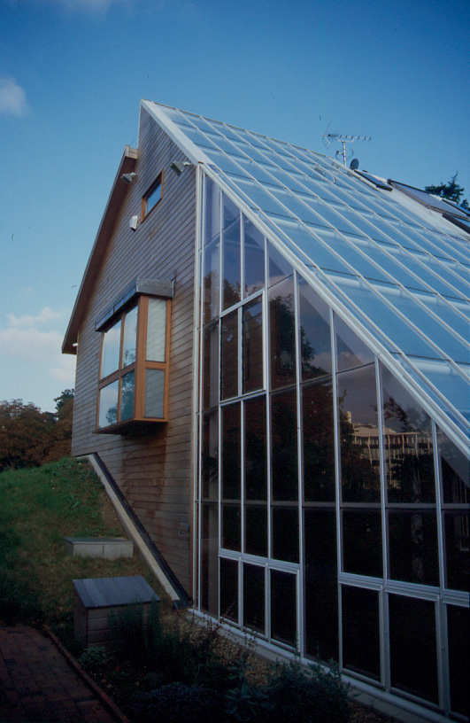
Opening vents in side walls of conservatory but only half way up the height of the conservatory

Slide 54
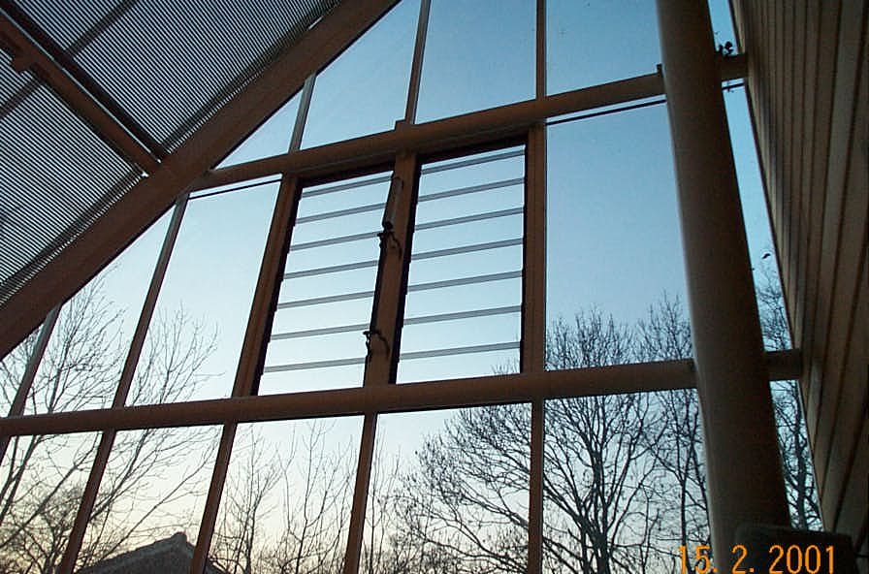
Thermostat control piston actuated vents
Thermostat at high level? Vents at mid level

Slide 55
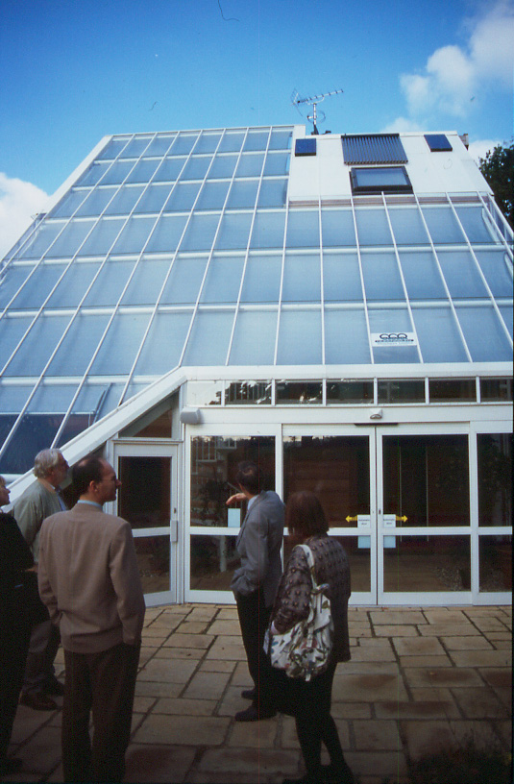
Doors: provide low level ventilation Windows: none at top
Internal solar shading: internal radiant heating & thermal stress in glass

Slide 56
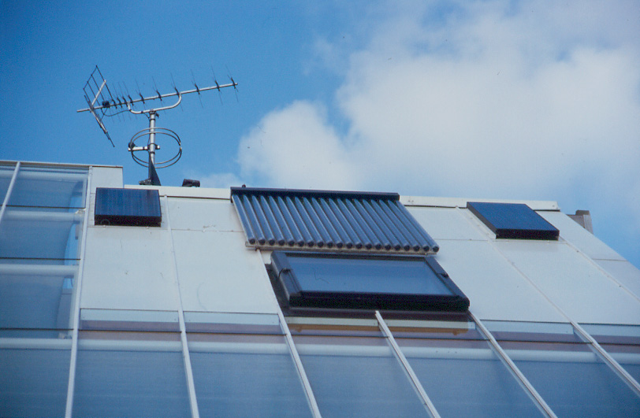
Solar Thermal ET for Hot Water
Roof window & minimal PV

Slide 57
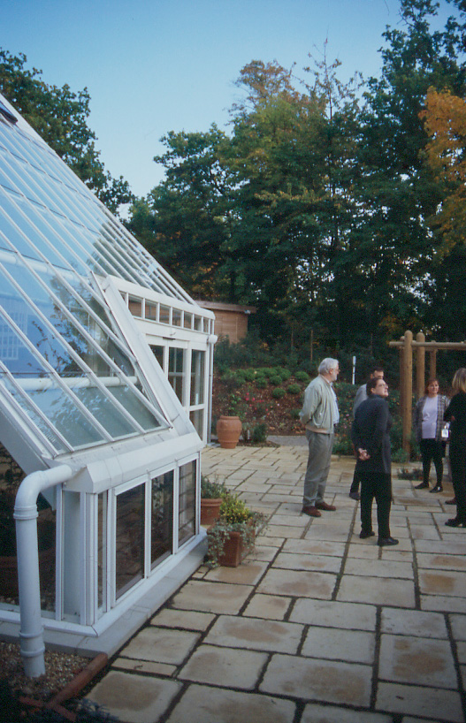
Rainwater: collection and disposal?
Any Harvesting and reusing?

Slide 58
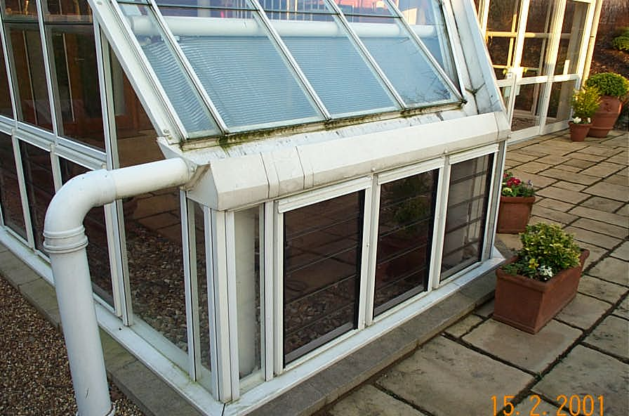

Slide 59
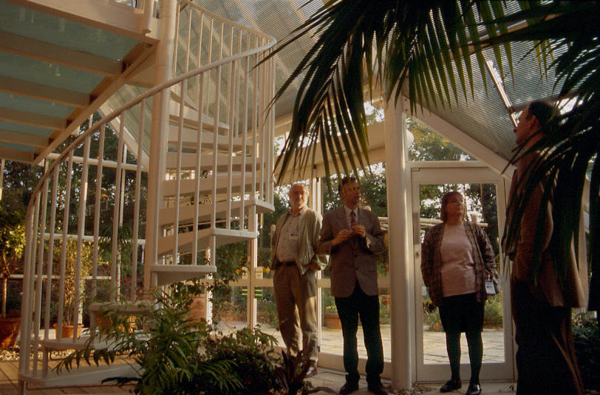

Slide 60
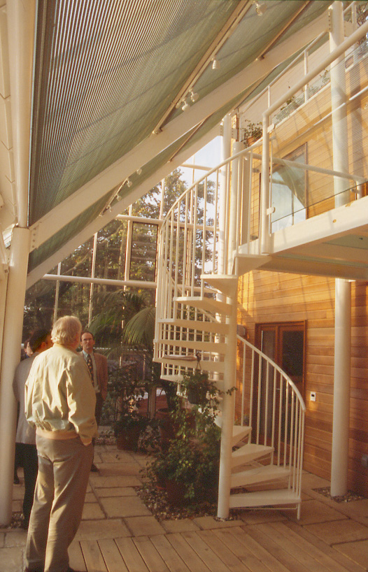
Internal Solar shading generates heat in conservatory air
Timber weatherboarding no thermal mass on rear wall
Concrete or stone paving some thermal mass on floor

Slide 61
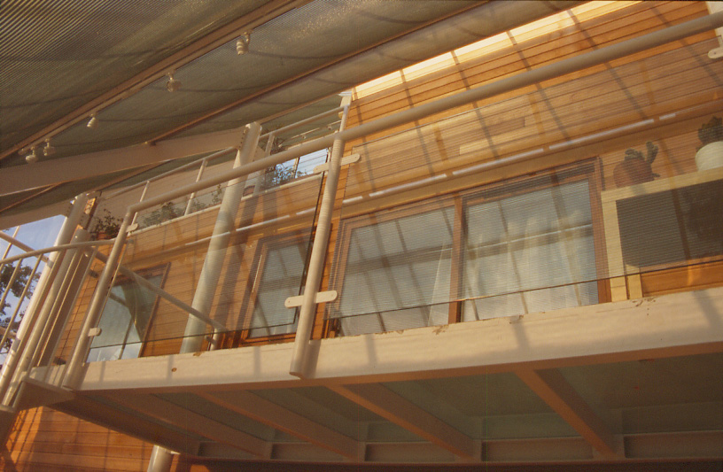
Top floor open to hottest part of conservatory

Slide 62
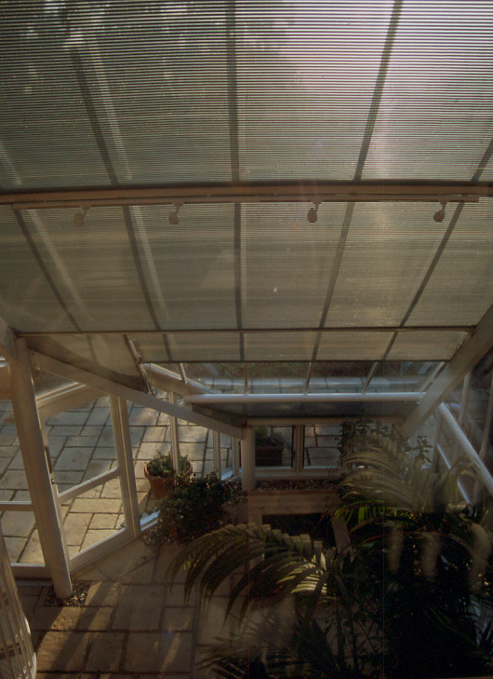
Internal solar shading: catches solar radiation heats up and re-radiates heat inwards.
Energy efficient light fittings?

Slide 63
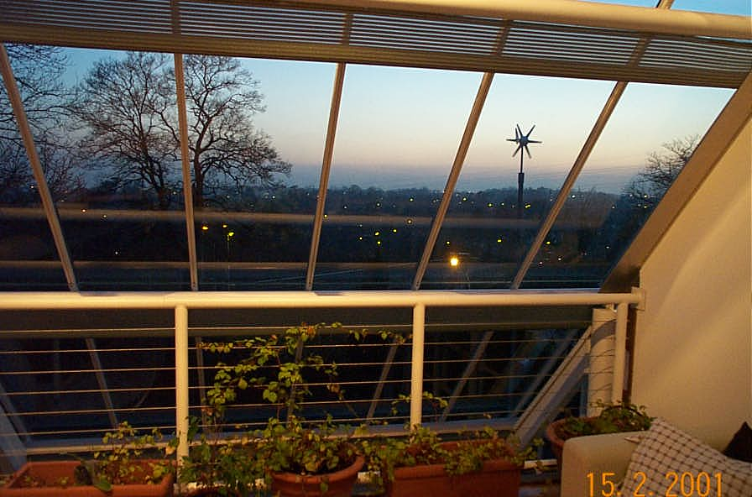
Top floor open to conservatory and no ventilation at high level an oven for hobby or TV room

Slide 64
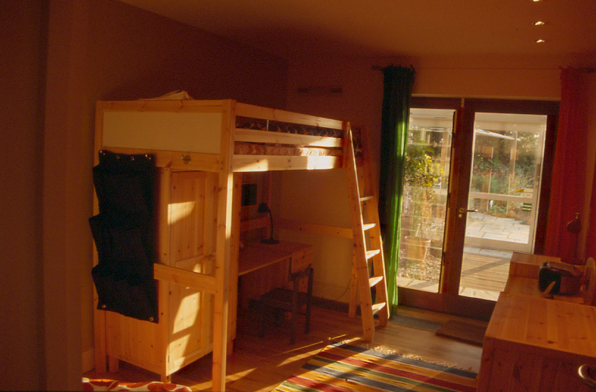
Bedrooms face South & open onto the warm conservatory, no escape

Slide 65
Test Yourself
What are the ideal characteristics of a conservatory?
How does HHP Hockerton exploit Thermal mass?

Slide 66
How did you do
North facing, large glass areas, low E glass to trap heat, window and door vents at high and low level, external controllable solar shading
High density, large surface area, exposed to passive heat gains from sun
Traps sun in conservatory, heats up floor and back wall then warms up house interior

Slide 67
Another GBE CPD/Lecture to download
And https://greenbuildingencyclopaedia.uk

Slide 68
Sampler
This is a cut down version of the original file to give you a sample of the whole
It’s the front end of the file with the middle and rear end deleted
Go to https://GreenBuildingEncyclopaedia.uk
to down load the whole file
You will find a large number of other files there too

Slide 69
Feedback
These files are created by generalists with a big dollop of green flavour
These files are updated from time to time
We are not experts so from time to time these file may get out of date or may be wrong.
If you feel that we have got it wrong please let us know so we can put it right

Slide 70
© GBE 2019
Brian Murphy BSc Dip Arch (Hons+Dist)
  Technician and Architect by Training
  Specification Writer by Choice
  Environmentalist by Actions
Greening up my act since 1999
Founded National Green Specification 2001
Launched www.greenspec.co.uk 2003
Created: GBE at https://greenbuildingencyclopaedia.uk 2015
E BrianSpecMan@icloud.com
Twitter: http://twitter.com/brianspecman
LinkedIn: BrianSpecMan
Facebook: BrianSpecMan
Facebook: http://www.facebook.com/brianspecman
Slide Share:
Pinterest: Brian Murphy • GBE Green Building Encyclopaedia

