Slide 1

Loft insulation isn’t working in 80% of UK houses
What can we do about it?
One hour CPD Seminar for architecture
and construction professionals

Slide 2
Order of content of seminar
EST Energy Saving Trust guidance
‘In-Use Factors’ which diminish insulation performance
Building Regulations, Technical Standards and voluntary schemes
ZCH Zero Carbon Hub statistics on overheating
DECC statistics on roof insulation
NPL National Physics Laboratory research on insulation performance
Carbon Trust surveys on loft usage
RoSPA loft/ceiling accident statistics
Alternative techniques to maximise insulation performance
GBE Calculator U Values & Thermal Bridge modification factors
Test Questions and Answers
Notes:
At same time as last item: Test Questions and Answers
Spoken: There is no such thing as a free lunch
Gesture: Smile

Slide 3
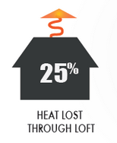
Loft insulation: why it’s needed
On average, 25% of a building’s heat loss through its insulated external envelop is through the roof
(source: Energy Savings Trust)

Slide 4
Loft insulation:
Buildings Regulations & Technical Standards
Type of application | Required U-value for the loft ceiling (W/m2.K | Required thickness of thermal conductivity insulation if laid at the ceiling of the loft
New build | U = 0.13 (EW&NI BRAD L1A) U = 0.11 (Scotland STS 6.2) | 340mm 400mm
Retrofit | U = 0.16 (EW&NI BRAD L1B) U = 0.13 (Scotland STS 6.2) | 270mm 340 mm
This assumes that mineral fibre thermal conductivity insulation is used
  with a thermal conductivity k value of 0.044 W/m.K
  as found in some of the common products
It is possible to have reduced thicknesses by using other materials
It is also possible to insulate above, between and/or below the pitched roof rafters; this creates a ‘warm loft’
  ‘Warm loft’ is not the subject of this presentation.

Slide 5
Loft insulation: Other Voluntary Standards
Type of application | Required U-value for the loft ceiling (W/m2.K) | Required thickness of thermal conductivity insulation if laid at the ceiling of the loft (k value: 0.044 W/m.K)
New build Passivhaus | U = 0.15 | 280 mm
New build AECB CarbonLite Steps: 1, 2 & 3 = Silver, Bronze & Gold | U = 0.15 | 280 mm
EnerPHit Passivhaus Retrofit Cool-temperate climate | U = 0.15 | 280 mm
AECB CarbonLite Retrofit (CLR) | U = 0.10 | 425mm
NB: These design standards do not normally state U values but set maximum building energy demands and their respective software determines U values based on many building and site parameters. These U values are only give as an example.

Slide 6
Food for thought (1)
It should also be noted that:
Mineral fibre and plastic thermal conductivity insulation
  Keep heat in during winter
  Do not readily let it out in summer (adding to overheating potential)
And they do not keep radiant solar heat out in summer
  Leading to potential overheating (affecting 20% of housing (ZCH))
Consider loft thermal conductivity insulation with the additional property of high decrement delay, including:
  Cellulose fibre flake (recycled newspaper)
    easy installation around any framing
  Cork granules (easy installation) or boards
  Wood fibre batts or boards
  Other plant fibre insulation materials in various formats

Slide 7
Food for thought (2)
mineral fibre and plastics are good for stopping winter heat loss
mineral fibre and plastics do not stop solar heat gain through opaque building fabric
UK Building Regulations do not address summer solar heat gain
  despite 20% of homes overheating in summer (ZCH)
The subject of a separate CPD seminar by GBE

Slide 8
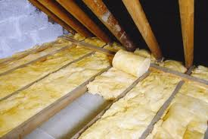
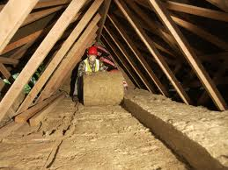
Thick loft insulation: installation method
Step 1: lay insulation between the joists
(usually 75 or 100mm tall)
Step 2: roll another layer at 90 degrees to the first layer, to give the total required thickness

Slide 9
Loft insulation: market penetration
Of the 23 million domestic lofts in the UK:
15 million have >100mm of insulation
(Source: DECC, 2016)
The vast majority have been insulated using mineral fibre rolls, usually selected for cheapness and ease of installation
Other materials are available:
  Cellulose fibre, wood fibre, cork, cotton, recycled denim,
  Foamed plastics, fibre plastics,
Others formats include:
  Loose, blown or sprayed insulation
  Rigid board insulation
  Multifoils

Slide 10
So, once a loft is properly insulated, is everything okay?
Unfortunately no, the performance is spoiled by:
  Significant ‘In-Use Factors’
  This means that loft thermal conductivity insulation does not work as well as it was meant to
Assuming that the insulation has been fitted correctly:
  Without gaps and
  Permitting cross-ventilation at eaves
Then ‘In-Use Factors’ come into play…

Slide 11
Some common In-Use Factors:
Compression of the loft insulation
  e.g. by storage of belongings directly on insulation or on deck boarding
Safe access deck boarding installed in the loft,
  Bearing on the ceiling joists
  Usually well below the required thickness of insulation
  Compressing the insulation above and between the joists
Householder or maintenance contractor action,
  e.g. moving the insulation away to create safe access pathways and then not being able to replace it properly, or at all
After becoming moist from condensation build up in the loft:
  Insulation deterioration
  Performance drop off
Thermal bridging through the ceiling joists

Slide 12
Some less-common In-Use Factors:
Vermin attack
Wildlife inhabitation displacing or tunnelling through insulation
Wind scour or wind washing at the eaves and along the top of the insulation, drawing heat out of the insulation surface
Accumulation of dust and debris, especially after roofing work
Water ingress through old or leaky roof coverings

Slide 13
The biggest ‘In-Use Factor’ is loft insulation compression
Tests undertaken by the National Physical Laboratory showed:
  Compressing mineral fibre loft insulation:
  Affects the U value
  It is very significant
  Much greater than previously thought
Compressing from 270mm to 100mm (4” ceiling joist height)
  U-value and heat loss increases by <200%
Compression from 270mm to 75mm (3” ceiling joist height)
  U-value and heat loss increases by <240%

Slide 14
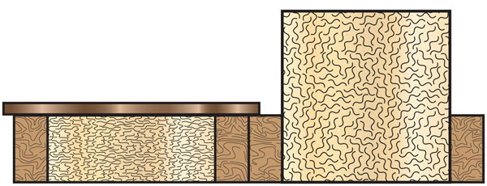

Loft insulation compression
Recommended thickness: 270 mm
Thermal resistance: 6.11 m2.K/W
U value: 0.164 W/m2.K
Squashed thickness: 100 mm
Thermal resistance: 3.09 m2.K/W
U value: 0.324 W/m2.K
Difference in U values: 198%
(NB. Illustration is not recommended: the top-up insulation should run at 90 degrees to the ceiling joist zone insulation to avoid thermal bridges and thermal bypass)

Slide 15
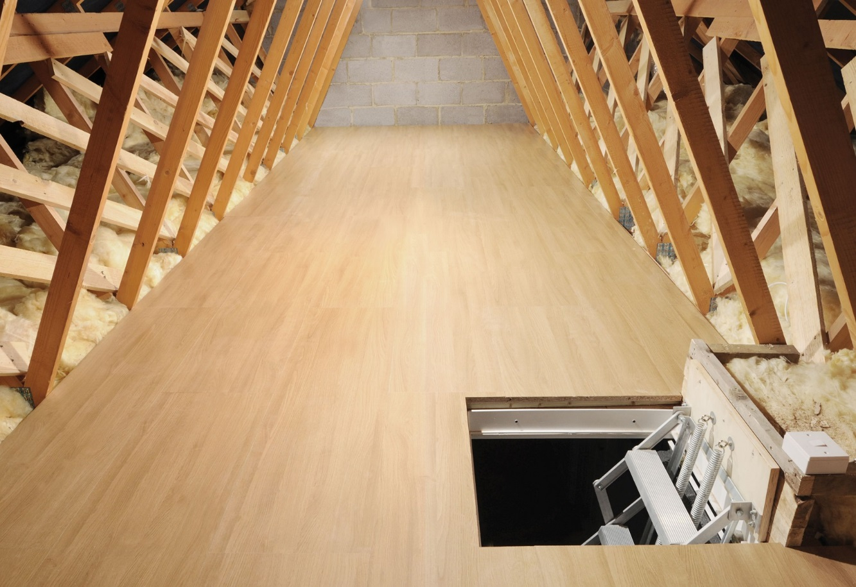
This loft may look tidy,
But from a thermal conductivity insulation perspective, it is very poor (at least in the central area)
The insulation is either only 100 mm (up to joist height)
Or the insulation has been squashed down to 100 mm

Slide 16
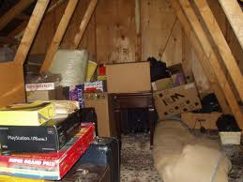
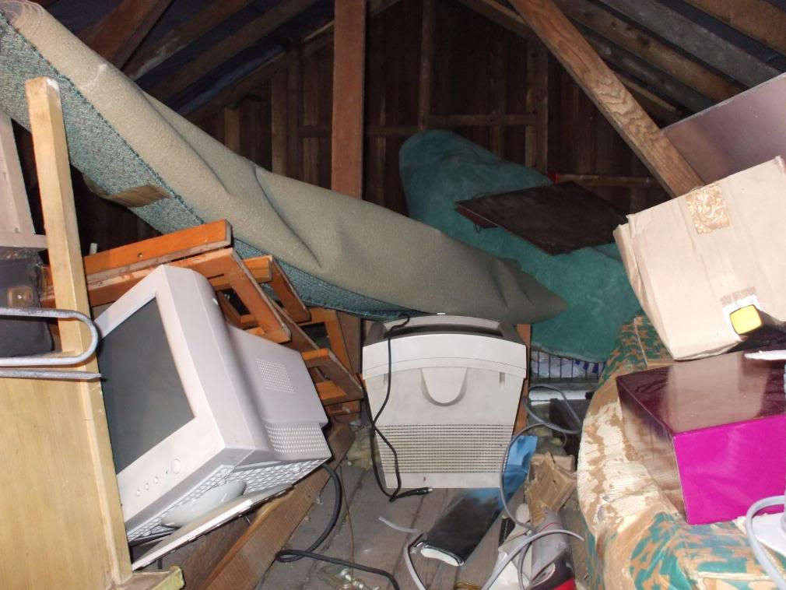
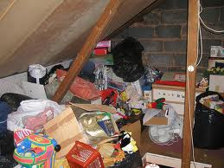
Causes of thermal conductivity insulation compression
Storage of belongings:
  directly on the insulation
  or on decking on the insulation

Slide 17
Loft ceiling light storage loadings
Building Regulations Approved Document A Table 4 and
BS 5268:Part 3 for modern trussed rafter roofs
Require the loft ceiling to support:
  0.25 kN/m2 distributed imposed load (for storage)
    (1/8th of the loading for a domestic floor)
  0.90 kN concentrated point load (for a person accessing loft)
Traditional insitu cut timber roofs are often much stronger than trussed rafter roofs
Many building owners and occupiers want to use their loft for storage

Slide 18
Loft storage is important
6000 survey respondents:
78% say loft storage is important or essential
82% use their lofts for storage
  Of those, 78% say theirs is more than half full
Only 26% know that squashing insulation is bad for it
Source: Carbon Trust survey
Biggest ever UK survey of loft users

Slide 19
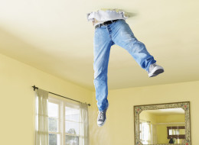
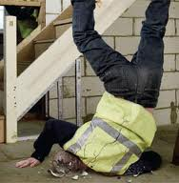
Safety in lofts is an issue:
200 hospital visits each year in the UK owing to:
falls from lofts
falls through loft ceilings
(source: RoSPA)
Architects and builders have a requirement to design-in safe maintenance under CDM 2015
Landlords have a ‘Duty of Care’ to their maintenance staff

Slide 20
Access is required to services:
Cold water storage tank, ball valve, water supply and delivery pipes, insulation and overflow pipe
Boiler top-up tank, ball valve, water supply and delivery pipes, insulation and overflow pipe
Boiler fuel and power supply, flues, pipes and insulation
Communal or District heating flow and return pipes and insulation if fitted
Hot water cylinder or solar cylinder, ball valve, water supply, overflow and delivery pipes, and insulation
Solar thermal panel expansion tank, pipes and insulation
Solar PV inverter and cables
Power Shower Pumps
Extractor fans and ducts
MVHR Mechanical Ventilation with Heat Recovery ducting
Power and data cables and conduit
Pipe work and insulation
TV aerial, satellite dish, cable box and cables
Domestic sprinkler system pipework and insulation
Smoke detectors and cables
Warden Call systems
Ceiling mounted down lighters
Ceiling mounted fans
Ceiling mounted air conditioning units

Slide 21
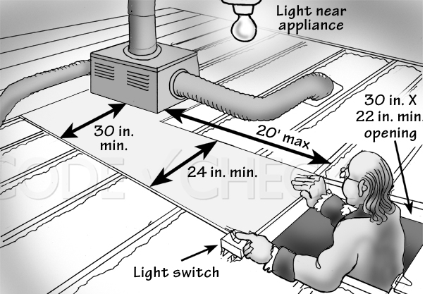
Safe access platforms can be the cause of top-up insulation removal or compression

Slide 22
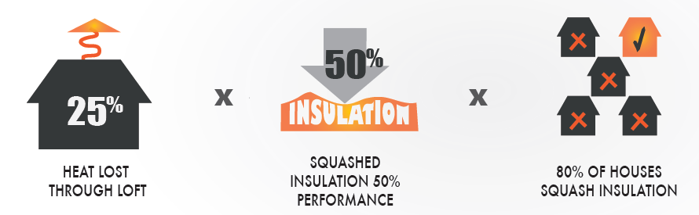
It all adds up…. 25-30% (2005) of UK energy demands are from domestic property
Heat lost through Loft: 25%
Squashed insulation 50% performance
80% of Houses Squash Insulation
Ofgem estimate that In-Use Factors reduce the effectiveness of loft insulation my 35%
Ofgem estimates that In-Use Factors reduce the effectiveness of UK-wide loft insulation by 29% (2013)
Ofgem Energy Company Obligation measures

Slide 23
So what are the alternatives?
Raising timber panel decking above existing joists with softwood framing or joists
Decking on top of rigid foamed-plastic boards
Proprietary supports and decking systems

Slide 24
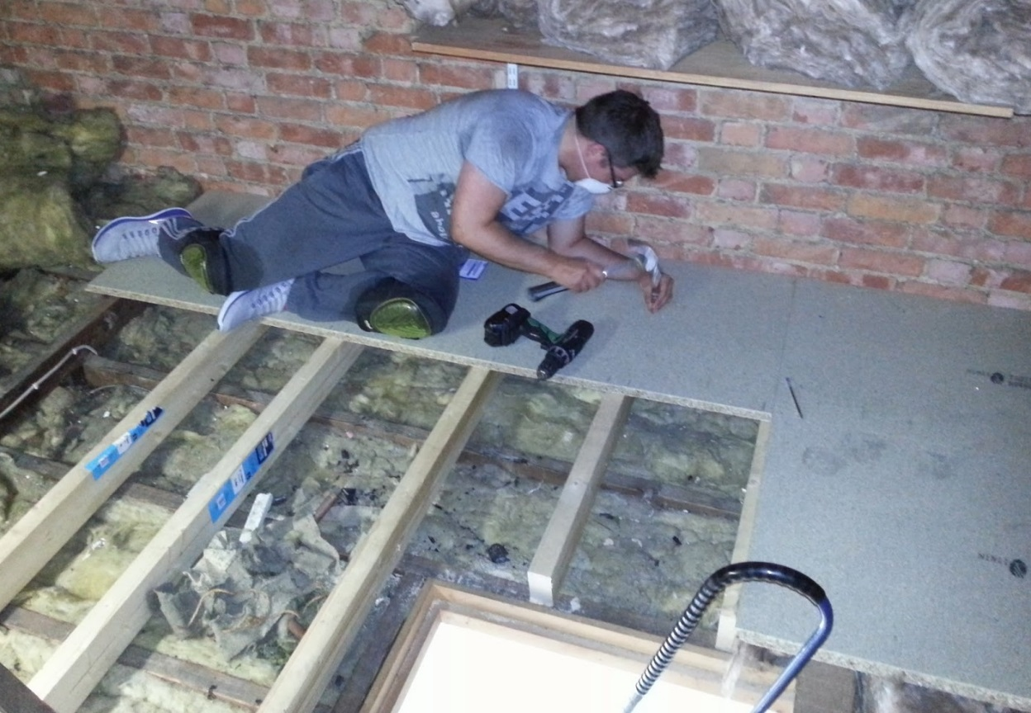
Raising decking above existing joists with softwood joists and timber panel decking?

Slide 25
Raising timber panel decking on new softwood framing or joists is no longer good practice
This used to be common practice when thermal conductivity insulation thickness requirements were low
But the extra timber is:
  heavy and awkward to get in and fit in a confined space
  Also acts as a thermal bridge through the insulation
    Linear (if on top of joists) or Point (if laid at right angles to existing joists)
    Psi values for the thermal bridges have to be allowed for in the U-value calculation for the roof under Building Regulations or Technical Standards
This will require an increase in thermal conductivity insulation thickness to compensate
  If there is no room in the loft location
  It will be needed elsewhere
  Not forgetting to put back in place any existing top-up thermal conductivity insulation before decking over
    Taking care to fit gap-free insulation around framing or joists

Slide 26
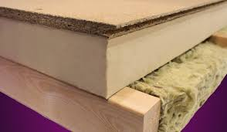
Decking on to rigid foamed plastic insulation?

Slide 27
Risk associated with decking on top of rigid foamed-plastics insulation
Foamed Plastics insulation are not normally moisture permeable so vapour barriers are essential but difficult to add to existing ceilings
The lack of a vapour barrier can cause interstitial or surface condensation, as moist air passing through the ceiling insulation it will cool and may condense on the underside of the deck board
For conventional pitched roof cross-ventilation it is recommended that there is at least a 50 mm air gap at the eaves
This cross ventilation gap should be continued between the top of the insulation and the underside of the decking board (source: BRE)
Plastic insulation must not be allowed to touch plastic conduit or plastic sheathing to electrical cables
  Polymer migration may modify the performance of both plastics
    Plastics can dissolve away
  Polystyrene rigid foamed-plastic
  Polyurethane spray foam insulation
Large sections of rigid insulation/decking are also hard to get through the loft hatch and fit within a confined loft space

Slide 28

New raised loft decking systems
There are a number of new products and systems on the market
Only one system has been approved by BBA for use in construction:
  It is strong enough to withstand the required loading
  It is tall enough to meet modern insulation thicknesses
  Without creating a significant thermal bridge through the insulation
  It has a ventilation gap to avoid surface or interstitial condensation.
That system is LoftZone StoreFloor

Slide 29
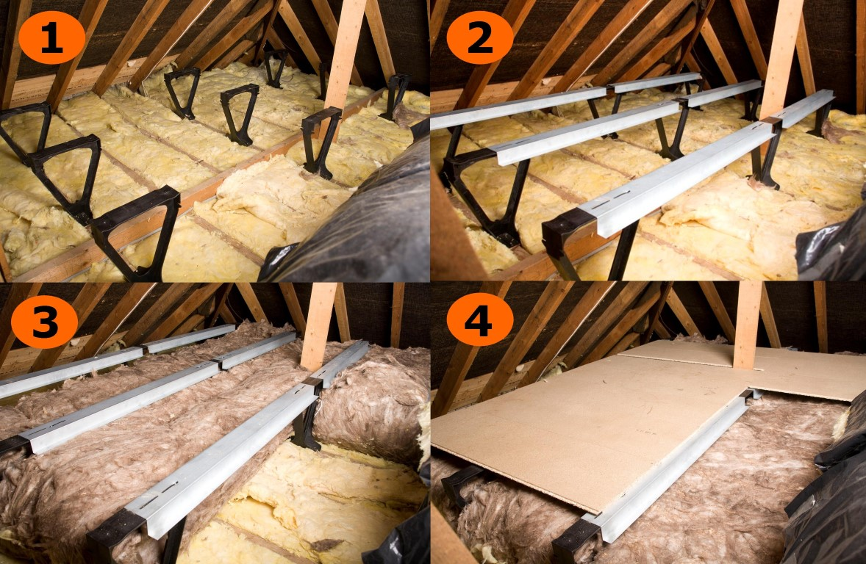
LoftZone StoreFloor: plastic supports and metal beams to raise timber panel decking

Slide 30
Reduced Ventilation Gap
50 mm pitched roof cross ventilation is default practice to reduce risk of interstitial condensation, BR, BRE and BBA recommend it
BBA were asked ask to carry out hygro-thermal moisture movement and thermal bridge analysis of LoftZone Storefloor details
They concluded 29 mm ventilation gap would was unlikely to cause interstitial condensation

Slide 31
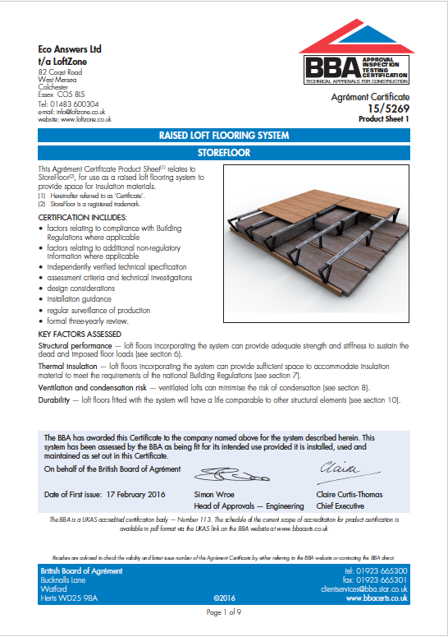


Slide 32
Thermal bridge through supports?
BRE Buildings Research Establishment
calculated the thermal conductivity through the plastic supports to be negligible
they need not be considered in U-value calculations

Slide 33

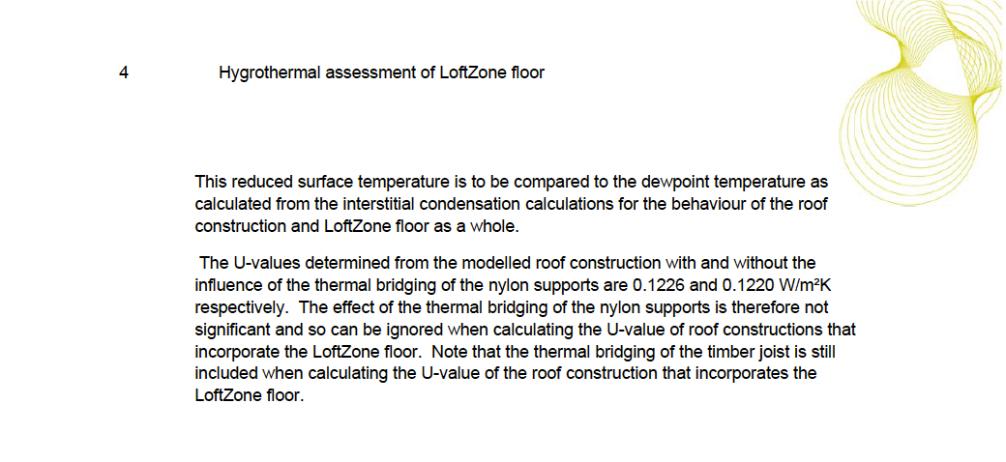
Thermal bridge through supports?

Slide 34
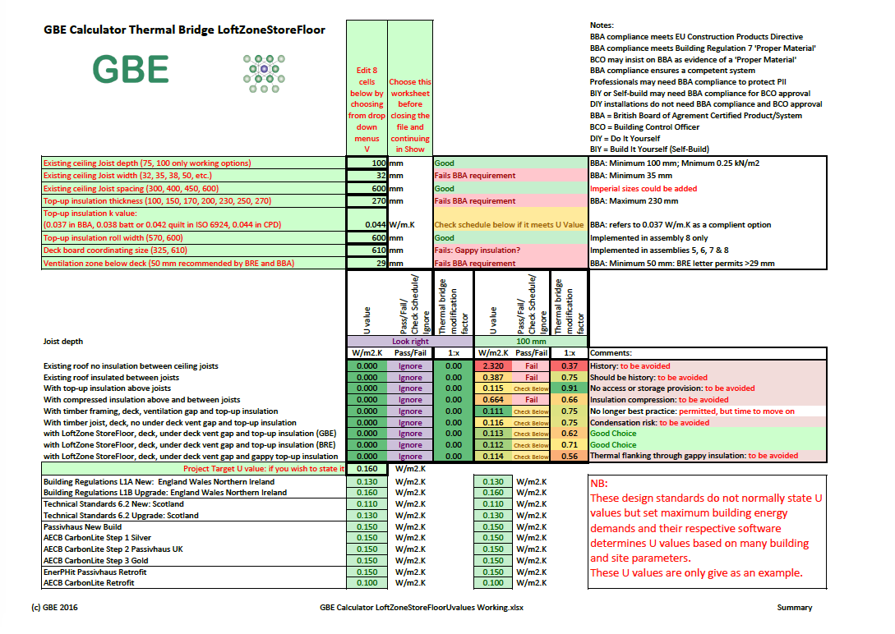
GBE Calculator LoftZone StoreFloor
GBE Calculator Page
Scroll down to find file
GBE Calculator LoftZoneStoreFloorUValue A05BRM100117 XLSX

Slide 35
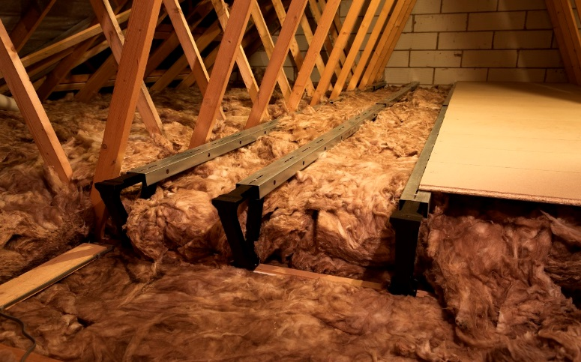
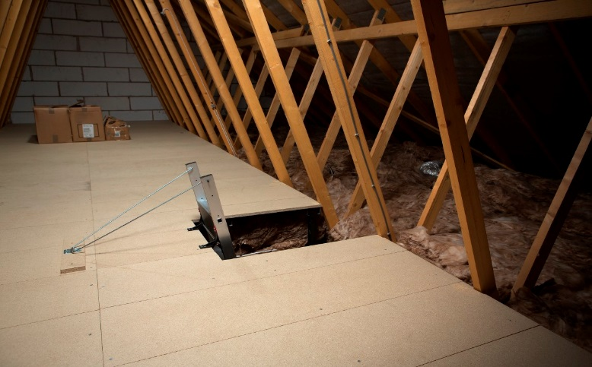
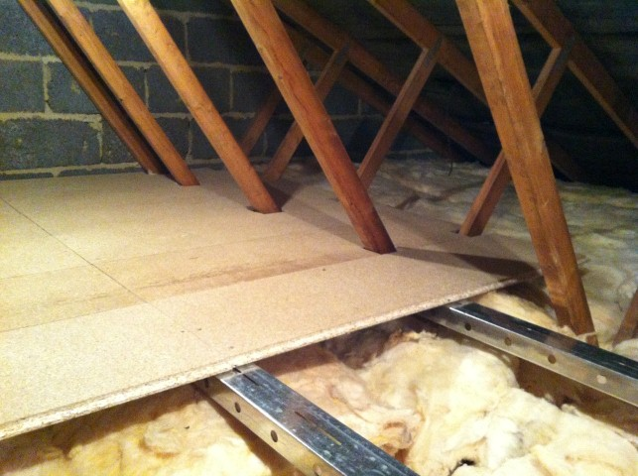
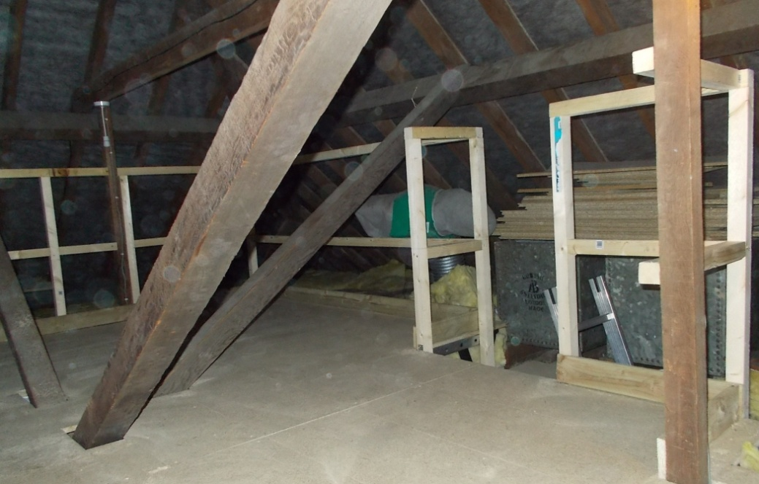
LoftZone StoreFloor installations

Slide 36

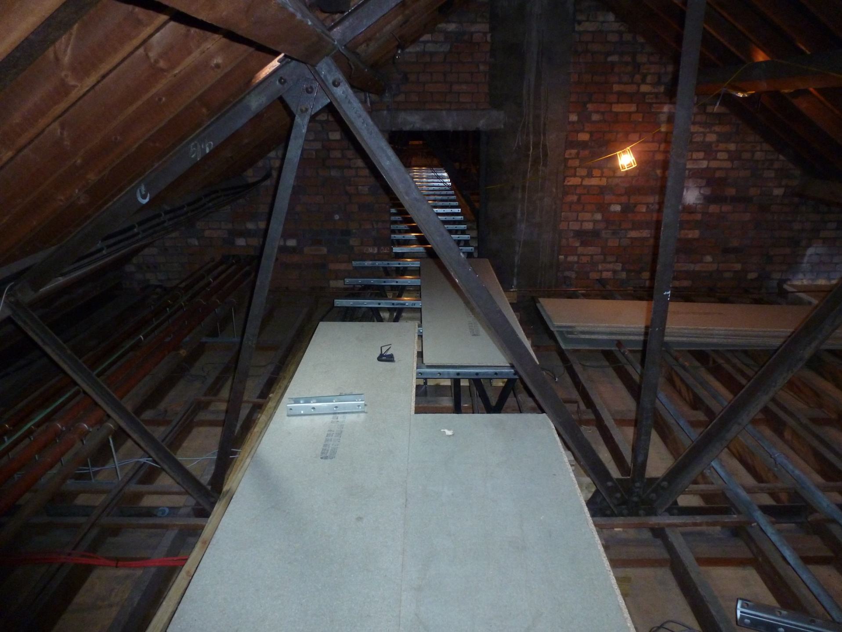
LoftZone StoreFloor installations
Also used for safe access walkways in schools

Slide 37
Summary
Loft insulation ‘In-Use Factors’, in particular, compression are a major issue
Significant numbers of houses are affected
Adding considerably to UK energy and fuel demands and carbon outputs of UK housing
Most traditional means of solving the need for storage space, safe access walkways are no longer good practice
The LoftZone StoreFloor is the only product for this purpose that has been approved by BBA for use in construction.

Slide 38
Test Questions:
What percentage of households use their loft for storage? (35%, 50%, 82%)
If loft insulation is compressed from 270 mm to 100 mm joist height, by how much does the U-value change? (It halves, it doubles, it stays the same)
What is the gap recommended by BRE between the top of the insulation and the bottom of the deck, to prevent surface condensation on the underside of the deck boards? (35 mm, 50 mm, 82 mm).
What does Ofgem consider the total reduction in the effectiveness of UK loft insulation owing to In-Use Factors? (35%, 50%, 82%)
What is the requirement for the loading of the bottom chord of trussed rafter roofs?
(0.25 kN/m2 distributed imposed load plus 0.90 kN concentrated point load
0.50 kN/m2 distributed imposed load plus 0.90 kN concentrated point load
0.82 kN/m2 distributed imposed load plus 0.90 kN concentrated point load)
Under which regulations are architects and builders required to design in safe maintenance access? (Part L1A, STS 6.2, Working at Height Regulations, CDM 2015)

Slide 39
Test Answers:
82% of households use their lofts for storage
U value doubles when insulation compressed 270 to 100 mm
50 mm cross-ventilation gap is recommended by BRE
Ofgem consider ‘In-use factors’ reduce UK insulation effectiveness by 35%
0.25 kN/m2 distributed imposed load plus 0.90 kN concentrated point load
CDM 2015 requires safe maintenance access to be designed in

