Slide 1
Retrofit UK
With PAS 2035
Brian Murphy at DWF Direct Works Forum

Slide 2
This Presentation on GBE:
Find this file on GBE website at:
https://GreenBuildingEcyclopaedia.uk/?P=21613
Previous Presentations:
https://GreenBuildingEcyclopaedia.uk/?P=362

Slide 3
Go back 9 years
…extracts from a series of seminars presented to SusCon & RIBA S/SE, SmartLIFE in EofE and others during 2010…
…as the tsunami of GreenDeal and ECO were just over the horizon…
...GreenDeal just started to arrived whilst ECO spoiled a good many pre-1919 properties…

Slide 4
Unregulated Domestic Repairs Sector

Slide 5
“Grey Economy” with no skills for repairs
CAD jockeys
“Architectural Services”
Buildings not Architecture
Little building know-how
Repairers
White van man
“Grey Economy”
= Black Market
Customer Exploitation
Jack of all trades
master of none
No Prior training
Claim work is needed
when none is required
Bad work will get worse
Governance
No Regulation of Constructors
Weak Consumer Law
Consumer Exploitation
Office of Fair Trade
Trading Standards Officers
Check a trade.com lists
Consumer feedback on manners and cleanliness
I can CAD, CAD Can, I do
Light touch by Development Control
No PII Professional Indemnity Insurance
Inappropriate or incompetent work

Slide 6
Unskilled Construction Industry for Retrofit

Slide 7
Construction Industry not ready for retrofit
Architects
Philosophical Theory
New Build College Knowledge
No Refurbishment know-how
Little or no
Building Physics
Little or No
Materials Science
Little or No
Number Crunching
Education/Skills
Out of Sync Syllabus
New Build Only
Trade by Trade
Multi-skilling seen as Devils Work
No interdisciplinary understanding
No Refurbishment Know-how training
No Future proofing skills
Graphic Design
Constructors
New-Build College Knowledge
Brick and Pitch know-how
No Customer Interface Training
Single Skills or
Jack of all trades
Not ready for
MMC or IMC
Not trained in BREEAM driven building
No refurbishment know-how
Governance
No Regulation of Constructors
Weak Consumer Law
No protection of term “Architect”
No Qualification for Builders needed
Bankrupt Directors in business again in days
Rely on word of mouth

Slide 8
GreenDeal
Delivery Mechanism

Slide 9
Green Deal Code of Practice BSI PAS 2030
UKAS (approved standards)
Assessor /Advisor standards
Green Deal Assessment Surveys
Product Requirements
k U value focus
GreenDeal Installer
Manufacturer’s Approved installers
Manufacturers & Approved Products
Wrong properties
UKAS (approved standards)
BSI PAS 2030 & Update not fit for purpose
Green Deal Provider Licence
Green Deal Provider
Certification Body
Accredited Assessor/ Advisors
Manage Process
Certification Body
Accredited Installers
Signed off installations
Performance Specification
Domestic /Commercial Assessors/Surveyors
Domestic /Commercial Advisors/Designers
Professional Indemnity Insurance
Installation Warranties
SWIGA or CIGA
OFT
Provide customer Service
Guarantor
Golden Rule
Pay for itself within 25 years or product guarantee period
Product Guarantee Warranties
FSA
Financial Services Act
Office of Fair Trade
Dictates the repayment period
Development Control
Fiscal Incentives Barriers
Error Corrections
Engage the GD assessors, advisors, installers
CoRE
Green Deal Coordinator
Weak Contract/ Specification
Weak Contract Administrator

Slide 10
GreenDeal
Stalling Mechanisms?

Slide 11
Development Control
T&C Planning Permission
Permitted Development
EcoBling
External Insulation Full Applications?
Postcode lottery
System already under stress
Using delaying tactics
Listed Building Consent
Conservation Areas
Conservation Officers
Postcode lottery
Outside/inside insulation building appearance
Building Control
Altering part
Required upgrading whole, consequences unforeseen
Extending part
Limited scope of interest
Limited expertise with old building extreme upgrades
Protective of historic fabric
Limited permitted activity
Limited scope for judgement

Slide 12
GreenDeal etc.
Fiscal Incentives

Slide 13
Fiscal Incentives? Or economy destroyers?
ECA
Enhanced Capital Allowance
Tax reduction after installation
ETL
Energy Technology List
WTL
Water Technology List
FIT
Feed In Tariff
Renewable Electricity Generation
Money saved
RHI
Renewable Heat Generation
Money saved
Renewable Heat Incentive
Money paid back
Good ROI
Return On Investment
CRC
Carbon Reduction Commitment
Big Industry Players
Government
Estate
Pay in advance for Carbon consumed/created
Reduce Carbon to reclaim money
Energy efficiency
Money paid back
Good ROI
Return On Investment
Government decides the rewards are too generous: turned into tax
Government decides the rewards are too generous
Government decides the rewards are too generous?
Complex paperwork
FIT reduced to 21p then less & based in EE Certs
Keep an eye on the news

Slide 14
GreenDeal etc.
Fiscal Incentives
Or Barriers?

Slide 15
Fiscal Incentives? v economic recovery barriers?
ECA
Enhanced Capital Allowance
Tax reduction after installation
ETL
Energy Technology List
WTL
Water Technology List
FIT
Feed In Tariff
Renewable Electricity Generation
Money saved
RHI
Renewable Heat Generation
Money saved
Renewable Heat
Incentive
Money paid back
Good ROI
Return On Investment
CRC
Carbon Reduction Commitment
Big Industry Players
Government Estate
Pay in advance for Carbon consumed/created
Reduce Carbon to reclaim money
Energy efficiency
Money paid back
Good ROI
Return On Investment
Government decides the rewards are too generous: turned into tax
Government decides the rewards are too generous
Government decides the rewards are too generous?
Complex paperwork
FIT reduced to 21p then less & based in EE Certs
Keep an eye on the news
VAT
New Build 0%
RMI +20%
Energy saving +20%
Refurbishment +20%
Retrofit +20%
Carbon Reduction +20%
Low carbon Materials +20%

Slide 16
Post-GreenDeal
Salvage Mission?

Slide 17
Picking up the pieces when it all goes wrong
Environmental Health Officer & EA
Moisture penetration
Mould starts growing
Asthma becomes prevalent
Toxic mould
Toxic buildings
Toxic waste
Building Control Officer
Frost action on cold walls
Brick and stone frost damage
Mortar frost damage
Unstable masonry
Unstable walls
Unstable structures
Condemned buildings
Condensation & Spores
EHO & BCO
Moisture rising in walls
Damp penetration
Embedded timber
High moisture content
Dry rot or wet rot
Timber failure
Floor collapses

Slide 18
Retrofit Future-Proof Project
BrianSpecMan @ DWF
Green Building Encyclopaedia
National Green Specification Ltd.

Slide 19
Retrofit
Notes following TGR BiteSize event at PTEa
Audio Recording:
  Peter Rickaby PAS 2035 181114_0187.WMA
Presentation:
  http://files.site-fusion.co.uk/f0/77/f077957c-4fa1-4ffa-b341-f290e5526f9c.pdf
NB anything the speaker says or GBE interpretation is all subject to awaiting the final issue of PAS 2030 update and PAS 2035
Issue date: 7th June 2019

Slide 20
Speaker: Dr. Peter Rickaby
Representing:
  Each Home Counts Implementation Board
  BSI Retrofit Standards Task Groups (PR is Chair) authors of PAS 2035
  UKCBM
Speaker: Dan Weisselberg
Representing:
  The Green Register
  Bristol Open Door

Slide 21
Reference Publications/Marks:
‘Each home counts’ Bonfield Review
  http://www.eachhomecounts.com/
Trustmark
  https://www.trustmark.org.uk/
  Expanding its remit to include Repair Maintenance Improvement (RMI)
PAS 2030 Specification for the installation of energy efficiency measures (EEM) in existing buildings and insulation in residential park homes
PAS 2035 Retrofitting Dwellings for Improved Energy Efficiency: Specification and Guidance
  http://drafts.bsigroup.com/Home/Search?searchText=pas+2030

Slide 22
Fight for the Standards
  Domestic Retrofit Ailores
  Milestones
  Errors

Slide 23
BSI Retrofit Standards Framework
Objectives
  Improve functionality and durability of buildings
  Improve the comfort and well-being of occupants
  Improve energy efficiency
  Reduce environmental impact
  Protect and enhance architectural heritage
  Minimise the ‘performance gap’
  Avoid unintended consequences
Principles
  Focus on materials, workmanship and processes
  Make retrofit standards accessible (online portal)
  Combine technical standards with guidance

Slide 24
Issue to address:
Climate Change, Adaptation, Mitigation
Carbon Reduction
Fuel Poverty
Fabric First Approach
  Except ‘No Insulation without Ventilation’

Slide 25
Fuel Poverty
One of biggest complications to contend with
Families trying to keep warm, no focus on Carbon
1990’s failures
Government modified counting methods to look better
Rises in Fuel Price wiped out savings,
Price increases ongoing
More Fuel Poverty not less
Choices between heating and food
People being imprisoned for failure to pay bills

Slide 26
Scope:
3 m households today
27 m total homes
4 m homes in social sector housing
68% in private ownership
25-30% of total emissions
80% of buildings will still be standing in 2050
20-25 m homes to retrofit by 2050
Current new Part L compliant buildings
  Will be added to retrofit program later
  Which year Part L are they built too (applications prior to building)
  Even current Part L is inadequate
  Performance Gap leave them inadequate

Slide 27
Programme:
10-year-old data:
2010-2050 40 years x 50 working weeks = 2,000 working weeks
20m/2,000 = 10,000 completions per week
25m/2,000 = 12,500 completions per week
10,000 No. * £25,000 = £250 m/week expenditure
12,500 No. * £25,000 = £312.5 m/week expenditure
£250 m/week expenditure x 50 weeks = £1.250 bn/year
£312.5 m/week expenditure x 50 weeks = £1.56 bn/year

Slide 28
Current data:
2020-2050 30 years x 50 working weeks = 1,500 working weeks
20m/1,500 = 13,333 completions per week
25 m/1,500 = 16,667 completions per week
13,333 No. * £25,000 = £333.3 m/week expenditure
16,667 No. * £25,000 = £416.7m/week expenditure
£333.3 m/week expenditure x 50 weeks = £1.666 bn/year
£416.7 m/week expenditure x 50 weeks = £2.32 bn/year

Slide 29
Totals:
25m x £25,000 = £625,000 m (£625 billion) total expenditure
10,000 homes per week
7 x 24 x 60 = 10,080 minutes per week
1 retrofit completion per minute

Slide 30
Comparison:
‘Quantitave easing’
  of 2008 banking crisis:
  £1,500bn
  in one go,
  not spread over 30 years
BEIS busy now on other things: BREXIT?

Slide 31
Every Home is Different,
Russell Smith ex Parity Projects
Pie chart image
  (all in the same S London estate)
Size of Pie
  = Consumption level
Size of Sector
  = Different energy use breakdown
Buildings of different eras building types are different,
The overlay different occupant life style consumptions

Slide 32
Failures:
Glasgow 2014:
  4 tonnes of EWI fell from top floor of tower
  due to extra wind loads at 14 stories
Oxgang School 2014:
  Gable wall EWI + Brick slips fell
  due to wind loadings
Preston Estate
Grenfell 2017
Many others

Slide 33
Preston Estate 300 No. homes in private ownership
Kate Selincourt wrote in Passivehouse+ magazine
LA persuaded house owners to join
Funding under CESP Scheme
No Design, poor labour = Bad installation
Rain penetration around terrible details
Walls behind saturated, mould growth and uninhabitable
Getting fixes is proving difficult
Confronted Insulation Industry with this example
Each Home Counts: Challenged

Slide 34
Grenfell over 18 m tower block
Non-combustible concrete tower
Clad in combustible materials
Internal fridge fire escaped through
Combustible window infill into
Rainscreen cladding air gap
Ineffective small fire stopping at floors
Combustible Cladding ignited
Fire passed back through window infill
Burned out all floors above seat of fire
72 dead from toxic smoke and fire

Slide 35
Hackett Inquiry Report:
Specification race to the bottom
  Substitution with inferior products
Slow response to correct:
  Corner cutting culture
  Cheapest is the only issue
  Profit culture

Slide 36
Many other failures:
Mostly Cavity wall insulation used where walls are too exposed
EWI put on badly
BEIS tired of letters from owners about failures
Not just wet insulation but saturated buildings unlivable buildings

Slide 37
Skills Training
Most CITB approved Skills courses
  are for new build not Retrofit
Needs to expand its remit to include:
  Repair Maintenance Improvement (RMI)
Whole new work force needed
  Existing will not switch easily and their busy
Skills is not enough,
  Competence and Care are essential
Profit motivated management
  Do not allow time to Care

Slide 38
Zoey Conway
Radio 4 Today Programme
Poor insulation
Wet buildings
Life Changing
Unable to sell
Mostly carried out as part of ECO programme
See Also
GBE Issue Paper: External Wall Insulation
  Thermal bridges at the edges junctions and services interfaces

Slide 39
How did we get here?

Slide 40
Retrofit for a Future Programme
86 projects, 115 HA Homes
Down to EnerPHit standard
Target: 17 kg/CO2/m2/year
  Naively set and challenging
  25% met the target
Budget: £90,000
Assessment by extendedSAP or PHPP
PCR Post Completion Report to 40 units (by PR)
POE Post Occupancy Evaluation x2
2 years of monitoring by EST
Expert review panel
Catapult Website
Book of 20 Case studies
Lessons Learned more about failures
Now think £25,000 per home if done at scale
See Also:
  GBE Peterborough Project
  GBE Book of case studies

Slide 41
Where does it go wrong?
Edges, Junctions, Interfaces, Corners,
Services Interfaces, Controls,
Occupant interaction
  Controls with Attitude
Ventilation is the biggest Problem
  UK has not needed it and has no experience or know-how

Slide 42
GreenDeal (Milestone)
PAYS Pay as You Save
  Principle established in Bristol Project
  GBC initiative
PAYS via GDP Green Deal Providers
  Sainsbury’s, M&S, B&Q, etc.
Ministers: ‘Cowboy Builders Paranoia’
  Of their own making,
  not allowing regulated control of builders
PAS 2030 Installation Standard
  But found not fit for purpose, revisions followed

Slide 43
Golden Rule
Each system has to pay for itself within 25 years
Encouraged single system approach unless payback was slow
  Insulation usually quickest
  But insulation without ventilation can be problematic
  Boilers without insulation did not make sense
  Airtightness without ventilation is a problem
Then combinations could work together
  Window and PVs slowest
  But FIT and RHI payments complicated this

Slide 44
GreenDeal Failed:
High Interest Rate (?Due to High Risk?)
No Promotion by Government
Underfunded assessment
No Design
Lack of Trust in the industry by consumers

Slide 45
ECO Energy Company Obligation
Threat of regulation and taxation
Following: Warm Front, CERT and CESP
Measures based system: one system at a time
  Quotas encouraged mass single solution without consumer choice
  Wrong Insulation: EWI whether you need it or not
SAP Standard Assessment Procedure
Keeping warm not reducing carbon
‘Deemed Savings’: Criteria
Measures Based
3 years completed 3 more to go
Move away from individual measure towards whole house approach

Slide 46
CoRE Centre of Retrofit Excellence
ERDF Funded
Stoke on Trent Technical Hub
CoRE fellowship
Ran Seminars and Conferences
Developed role of Retrofit Coordinator (RC)
Training Programme for RC
2015 Local government changed parties,
funding cut
Now Retrofit Academy picked up the pieces

Slide 47
ReNew
GLA
EIB Funded London Retrofit Support Programme
EU funding
Developed Risk management tools
London Homes Energy Efficiency Programme LHEEP
Tenders in to do £3m of work

Slide 48
STBA Sustainable Traditional
Building Alliance
Neil May RIP founded it,
DECC loan Funded
Specification and Guidance
Report:
  Responsible Retrofit of Traditional Building
Solid wall construction
Online: Guidance Wheel
See Also:
  GBE CPD GreenDeal & ECO
  STBA
  Retrofit Guidance Wheel

Slide 49
Centre for Moisture in Building
Set up by Neil May RIP
Peter Rickaby (speaker) is now Chair
Tools

Slide 50
Retrofit Process:
GreenDeal& ECO
BEIS definition of the ‘Customer Journey’ (marketing jargon)
  Assessment > ?Design? > Installation > Operation
  Installers have no design skills
QA system based on PAS 2030 (Installation)
  Aggregation of Industry based training
  PAS 2030:2011 to 2014 not fit for purpose
  Concerned with individual systems
  Accrediting installers does not guarantee quality installation
  Preserved high fragmentation of Supply Chain
  2017 extensive update to try to put it right
  Ensure Design
  Attend to interfaces between fabric and systems/measures
  Address Ventilation: “No Insulation without Ventilation

Slide 51
TGR Project (more later)
Focus in detail distributed elements no interface

Slide 52
Managing Risk in Retrofit
What are they and how to avoid them
Put design back
Technical Risk (more)
Process Risk (more)

Slide 53
Technical Risks
Putting the correct package of improvements in place
  Right Insulation for the house
  Not EWI on a ventilated cavity wall
Managing the Interaction between measures
Managing moisture
Managing Indoor Air Quality (IAQ)
Managing and delivering Ventilation
Avoiding unintended consequences
  E.g. stuff falling off
  E.g. Insulation wrong materials causing overheating

Slide 54
Process Risks
Assigning tasks to right and competent people
Ensuring Appropriate Qualifications, Skills, competence & Tools
Auditing and Inspections of work
Based on Risk Assessments
Feedback loops in process for improvement
In the Spirit of Safety

Slide 55
Retrofit Coordinator role
Responsibility to see retrofit project is done right
Essentially a Project Manager
  (perceived as less expensive)
Identical role to Architects
  (perceived as expensive)
Cannot afford not to have this role
CoRE developed the role and the training
RC look after a library of Materials, Products, Details, Processes used in any given Retrofit
Ensure the right people are assigned to a Retrofit
  Assessors doing Assessment
  Feeding assessment into Design and Installation
  Risk Assessments helps know what could go wrong
  Target their Monitoring and Inspections during installation and after
  Most importantly use a rapid feedback loop to learn quickly and change

Slide 56
New Risks
New materials appropriate to retrofit
Not new-build materials in a Retrofit project
A self-learning QA system for things we do not know yet
Assessment
Design
Install
Operation
Materials Products Details Processes
Assess Specialisation & Deployment
Retrofit Coordinator
Risk Assessment
Rapid Feedback
Samples, Inspections & Monitoring

Slide 58
New Technical Risk Matrix
Lisa Pasquale developed
Measure against measures
Blue inherent technical risk of measures
Risk of Measures
Risk of Interactions of measures or systems
Every permutation of systems have their own risk score
Like STBA Guidance Wheel
  (translated to 3 languages already)

Slide 60
Q&A
Risk in funding and failure of Green Deal
Having done the risk Assessments have you approached Financial world
Interest Rate of 7% was average over period compared with 3% mortgage
Too many other failures too complicated to assign one cause

Slide 61
GreenDeal Community Scheme
Did well out of the scheme
Private individuals in Cambridge
Landlords not interested
Provision for Tenant Cooperatives to take over social (communal) part of blocks of flats

Slide 62
Architect’s Training
Retrofit Coordinator developed with RIBA involvement
Perfect for small practices who do this type of work already but now with different funding scheme
A more robust focus on extreme energy, carbon and effectiveness
Further obligations
Value Added Service

Slide 63
Drivers to make things happen
Barrier: High cost
  Carrots and Sticks at same time
  Sticks: Building Regulations
  Carrots: Funding
Liberal Democrats greener flavour
Greens gaining ground in EU elections 2019
Greta Thunberg from Davos
  ‘behave as if your House is on Fire’
  Youth rebellion, just in time?
Selling Private house
  Obligation EPCs progressive improvement

Slide 64
EPC Energy Performance Certificate
D towards A
Obligation on Private landlords C by 2030

Slide 65
Future Proofing in Bristol
Able to pay Programme
Enough People Want it,
  but do not know how to do it or who to do it well
Bringing the Builders up to speed
Attempt to Normalise it
‘Next million First’
  Able to pay
  Already being green
  Find them, do it right, shout about it
Develop the Supply chain
  Parity Projects: £25,000 60% reduction
1 in every street ideally
  Bristol City Open Doors is a Big program to promote it
Postcode of visitors and demographics of them and location to them
Fuel Poor As well

Slide 66
‘Each Home Counts’ Bonfield Review
Chaired by Peter Bonfield
  CEO at BRE,
Industry led
Sponsored by DECC, DCLG, BEIS, MHCLG whichever
Consumer Advice, Standards,
  8-10 work streams
  27 Recommendations
Cross industry Implementation Board: £2m support so far
Transition
2 Strategic objectives
  Boost Demand (Cities involved)
  Restore trust in the Industry
    Reduce Risk to financial Bodies
    (68% owner Occupied

Slide 67
Establish Framework
Led by Industry (not like GreenDeal)
Government intervening only where necessary to create the scheme

Slide 68
Vision Diagram
Assessment Design Install Operation
Becomes >
Whole House Assessment Design Install Commission Handover

Slide 69
Retrofit Standards
Quality Mark = Trustmark supported by:
  Retrofit Consumer Charter
  Retrofit Code of Conduct (how to behave, not do)
  Retrofit Code of Practice (new name Technical Standards)
Feed into training, etc.
Data warehouse: Records of all retrofits
  Used by Trustmark Enforcement team
  Pinpoint by risk assessment: building or measures to inspect
  Monitoring and Evaluation
  Lessons learning

Slide 70
ECO Trustmark™ (TM)
Funded to develop the ‘Data Warehouse’
Government Owned and Endorsed quality scheme
TrustMark operates within a Master Licence Agreement issued by the Government’s Department for Business, Energy and Industrial Strategy (BEIS)
  3 cornerstones of quality
    Technical Competence
    Good Customer Service
    Good Trading Practices
Working alongside MCS Micro-generation Certification Scheme (Renewables)
Trustmark and Retrofit members must adhere to Consumer Charter and Code of Conduct
ECO installers must be members of TM
TM & OFGEM require compliance with standards
Trying to persuade BEIS to expand scope beyond retrofit to HA, ALMO, etc.
Sanctions: Loss of Trustmark, no more work

Slide 71
BSI Retrofit Standard Task Group
Chaired by Dr. Peter Rickaby
Review 100s of standards that apply and deliver updates
Retrofit Technical Standards
  (renamed from Code of Practice)
Feeds into training, specified products
NB: Certify the retrofit work done to buildings, not the Installer
  Alternative has no effect on results
Underfunding erodes trained installers

Slide 72
Objectives
Energy Efficiency
Maintain Buildings and heritage for our society
Looking after Occupants/Owners
Avoiding unintended consequences
Performance gap (misnomer)
  Failing to meet savings claimed
  Lack of attention to detail
EnerPHit + PHPP (Passive House Planning Package) addresses the details
  Tells you which details to get right and how

Slide 73
Principles
Plain English
Focus on the materials, workmanship and process
Standards on line accessible by smart phone
Combine Tech standards and guidance
PAS 2035 >

Slide 75
Retrofit
Customer Charter
Quality Management
Retrofit
Code of Conduct
Code of Practice
PAS 2035 Technical Standards
Exiting non-BSI:
NIA, INCA, SWIGA
MCS,
CIBSE TM59
New BSI:
Assessment
Airtightness
Ventilation
Energy Advice
Monitoring
Evaluation
Existing BSI:
PAS 2030
BS 5250
BS 7913

Slide 76
PAS 2035: 2019
Application:
  Any Domestic Retrofit
  PAS Public anybody can use it: LA, HA, Individuals, designers, Cities (e.g. Bristol, London)
  PAS 2030 must be in conjunction with requirements
  Must have a design
  Must also comply (where applicable) with: PAS 2030, BS 5250, BS 7913, MCS,

Slide 77
Compliance:
Energy Retrofit Project must have a Retrofit Coordinator (RC)
RC NVQ National Vocational Qualification on OFFQUAL website
Retrofit Coordinator RC is responsible for ensuring PAS 2035 compliance
Agreement with client
  What are their objectives
  Save energy or carbon
  Have they achieved it
RC independence
  Within installers doing design
  In Architectural Practices
Responsibility:
  Not design but can be
  Might need PII (but difficult now)
  PII is new so getting insured may be difficult
  Architects already have PII

Slide 78
Exponential Curve
60% £90,000 (includes risk factors)
50% Reduction is good enough
Lots in fabric cost
30-40% underfunded
Doing it properly needs 2 x the money or half the work
BEIS long discussions:
  Cost of not doing it properly is huge:
  Clawbacks, legal cases, insurance, remedial works, loss of progress and loss of confidence

Slide 79
PAS 2035 Risk assessment
Private until Published (7th June)
Flow charts
Content Diagram
Standards & Guidance
60 Pages +
Risk Assessment
Assessed risk determines the Path
3 Processes = 3 Paths = 3 Routes
3 Risk levels: A low risk B mid risk C high risk
Qualifications of people to suit each route

Slide 80
PAS 2035 Role of RC
Full list in document
Predates D&B Design & Build
Its what Architects do
Its not rocket science but it is complicated
That’s why we have a Retrofit Coordinator
Establish intended outcomes
  Energy Efficiency
  Cost cutting
  Cutting CO2 emissions
  Fuel saving
  Fuel Poverty
  Eliminating CBM?
  Dealing with overheating
  Better Internal Comfort
  Improving SAP Rating
  PHPP
  Meeting EnerPHit
  AECB Carbonlite Retrofit
  Bio-based materials
  Reduce VOCs in indoor air
RC Discuss with client
  Select outcomes
  Agree outcomes
  Put numbers to it if ……
  Do what was agreed and check it

Slide 81
PAS 2035 Risk Assessment
Carried out by RC
RC to organise Good advice
Before Survey
Pre-assessment (=Triage)
Annex B Pro-former A B or C based on 5 criteria
  How many dwellings
  Numbers of Buildings
  Number of improvement measures/dwelling (more interactions between measures)
  Type of construction
  Built form: E.g. High rise
Measures have their own inherent technical risks
  E.g. Internal wall insulation higher risk than cavity wall insulation
  E.g. HP heat pumps more risk than a boiler
Highest risk Combination of measures
Construction of built form criteria
  Conventional Construction = A
  Low rise = A
  High rise = C
Overall Risk Grade:
  Best scores A, Worst score C, total project score = C = Path C

Slide 82
ITR Inerrant Technical Risk of the measures
1-4 (none have no risk)
  High Rise 3
  Flat roof Insulation 3
  Room in Roof Insulation 3
  Micro CHP 3
  ASHP 3
  MVHR 3
  PIV 3
  Insulation 1
  Airtightness 1
Modifications:
  If Industry sector has good QA scheme – 1
  Good details available – 1

Slide 83
Matrix of measures interactions
Green: No connection
  Retrofit Designer: No other actions
Yellow: Physical interaction Junction needs a detail
  Retrofit Designer: Need to do detail
Amber: non-physical interaction
  Heating & boiler needs complimentary specifications
  Retrofit Designer: Need to write and coordinate the specifications
Red: do not do together
  Retrofit Designer: Check design avoids these
Crude, but better than nothing

Slide 84
Source of detail does not matter
E.g. Jonny Baker of Red Carp in Manchester
  Best Practice details
  Minimise thermal bridges
  Maintain airtightness
AECB Association of Environment Conscious Building
  Carbon Lite Programme
  Passivhaus interpreted: UK Climate & Energy Mix
  Competent construction
  Minimise thermal bridges
  Maintain airtightness

Slide 85
Whole Dwelling Assessment
What the assessor needs to look at
Assessors:
  DEA Domestic Energy Assessor/Advisor
Not just rdSAP reduced data Standard Assessment Procedure
Other stuff:
  Full scale whole assessment of building
  Site Constraints
  Heritage Architecture
  Age of building
  Building Condition what is wrong than needs putting right
  Building Problems
  Anything you will need for a SAP assessment
Granulated WDA according to Path A B or C
To be uploaded to the data Warehouse

Slide 86
Path A B or C separate
Path A does not need SAP or PHPP (optional)
ECO programme OFGEM dropped SAP
  Used ‘Deemed scores’
  Dumbed down assessment
  BSI RSTG Argued with OFGEM
  SAP is back in here
Suggests EPC needed at end to reassess
  Improvement options is useful
Full SAP not rdSAP
SAP has many very Conservative Assessment
Design wants more details
IOE Improvement option evaluations useful
Need to add in Psi values
Needs a thorough survey to determine Psi values

Slide 87
BS 7913
Historic Significance Assessment
Process: very simple
Traditional Constructed
  Pre-1919 (solid walls)
Protected:
  Listed Building
  Conservation Area
  ANOB Area of Outstanding Natural Beauty
  WHS World Heritage Site
  Planning restriction imposed for other reasons
  Urban context contribution
If any of these:
  Assessment of Significance
  To Retrofit Designer via RC to inform the design

Slide 88
Annex C Ventilation Assessment
A B or C all need this
“No Insulation without Ventilation”
Assessment:
  Is the existing ventilation is adequate: yes or no
  Condensation or mould existing: yes or no
  No working ventilation present: none or not working
  Present but incomplete or partial or inadequate design (including air vents)
  Airtightness may be inadequate
  Upgrade the ventilation system

Slide 89
Upgrade Ventilation if:
It is, or it might become:
  (because of what is being done)
Q50 > 5m2/m2h then
  IEV Inter E Ventilation
  PSV Passive Stack Ventilation
Q50 < 5m2/m2h then
  CMV Continuous Mechanical Ventilation
  MEV Mechanical Extract Ventilation
  MVHR Mechanical Ventilation with Heat Recovery
  PIV Positive Inward Ventilation

Slide 90
Upgrade Ventilation:
Calculations to acknowledge number of beds
  Has to assume full occupation numbers of bedrooms or beds
  BRAD F allows minimum occupation capacity
  Greater occupation level, intensive occupation
  Higher moisture levels in the air from breathing
  Tend to have condensation and mould
Over provision
  More ventilation
  More fan power
  More energy
  More Noise
Demand Control room by room
  So only matches demand to actual occupation level
  Only ventilates where it is needed
To be uploaded to the data Warehouse

Slide 91
PIV Positive Inward ventilation
Pushes moisture into construction
  (tried to get them out)

Slide 92
PAS 2035 Design
Designer to Design
  Irrespective of path
Take account of:
  Deliver the Client outcomes
  Whole Dwelling assessment
  Architectural Heritage context
  Planning and Building Control constraints
  Moistures management
  Construction Details: cores, Junctions and edges
  Interface between fabric, systems and occupants
  Ventilation upgrade if required
  Specify the testing and commissioning handover requirements
  Specify Warranties Guarantees maintenance documents for all products are submitted
Design
  A proper job
  To be uploaded to the data Warehouse
  Inspected by the Trust Mark assessor
  Occupier Access

Slide 93
Path A
Single measure based on a systems
  E.g. EWI, by manufacturer/installer
  E.g. MVHR by engineer
  Can be designed by specialist designer or engineer
  Designer subject to approval by the RC
  Check it fits the rest of the building and interacts with other parts
  Avoid risk of standard product off shelf applied without consideration

Slide 94
Path B or C: also requires
IOE Improvement Option Evaluation
Based on SAP or PHPP
  Look at effects of improvement measures
  Provide Simple payback
  Prior
Discuss with the client
  This house, this budges, these measures
  Agree with client
  This become the retrofit-plan
Medium-term retro-improvement-plan
  Future proofing up to 2050
  If it can’t be done now
  Plan what is next and when
Logged onto Data warehouse
  Coexists with house
  For owner/occupier and future owner/occupier access
  Avoid doing things twice
  Plays same role as HIP Home Information Pack
  Previously dropped by government

Slide 95
Path C also requires:
= RIBA Conservation Qualification
= CIBSE List
= RICS List
= CITB List, etc,
Right people for the design, who know what they are doing

Slide 96
Installation
Must comply with PAS 2030:2019
Retrofit Installer must work to a design to PAS 2035:2019
  Both locked into each other both ways
?Validate the design: does it make sense
Qualification or competence of operatives
Method statement for works
Pre-installation Building Inspection
Purpose of the installation
Testing Commissioning and handover in accordance with the design and specification
Provision of Documents
Uploading to Data warehouse

Slide 97
Moisture Evaluation
Objective
Basic Monitoring
  Every project
  Within 3-6 months
  But some may emerge later
  CO2 measures outcomes difficult
Intermediate Monitoring
  To get to the bottom of the problem
  Investigates

Slide 98
Questionnaire to Client
Good professional service
POE Questionnaire
Satisfied with outcomes?
Unintended Consequences
Monetary Evaluation
Provision of documents
Basic monitoring

Slide 99
Retrofit Evaluator (RE)
(RC initially, RE Training to follow)
Advanced Monitoring: up to 1 year
RE responsible for Report
Paid for by industry/design team:
  Deterrent to getting it wrong
  Get it right first time
3 months for most
  Customer Option for 12 months
  Heating needs longer to assess
  (1 heating season potentially 1.25 year)
Customer Satisfaction Difficult
  Subjective
  Won’t know
  Satisfaction levels vary
  Open to misuse by both sides
Data Warehouse: Public Access for later work
  GDPR rules apply

Slide 100
Appendix A Qualifications
RA Retrofit Energy Advisor
  C&G City and Guilds 6176 Energy Awareness training
RA Retrofit Assessor
  Path A: Can be RC
  Path B: DEA Domestic Energy Advisor
  Path C:
    DEA and some more ___
    See RICS Guidance Note ‘Surveys of Residential Properties’,
    Historic Building Qualifications
RC Retrofit Coordinator
  Level 5 diploma in Retrofit ___ as standard
  RPEL taken into accounts Rapid process CoRE or Retrofit Academy
  6 day training at CoRE or Retrofit Academy or online
  Path A: qualified construction project management
  Path B & C: qualified Retrofit coordinator
RD Retrofit Designer
  Path A: RC, Architects, Technologist
  Path B: Architects, Technologist, Professional member of CIOB
  Path C: +Conservation Course Historic Building Qualifications
RE Retrofit Evaluators: RC until RE established
GDA Green Deal Assessor
RPEL Requires Prior Experience or Learning will apply to most of the above

Slide 101
Data warehouse
Trustmark™ (TM)
  Funded to develop the ‘Data Warehouse’
  Government Owned and Endorsed quality scheme
Data warehouse: Records of all retrofits
  Used by Trustmark Enforcement team
  Pinpoint by risk assessment: building or measures to inspect
  Monitoring and Evaluation
  Lessons learning
Whole House Assessment
  To be uploaded to the data Warehouse
PAS 2035 Design
  A proper job
  To be uploaded to the data Warehouse
  Inspected by the Trust Mark assessor
Design Logged onto Data warehouse
  Coexists with house
  For owner/occupier and future owner/occupier access
  Avoid doing things twice
  Plays same role as HIP Home Information Pack
    Previously dropped by government
Ventilation Assessment
  Uploading to Data warehouse
Installation:
  Provision of Documents
  Uploading to Data warehouse

Slide 102
Summary
Retrofit Project Risk Assessment
  Whole dwelling
  Ventilation
  Determines Path A B or C
Qualification to suit Risk Path
Design essential
Ventilation essential
  Assessment of existing
  Upgrade subject to outcome airtightness
Measures Interaction Matrix (Inherent and combined risk)
Details of interfaces
Installation
Monitoring & Evaluation
Documents
  Data Warehouse
Trustmark
Funding
All the ducks aligned

Slide 103
Next Steps
Transition Period
Standards Publish in June 2019
Certification information July 2019
6 months period UKAS recertifying assessment bodies
12 months period certification bodies to update
Takes you to November/December 2020
OFGEM to engage ECO Regulations to require Trustmark therefore PAS 2035
19 Months to do it
Interim Pilots underway
  promoted on Linked In 6th June 2019
  Bristol and London
Getting Sectors and regulators engaged and make sure Trustmark is applied
Promote Trustmark on all housing Sectors
Require funding sector to adopt Trustmark
All of us to promote Trustmark

Slide 104
Another GBE CPD/Lecture file to download
And https://greenbuildingencyclopaedia.uk

Slide 105
Sampler
This is a cut down version of the original file to give you a sample of the whole
It’s the front end of the file with the middle and rear end deleted
Go to https://GreenBuildingEncyclopaedia.uk
to down load the whole file
You will find a large number of other files there too

Slide 106
Feedback
These files are created by generalists with a big dollop of green flavour
These files are updated from time to time
We are not experts so from time to time these file may get out of date or may be wrong.
If you feel that we have got it wrong please let us know so we can put it right

Slide 107
© GBE 2010-2019
Brian Murphy BSc Dip Arch (Hons+Dist)
  Architect by Training
  Specification Writer by Choice
  Environmentalist by Actions
Greening up my act since 1999
Founded National Green Specification 2001
Launched www.greenspec.co.uk 2003
Created: GBE at https://greenbuildingencyclopaedia.uk 2015
E BrianSpecMan@aol.com
Twitter: http://twitter.com/brianspecman
Twitter: GBEGreenBuild @GBEGreenBuild
Scribd: BrianSpecMan
LinkedIn: BrianSpecMan
Facebook: BrianSpecMan Facebook: https://www.facebook.com/brianspecman
Google+: BrianSpecMan • BrianSpecMan CAPEM • NGS National Green Specification
Slide Share:
Pinterest: Brian Murphy • GBE Green Building Encyclopaedia
CAP’EM: GreenSpec & NGS
CAP’EM Compass
UH University of Hertfordshire Brian Murphy

Slide 108
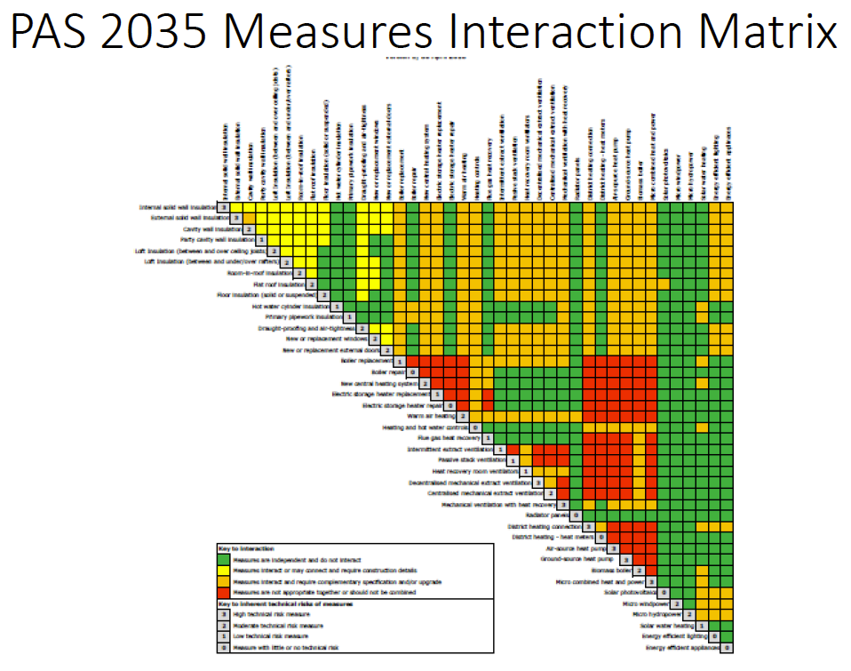

Slide 109
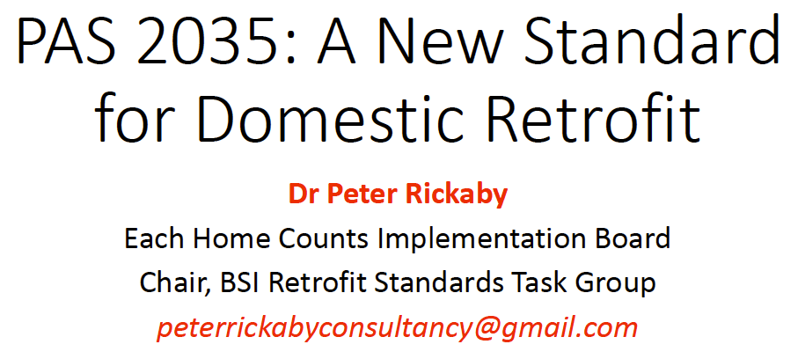

Slide 110
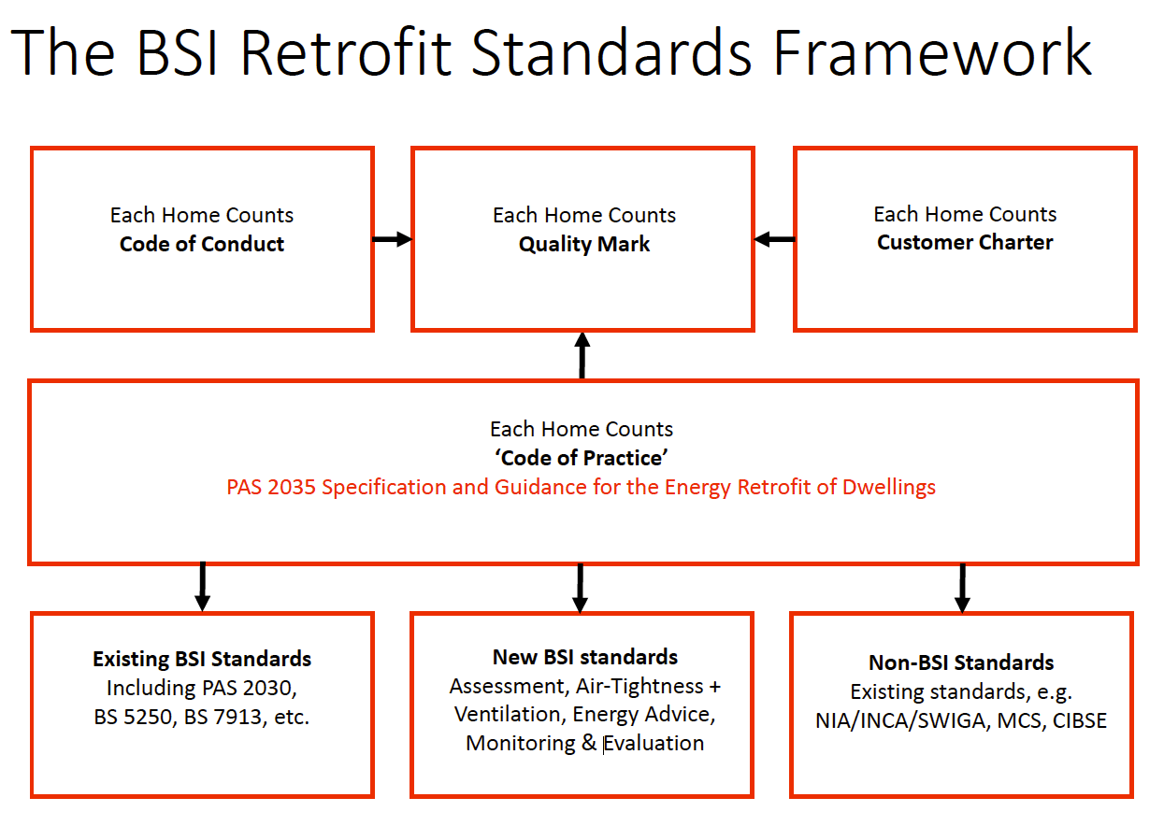

Slide 111
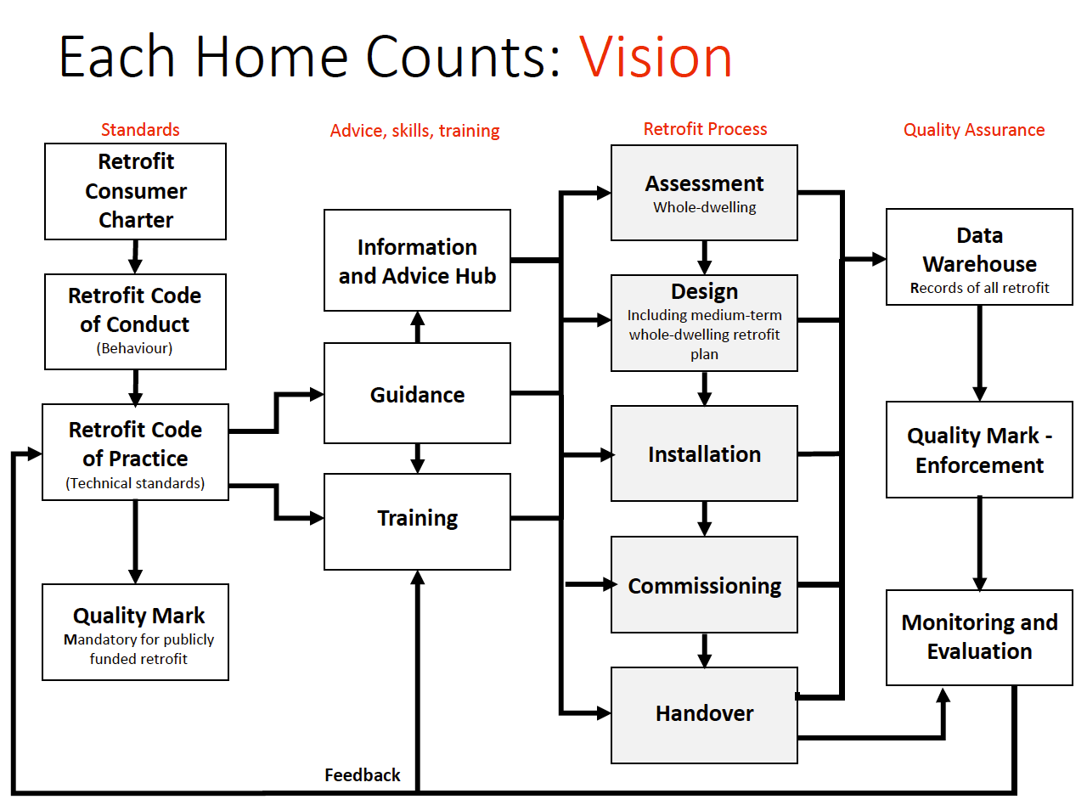

Slide 112
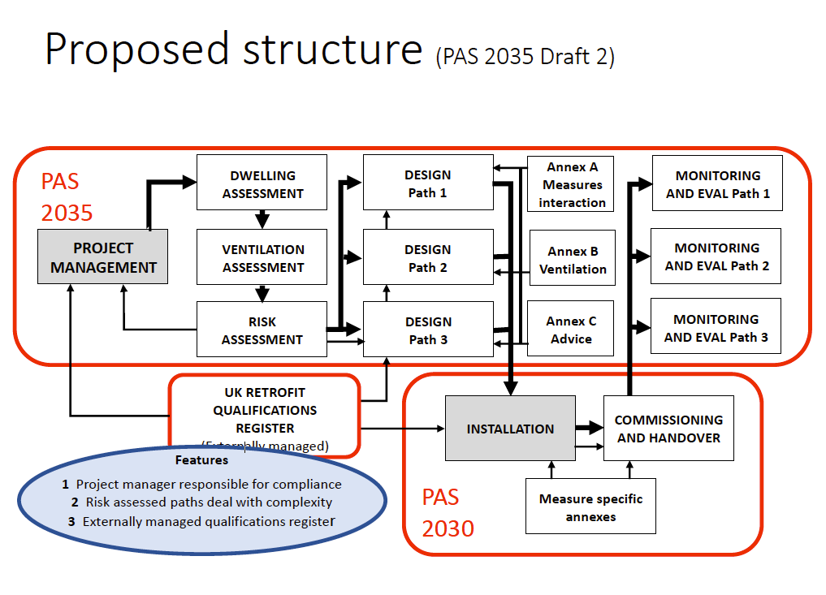

Slide 113
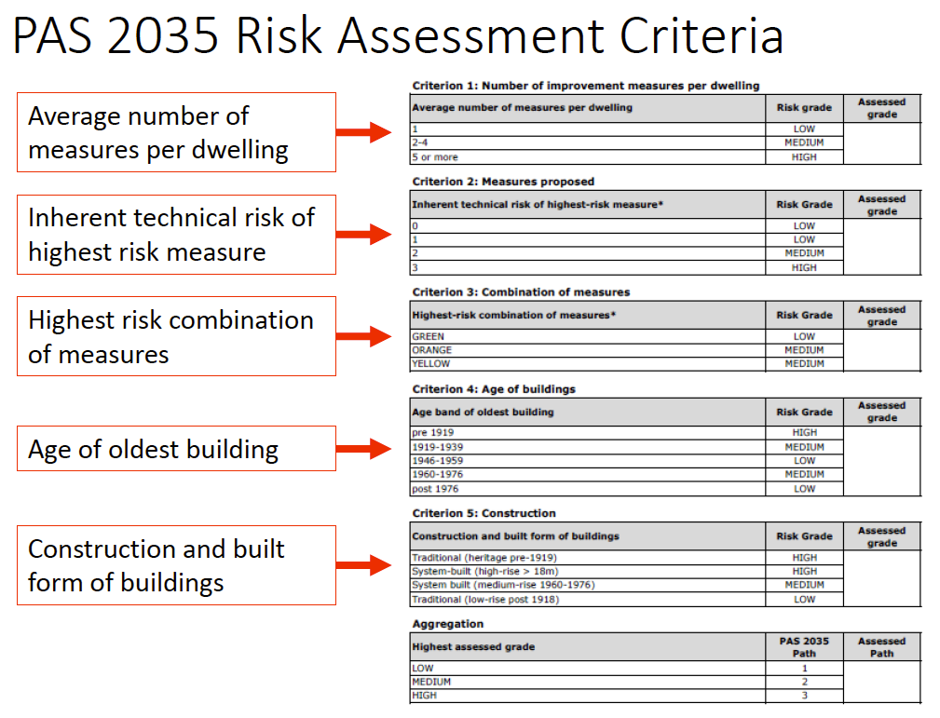

Slide 114
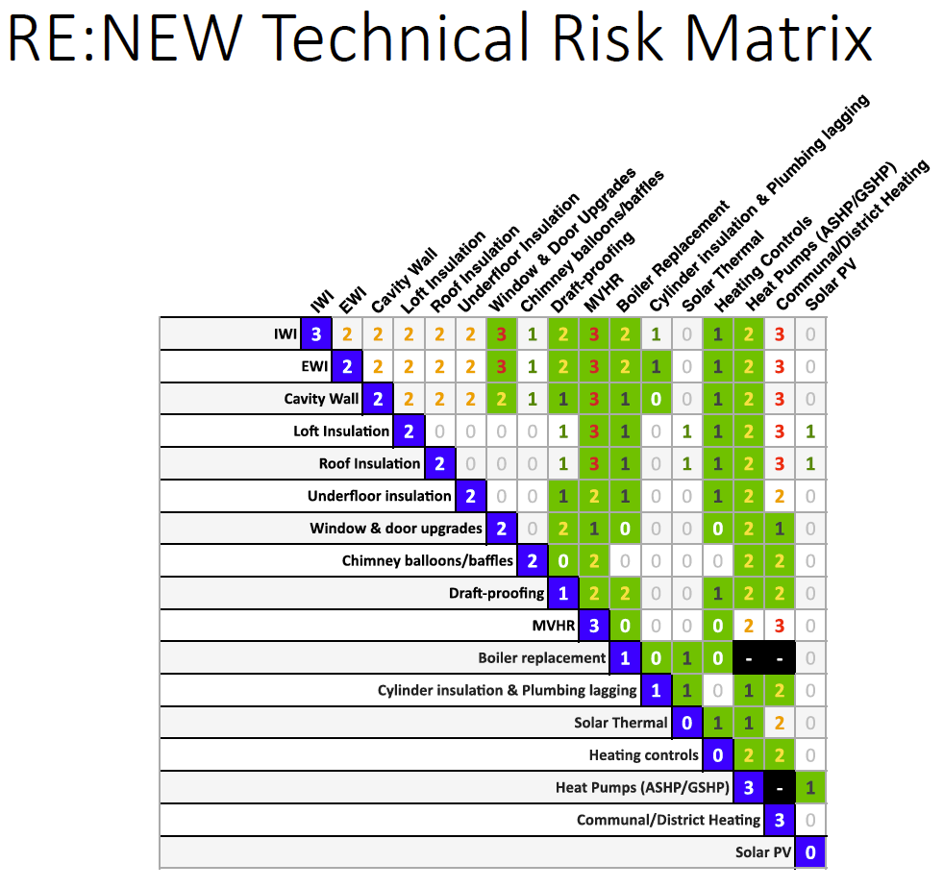

Slide 117


Slide 118


