Slide 1

Tech Lecture 1
Introduction to Materials
Advanced Technology Module Code: 5CTA1140
Semester A: Weeks 10 - 24
Credits: 15
Module Coordinator: Brian Murphy
Course Leader: Ilona Hay
Lecturer: Sonia Tong
Lecture 1: Week 10 3:30-4:30pm
15th October 2019

Slide 2
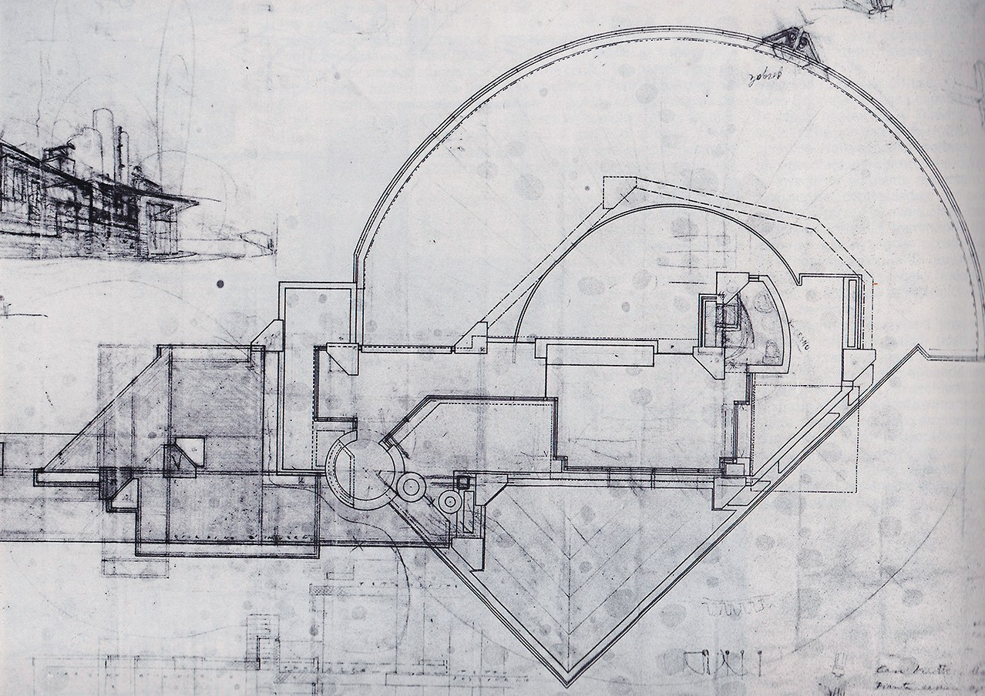
Architects and IADs need to be able to think in 3D and explore around all the corners
BIM may detect clashes for you but you still have to work it out
“I want to see things, that’s why I draw. Things show to me only when I draw them.”
Carlo Scarpa, Architect

Slide 3
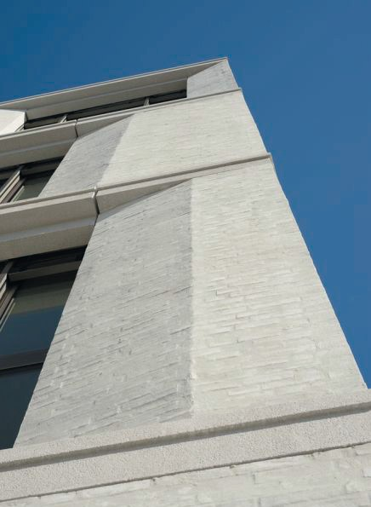
Introduction to Materials
In line with your ﬁrst Studio Project, we will brieﬂy examine a few material types;
Timber Materials
Fired Materials
Formed Materials
Textile Materials
David Chipperﬁeld, Killesberg

Slide 4
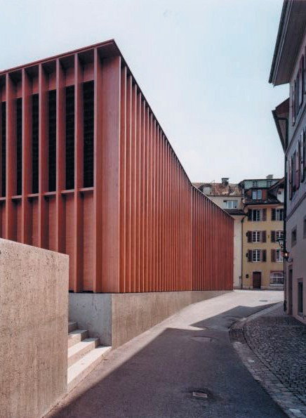
1 Timber Materials
Hardwood
Softwood
Plywood
Particleboard (Chipboard)
Oriented Strand Board (OSB)
Medium Density Fibreboard (MDF)
Cross Laminated Timber Panels (CLTP)
Laminated Veneer Lumber (LVL)
Miller & Maranta, Market Hall in Aarau

Slide 5
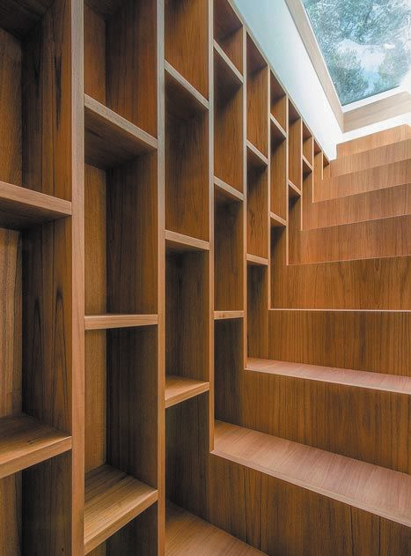
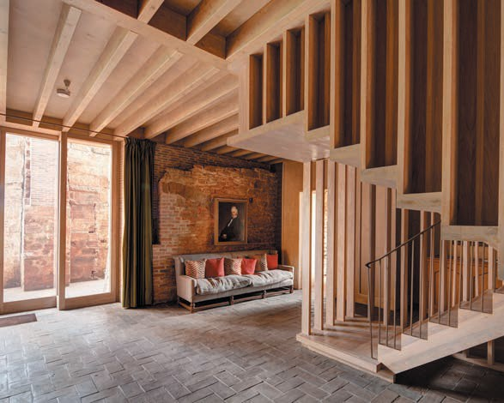
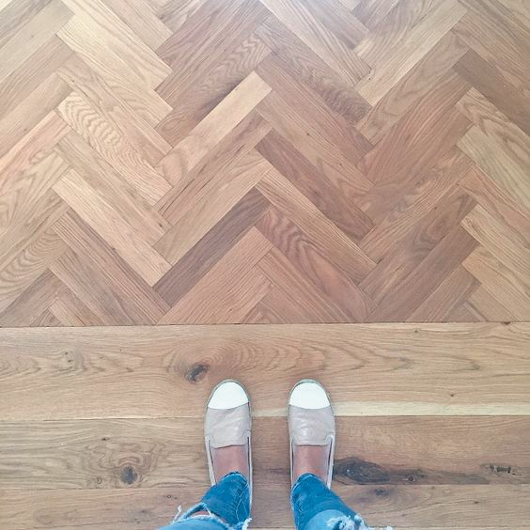
Hardwood

Slide 6
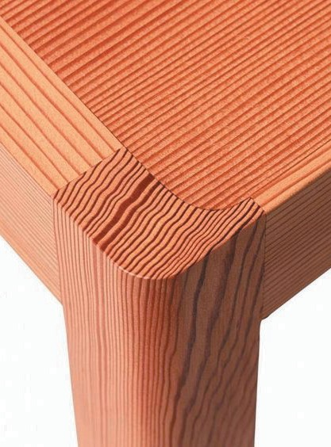
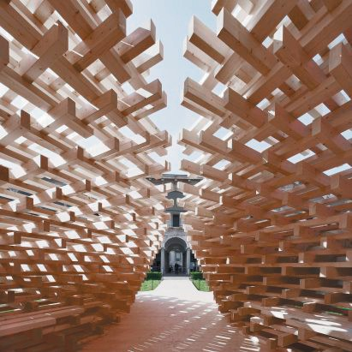
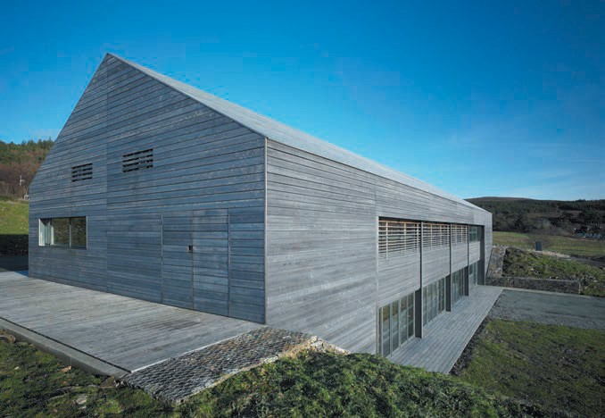
Softwood

Slide 7
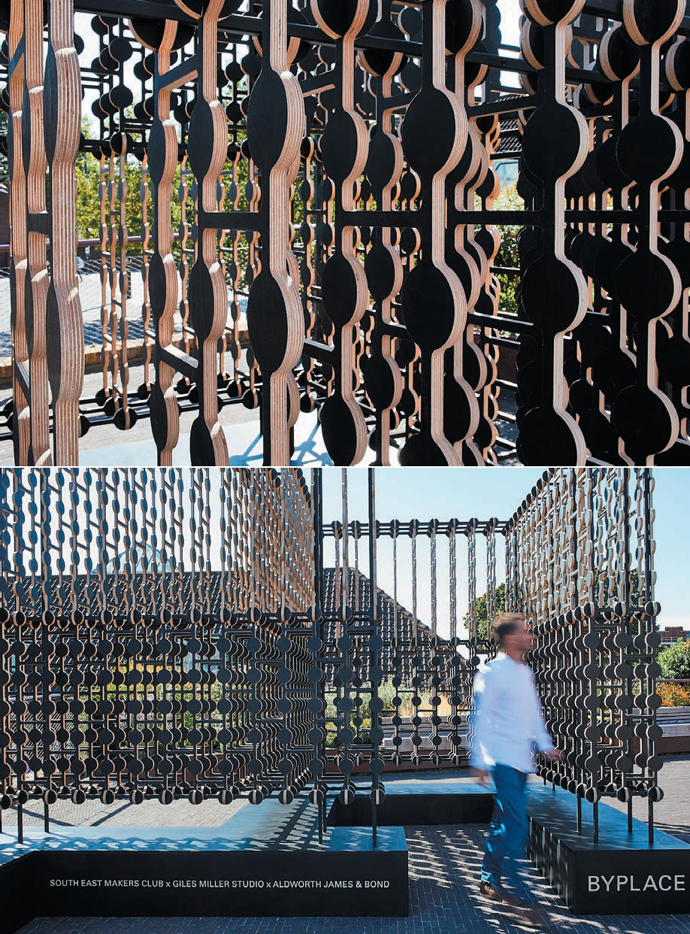
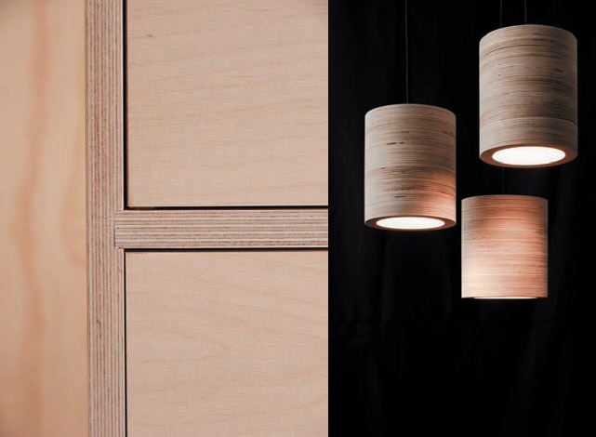
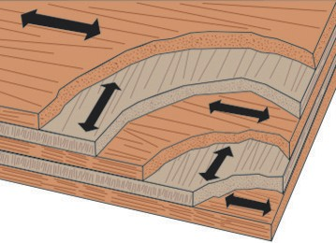
Plywood

Slide 8

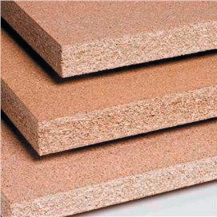
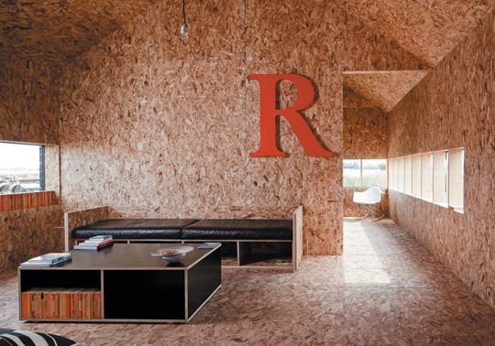
Particleboard (Chipboard)
Oriented Strand Board (OSB)

Slide 9
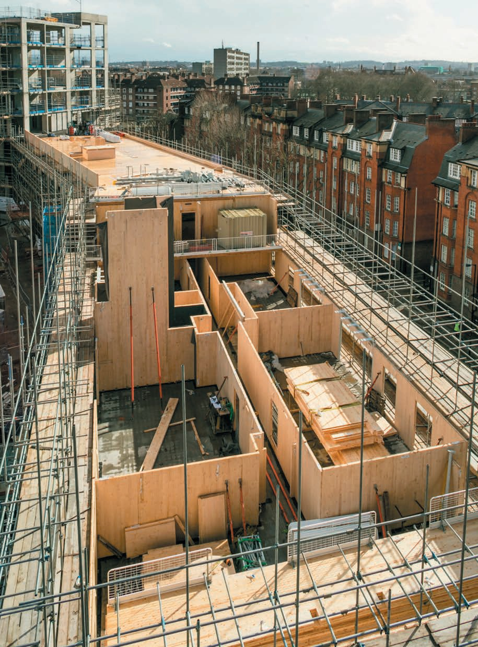
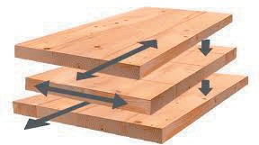
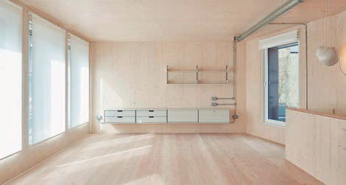
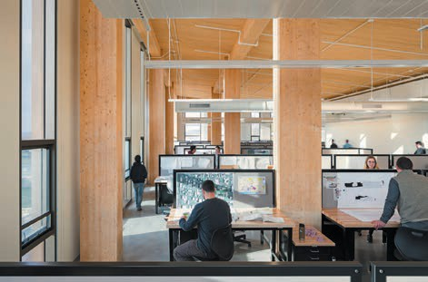
Cross Laminated Timber Panels (CLTP)

Slide 10
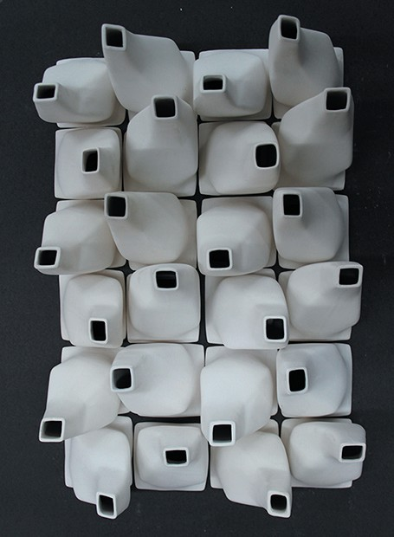
2 Fired Materials
Clay
Ceramics
Porcelain
Terracotta
Bricks
ECALab, prototype ceiling

Slide 11
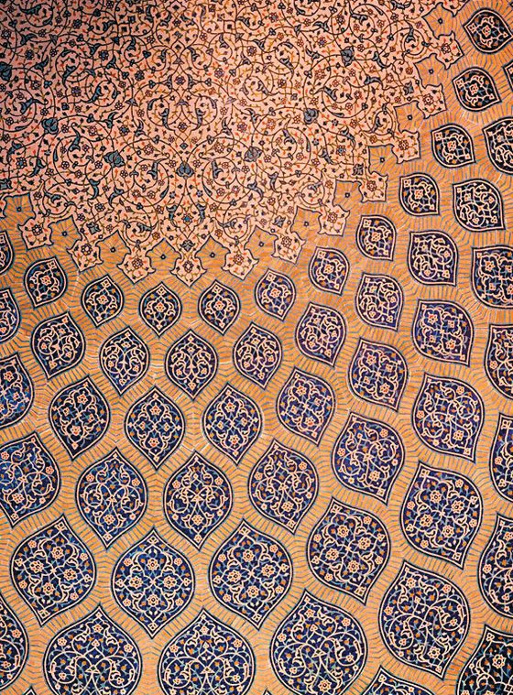
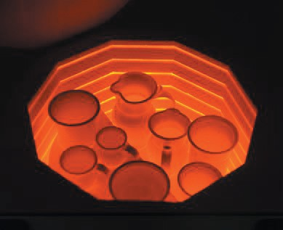
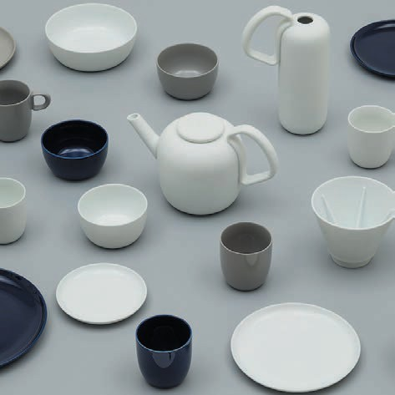
Ceramics & Porcelain

Slide 12
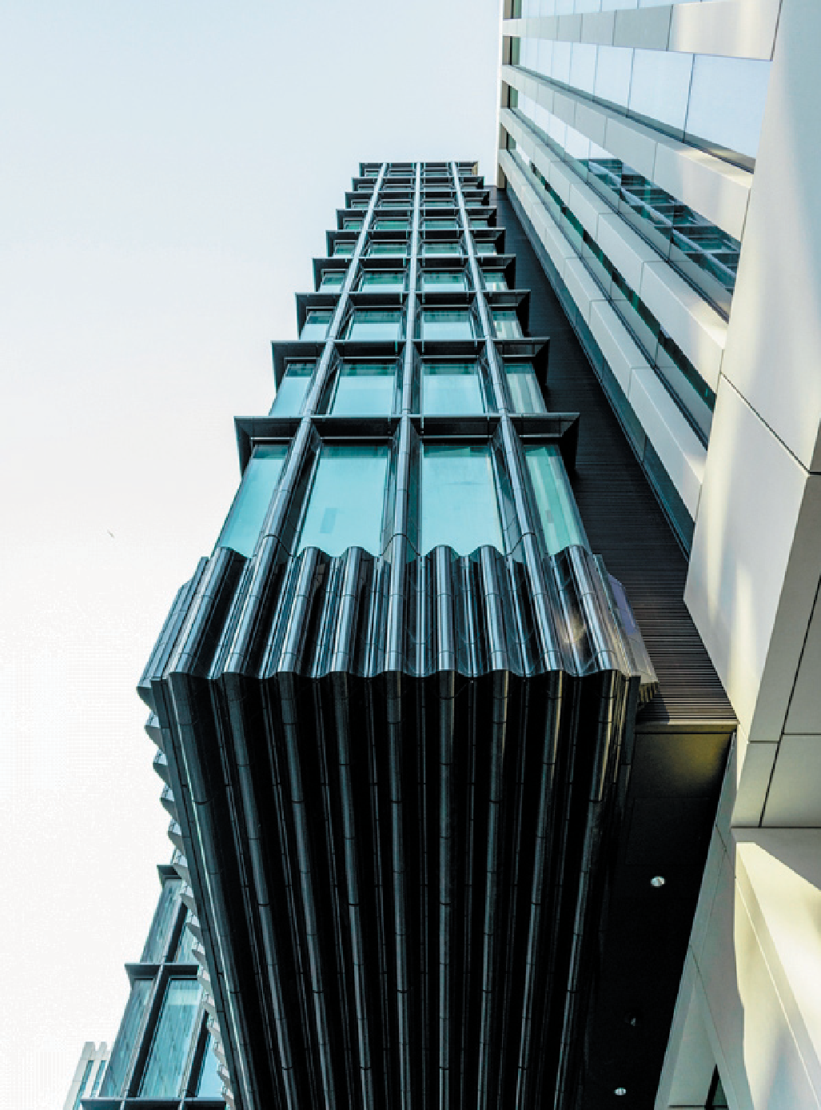
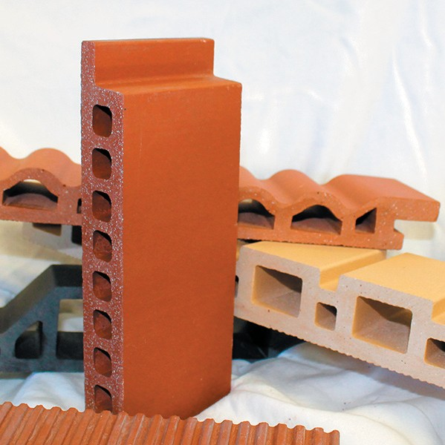
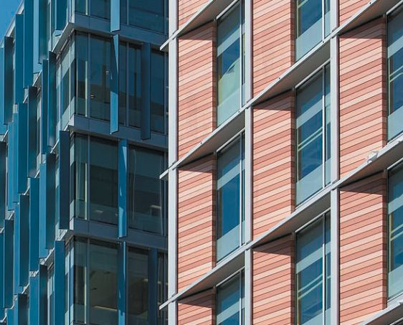
Terracotta

Slide 13
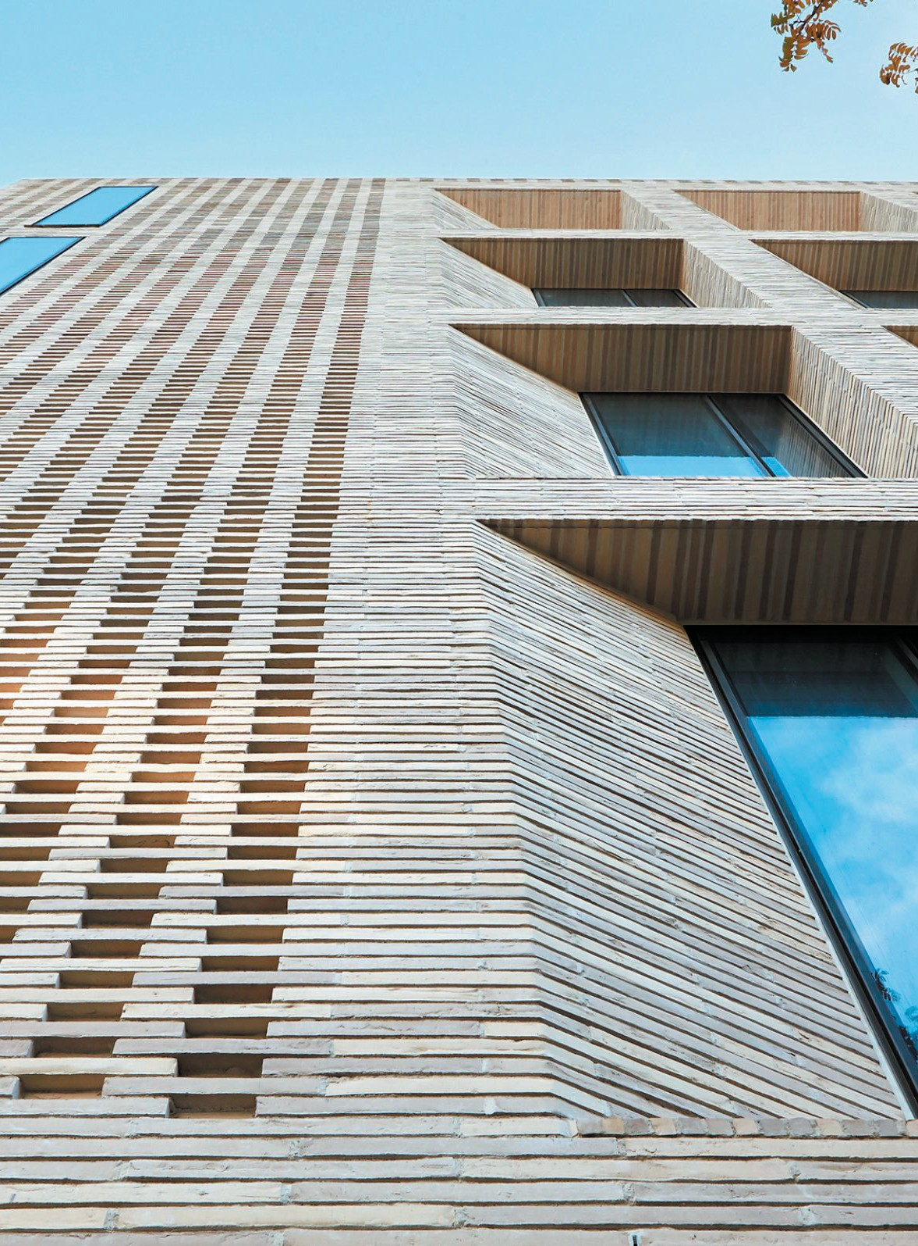
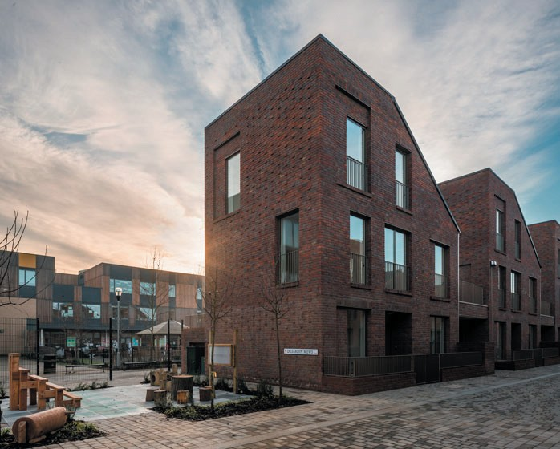
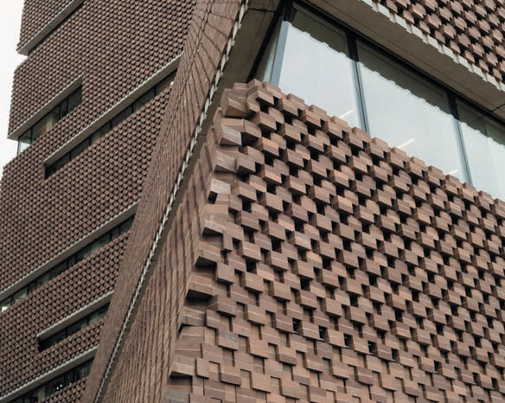
Bricks

Slide 14

3 Formed Materials
Concrete
Plaster
Cast Glass
Cast Iron
Eduardo Souto de Moura, Braga Municipal Stadium

Slide 15
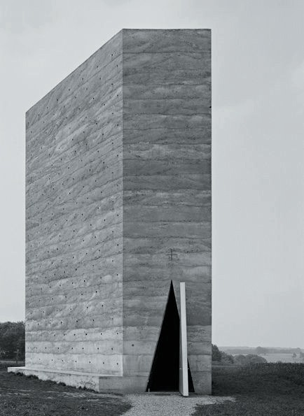
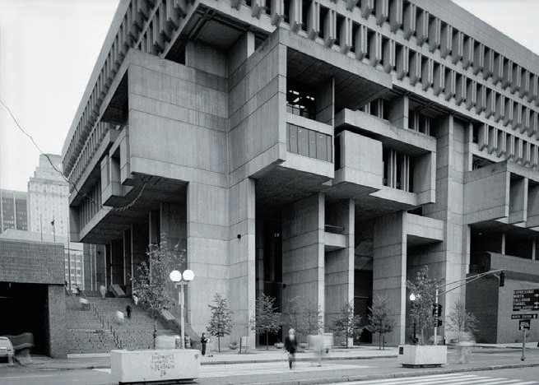

Concrete - In-situ

Slide 16
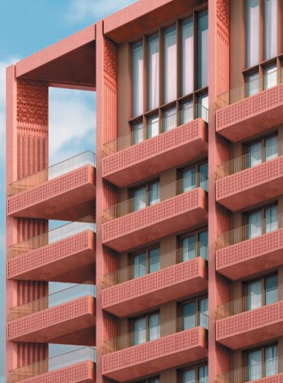

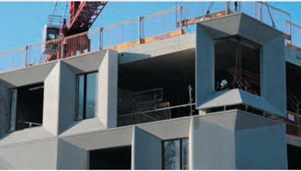
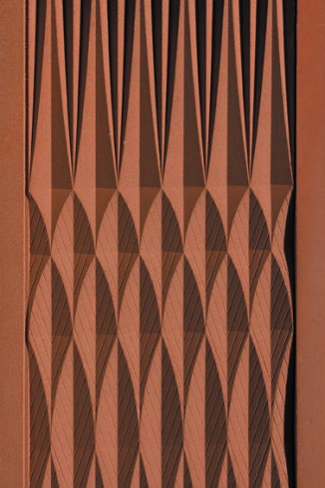
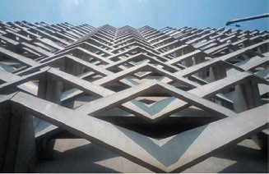
Concrete - Pre-cast

Slide 17

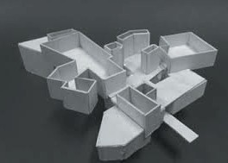
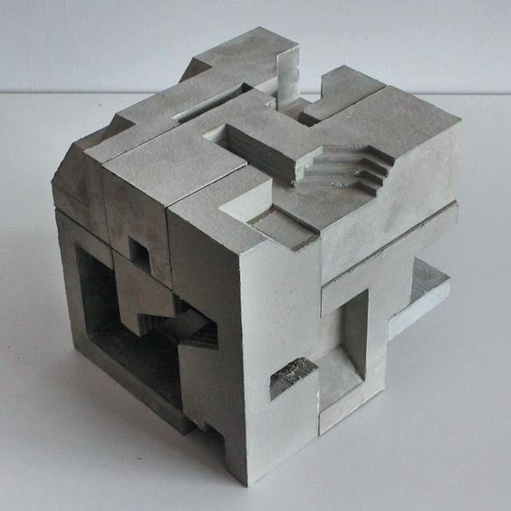
Plaster

Slide 18

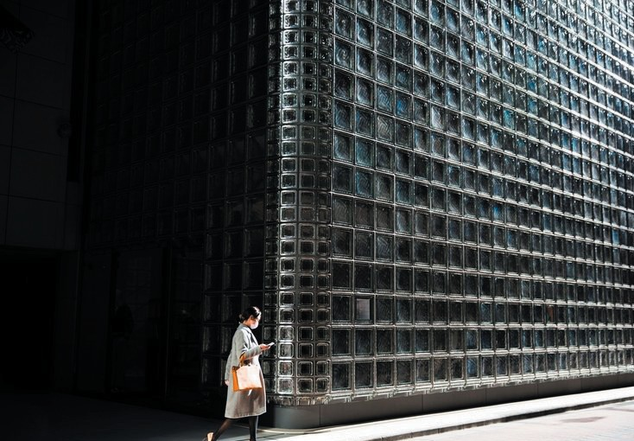
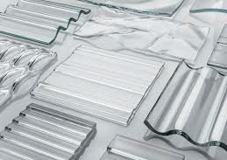
Cast Glass

Slide 19

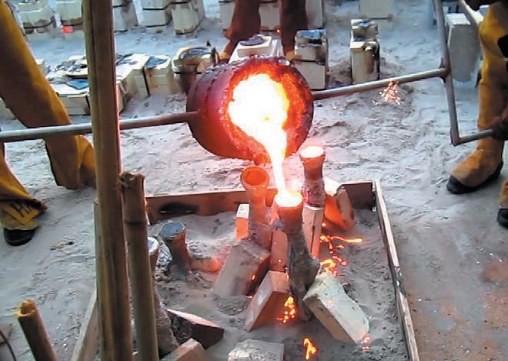
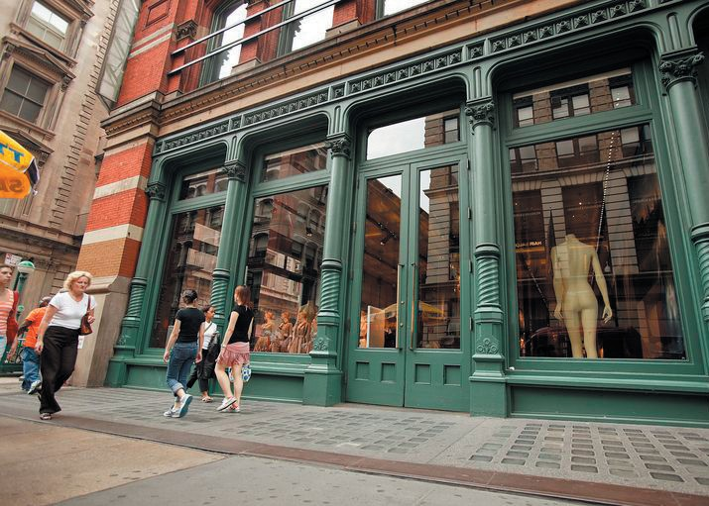
Cast Iron

Slide 20
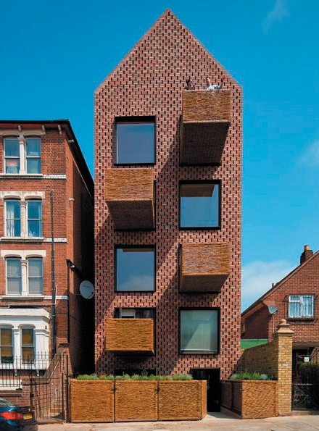
4 Textile Materials
Tensile
Fabric
Carpet
Cloth
Woven
Amin Taha Architects,Barrett’s Grove

Slide 21
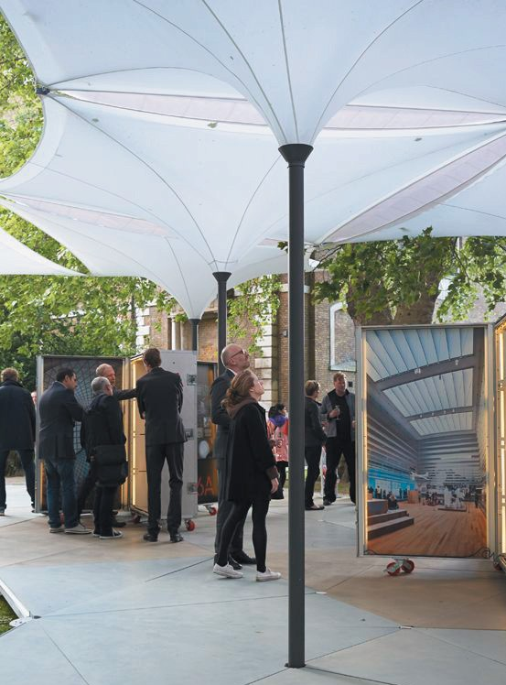

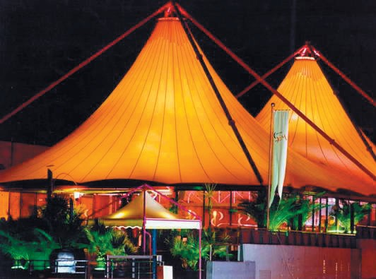
Tensile Fabric

Slide 22
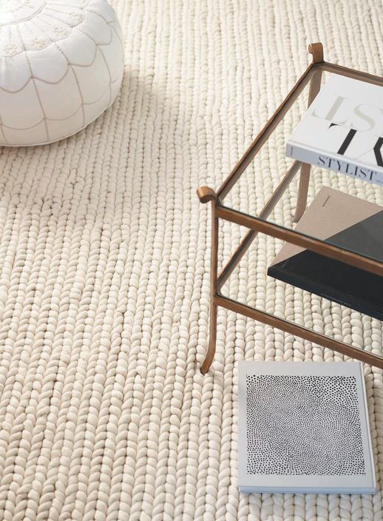

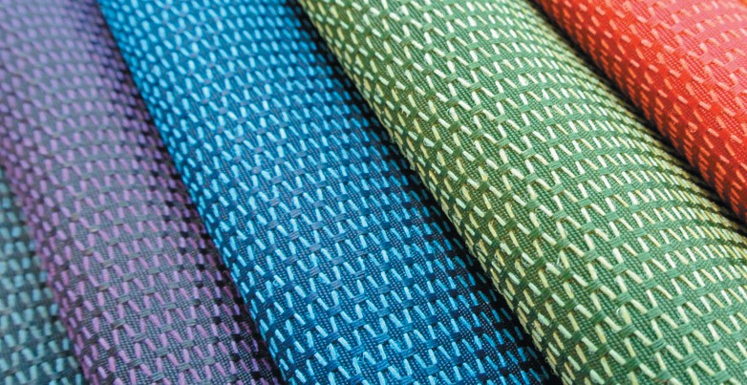
Fabric/Cloth + Carpet

Slide 23
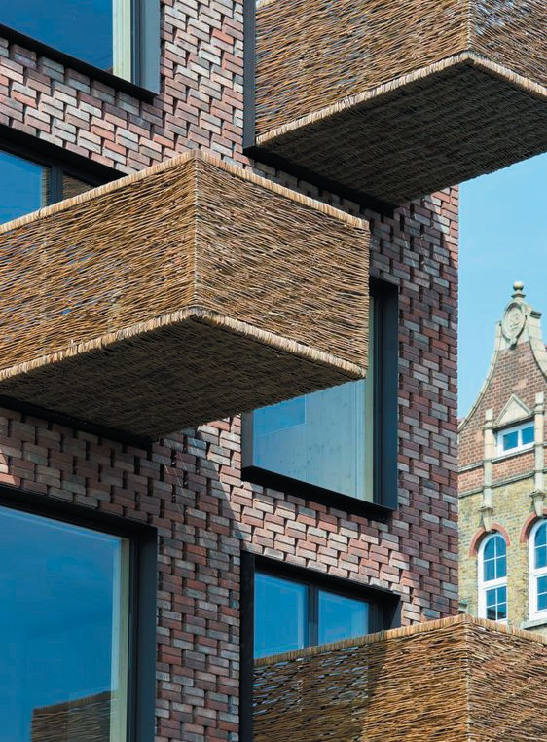
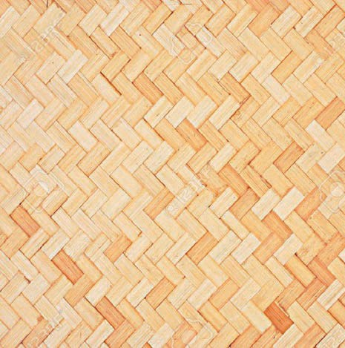
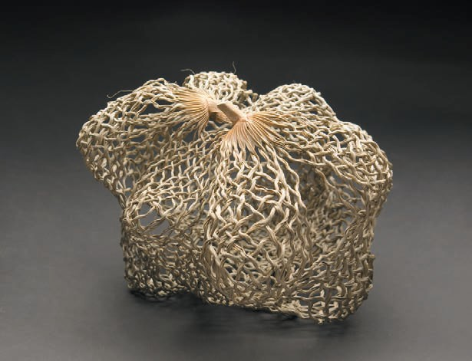
Woven

Slide 24
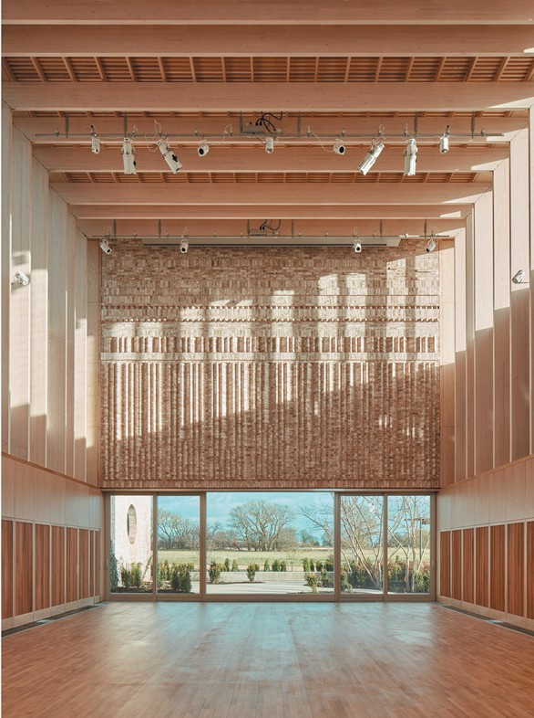
Technology Task 01: Adopt a Material
Based on your Studio Design Project 1,
‘Adopt' a material to study in more detail.
Learning Outcomes:
Integrate technology into your Studio project through an exploration of design ideas and materials
Understand impact of chosen material on design proposal
Place sustainability and green issues at the centre of your design process
Develop modelling and prototyping skills
MUMA Architects, Storey’s Field Centre, Cambridge

Slide 25
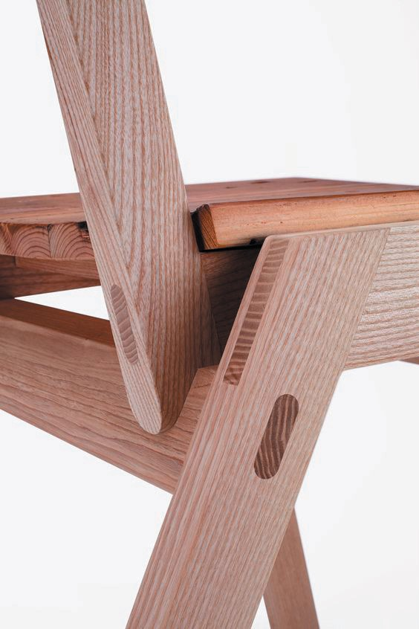
Design Task 01: Adopt a Material
Use following headings:
How It Is Made
  (raw materials groewing /extraction, preparation, process, end product, etc.)
Inherent Properties
  (strengths, weaknesses, construction considerations, etc. ideally tabulated)
Sustainability
  (sourcing, production process, pollution caused, energy and carbon footprint, recycling, labelling, etc)
Relevant Precedent Studies
  (minimum 5 No. exploring construction principles, typologies, details, etc)
Comparative Qualities
  (compare to material from different category; Timber, Fired, Formed, Textile; ideally tabulated for comparisons)
Design Process
  Studio Design Project 1: record design process, tectonics, fabrication, etc.)
Link to Brief:
https://herts.instructure.com/courses/29445/assignemnts Page not found
Format:
Report, A4 landscape, bound as a single PDF
Submission:
04/11/2019 before 12 o’clock midnight to Folder

Slide 26

End of Lecture
Begin Your task 1
“Less is more.”
Mies van der Rohe, Architect

