Slide 1
Low Rise Building
No.3A UH M.Arch
18th November 2019

Slide 2
This Presentation on GBE:
Find this file on GBE website at:
https://GreenBuildingEcyclopaedia.uk/?P=xxxxx
After the seminar/lecture I will update the page with this updated file

Slide 3
Speaker:
Brian Murphy brianspecman@icloud.com
Technician and Architect by training, a Specification Writer by choice and an Environmentalist by action
Greening up my act since 1999
Founded National Green Specification 2001
GreenSpec.co.uk Website 2003
Started GBE online 2015 https://GreenBuildingEncyclopaedia.uk
  2050 pages created and 30,000 to go.

Slide 4
Violet Low Rise Construction
No.3 (part) UH M.Arch 18th November 2019

Slide 5
Conventional Low Rise 1
Masonry Cavity Wall: Brick outer block inner
  Partial or full fill cavity insulation
Ground bearing insitu concrete slab
Suspended Precast beam and Block floor
  GF sloping sites or methane/radon sites
  Upper floor Apartments (Acoustics and fire)
Suspended timber upper floors
Trussed rafter roof
Glasswool, stonewool or EPS insulated
  Will overheat
Softwood framed plasterboard partitions

Slide 6
Conventional Low Rise 2
Masonry outer and timber framed inner Cavity Wall
  Partial or full fill cavity insulation
  stonewool or EPS insulated
Ground bearing insitu concrete slab
Suspended timber ground floor
  GF sloping or methane/radon sites
Suspended timber upper floors
Trussed rafter roof
Glasswool, stonewool or EPS insulated
  Will overheat
Softwood framed plasterboard partitions

Slide 7
Conventional Low Rise 3
Masonry outer, light metal framed inner Cavity Wall
  Partial or full fill cavity insulation
  stonewool or EPS insulated
Ground bearing insitu concrete slab
Suspended light metal frame ground floor
  GF sloping or methane/radon sites
Suspended light metal frame upper floors
Light metal frame trussed rafter roof
Glasswool, stonewool or EPS insulated
  Will overheat
Light metal framed plasterboard partitions

Slide 8
Conventional Low Rise 4
Masonry Solid Wall:
  Blockwork External Insulated render
Ground bearing insitu concrete slab
Suspended Precast beam and Block floor
  GF sloping sites or methane/radon sites
  Upper floor Apartments (Acoustics and fire)
Suspended timber upper floors
Trussed rafter roof
Glasswool, stonewool or EPS insulated
  Will overheat
Softwood framed plasterboard partitions

Slide 9
Conventional Low Rise 5
SIPS Structural Insulated Panels System in place of Light timber frame
  Plastic insulation sandwich
  Roof will, walls may, overheat

Slide 10
Conventional Low Rise 6
ICF Insulating Concrete Formwork
  Interlocking Plastic insulated formwork
  Concrete infill
  Render externally, plaster internally
  Remains vulnerable to fire
  Roof may still overheat

Slide 11
Green Low Rise Construction
No.3 (part) UH M.Arch 18th November 2019

Slide 12
New Build Green Materials &
Construction

Slide 13
Green Walls:
Masonry

Slide 14
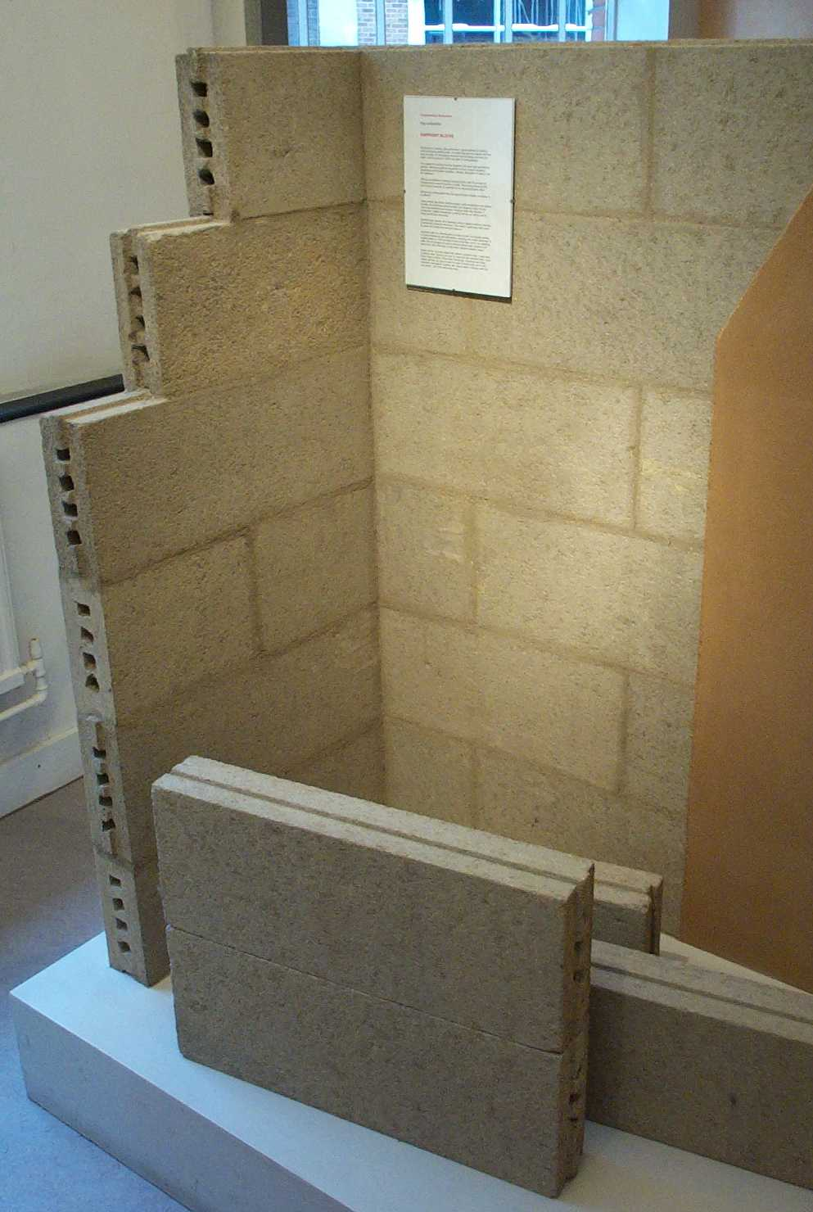
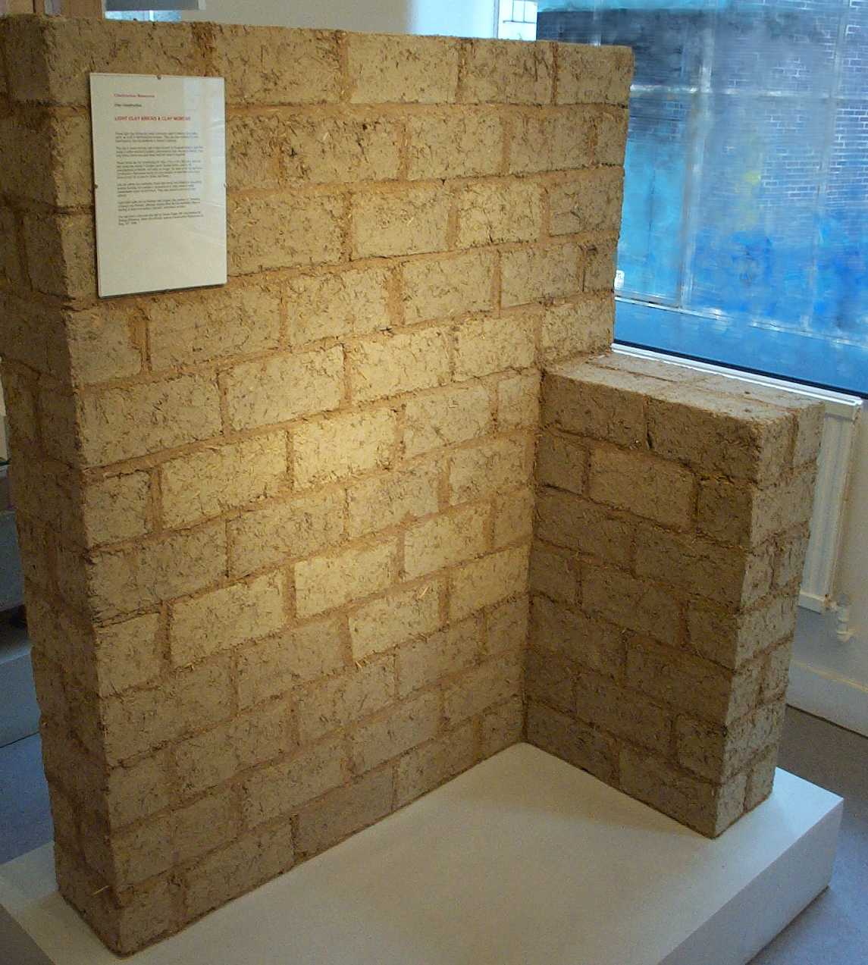
Unfired clay and straw

Slide 15
Unfired clay
Hollow extruded clay
  Lighter weight
Interlocking profile
  Acoustic and airtight
Dry or slip clay joint
Hygroscopic
  Moisture mass
Thermal mass and lag

Slide 16
Unfired clay and straw
Simple solid block
Straw for reinforcement and hygroscopicity
Clay mortar purpend and bed joints

Slide 17
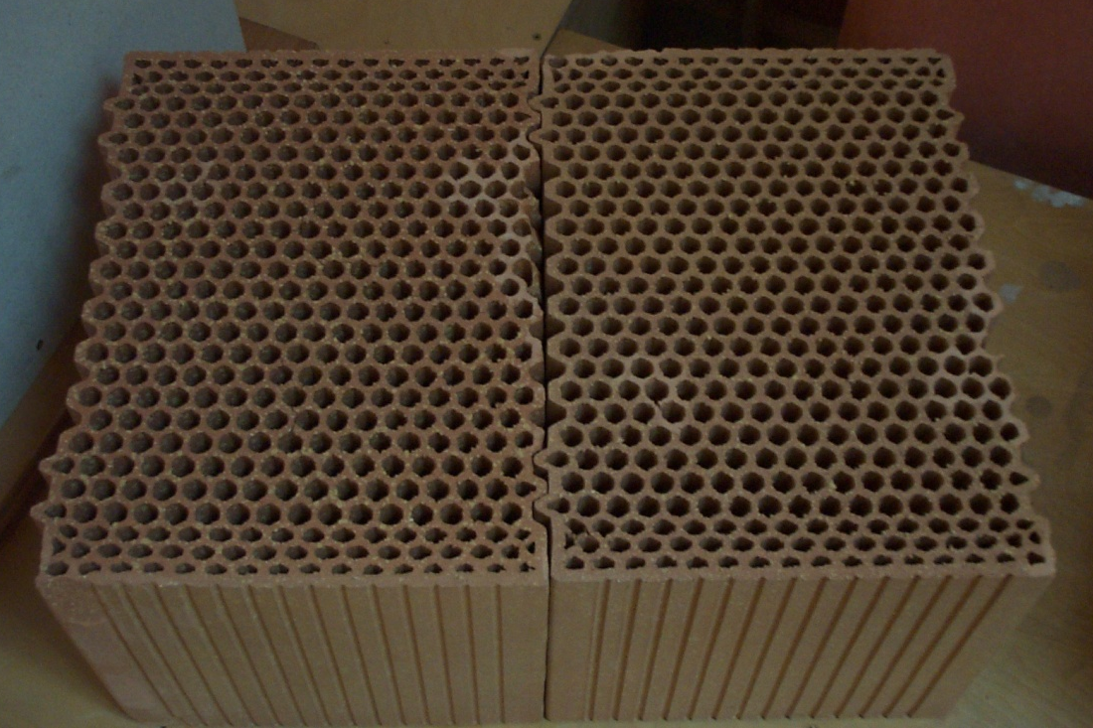
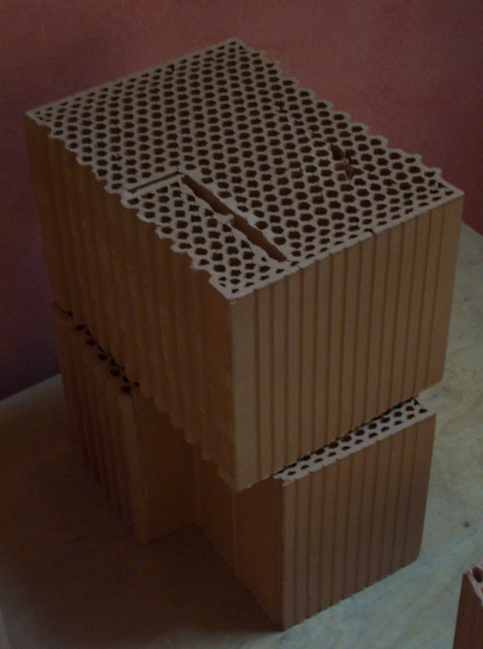
Cellular fired clay blocks

Slide 18
Cellular fired clay blocks
Abundant Mineral: clay
Fired clay
Cellular insulation
Long conduction path
Interlocking dry perpend
Mortared bed joint
Thermal mass
Acoustic mass
Decrement delay
Moisture Permeable

Slide 19
Cellular fired clay blocks
Knock out pieces
Allow conduit runs
Form corners and interlocking

Slide 20
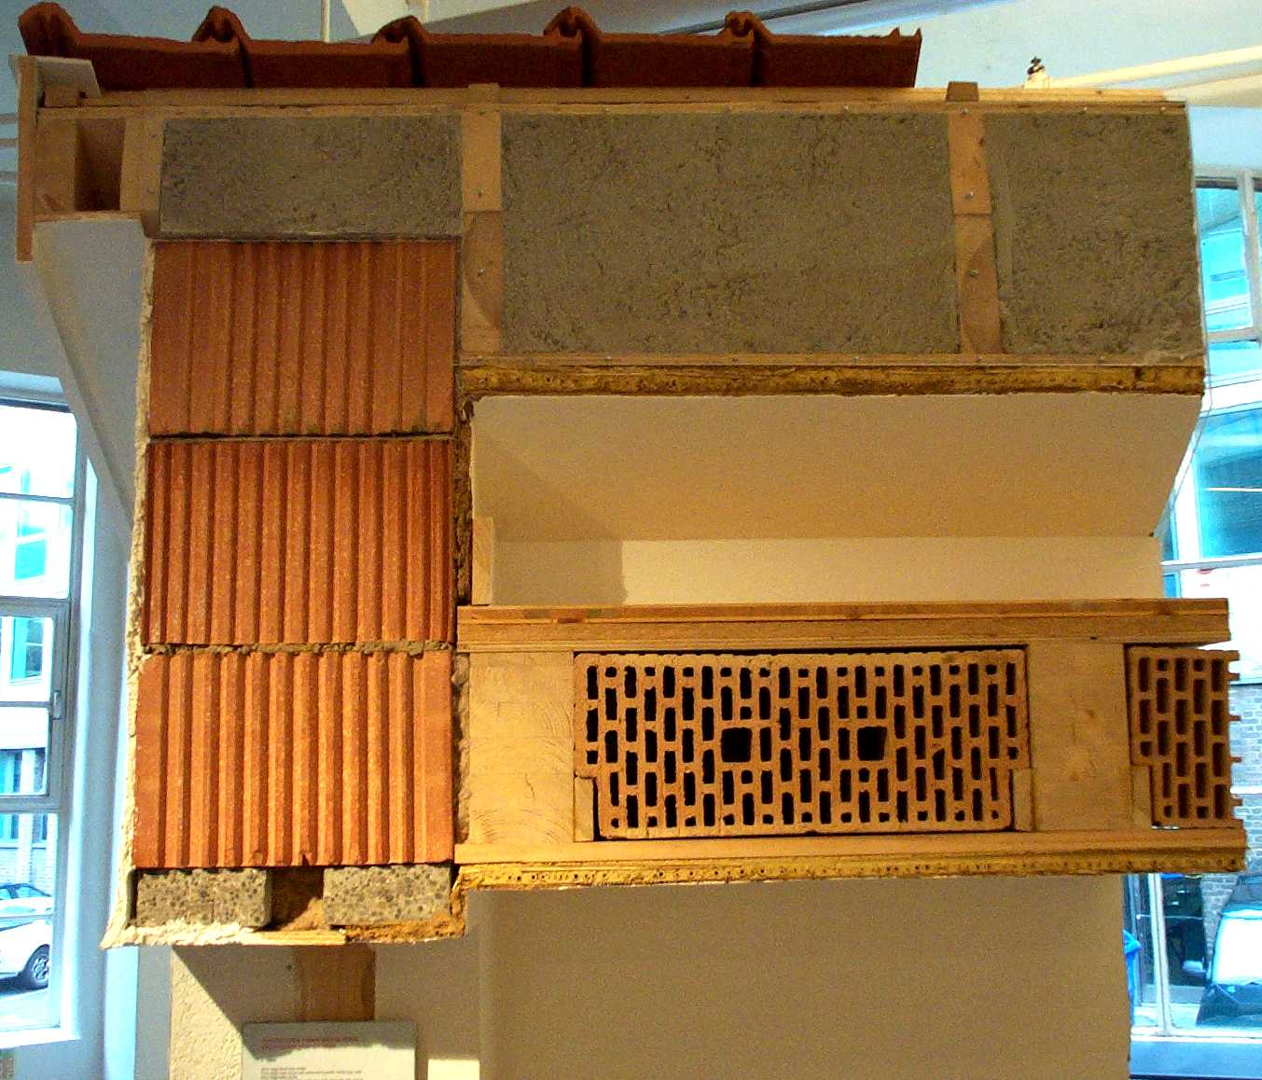
Thermal Mass
Thermal mass:
Fired honeycomb
blocks in walls and floors adds long term
thermal and acoustic mass
Clay board adds short term thermal mass
Not high load capacity
Construction Resources Showrooms Southwark London

Slide 21
21st Century Cob Walls
CobBauge Interreg Channel Project
Phase 2 underway
Traditional will not meet BRADL
Structural Cob + Insulating Cob
600 mm U value: 0.28 W/m2.K (0.3min)
U: 0.15 achievable CobBauge Phase3

Slide 22
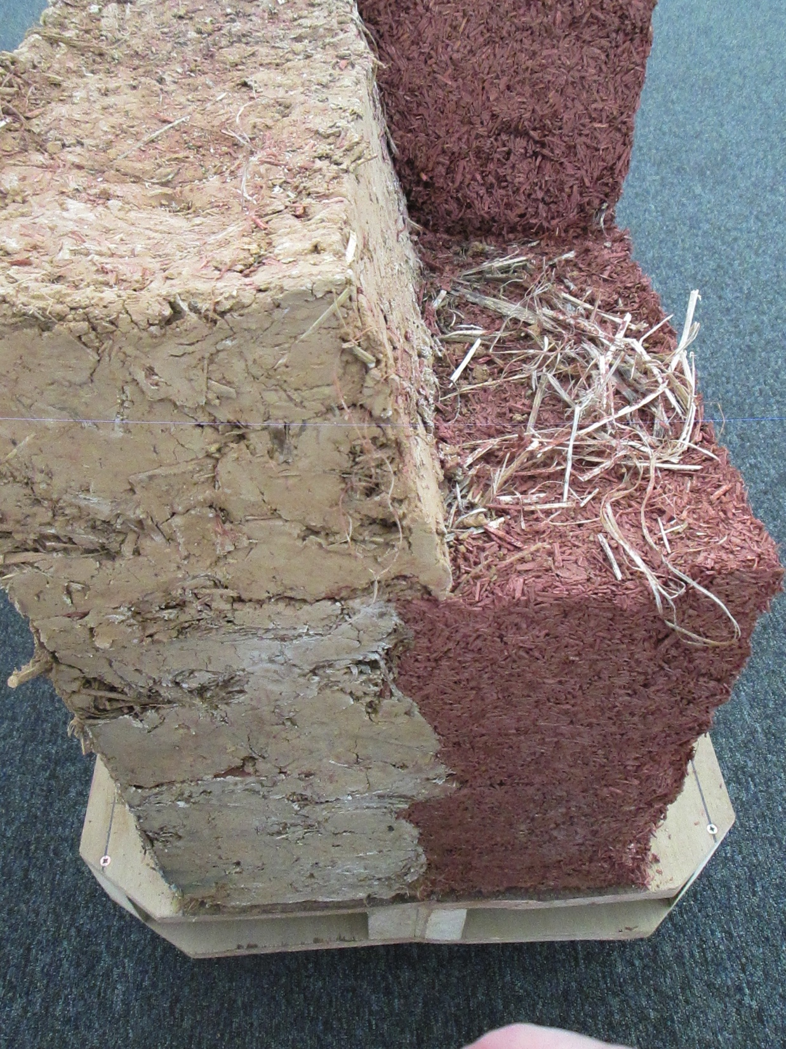
CobBauge
2 halves make a whole
Structural k=0.42
Insulating k=0.11
Act as one
Difficult to get apart
400 mm wall shown

Slide 23
Hemp-Lime
Hempcrete
Hemp shiv (part of stalk)
  is aggregate in a mix
Lime
  (lower energy and carbon than Cement)
Mixed to a concrete-like mix
  Sprayed into open cassettes or like render
  Cast into formwork and tamped down

Slide 24
21st Century hemp-lime
Hemcrete via Lime Technology Ltd. Tradical by Lhoist (FR)
Hemp shiv: part of stalk
  is aggregate in a mix
Lime
  Lower energy and carbon than Cement
Cement
  Higher energy and carbon than Lime
  To get an initial set sooner
  To drive the lime to hydrate faster
Aluminium Oxide
  High embodied energy and carbon
  Chemical reaction with cement: Saponificate: Bubbles entrained in cement matrix
Mixed to a aerated concrete-like mix
  Sprayed into open cassettes or like render
  Cast into formwork and tamped down
  Into robust CLT Frame
  Air pushed through to hydrate and dry mix for quick turn around
  MMC Moderns Method of Construction or IMC Innovative Method of Construction

Slide 25
Green Walls:
Timber

Slide 26
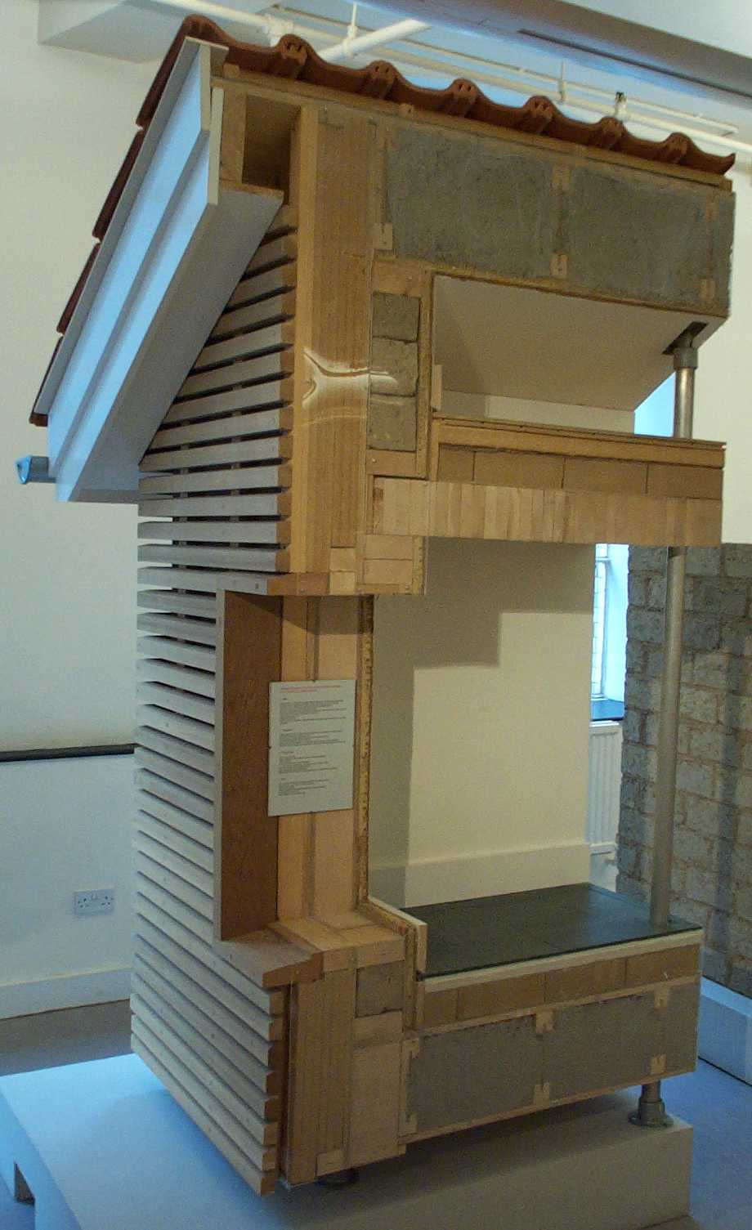
EVT Enhanced Vapour Transfer
Hygroscopic insulation
maintain their performance
even when moist
Vapour and water released
when conditions permit
No need for VB Vapour Barrier
Use vapour permeable
construction
5:1 ratio vr inside:outside
ATL air tightness layer
Construction Resources Showrooms Southwark London

Slide 27
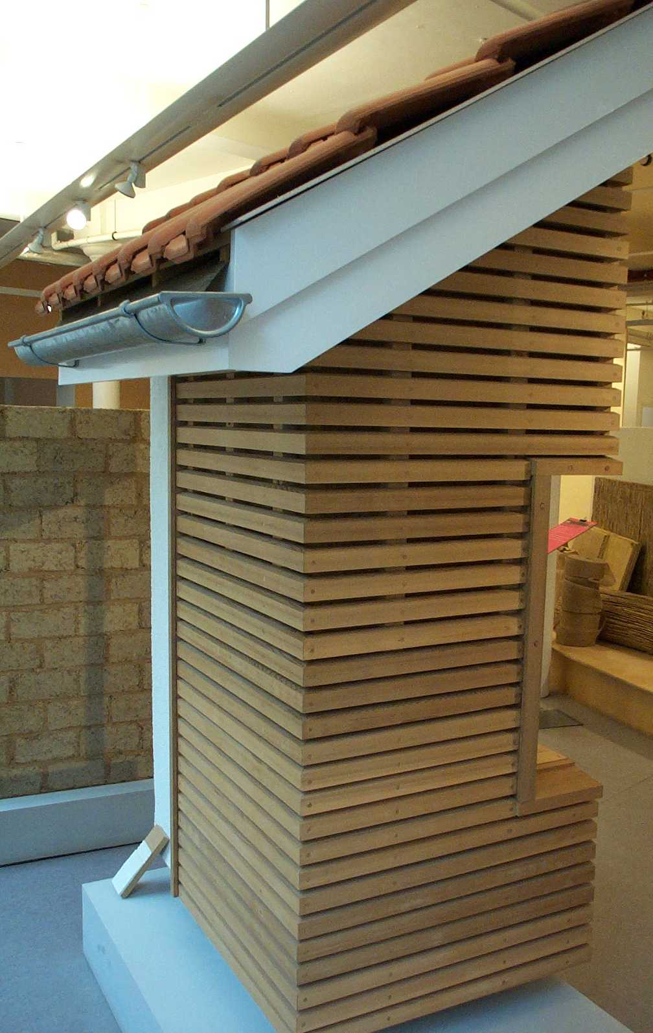
EVT Enhanced Vapour Transfer
Hygroscopic insulation
maintain their performance
even when wet
Vapour and water released
when conditions permit
No need for Vapour Barrier VB
Use vapour permeable
construction
5:1 ratio vr inside:outside
Air Tightness Layer ATL
Not for High Rise/near boundary
Construction Resources Showrooms Southwark London

Slide 28
Thick walls, roofs and floors
We have a preoccupation with
thin walls 300 mm. or less
Which drives the demand for
energy intensive man-made
petrochemical fossil derived
CFC HCFC HFC HFA foamed plastic
O₃ Ozone Depletion
Greenhouse Gas Potential
300-600 mm. optimum
insulation thicknesses
Construction Resources Showrooms Southwark London

Slide 29
Cellulose Fibre
Optimum:
300-400 mm. deep compound
rafters with Cellulose fibre
insulation
High density and
high thermal mass
cellulose fibre insulation
boards in walls and floors
Construction Resources Showrooms Southwark London

Slide 30
Thermal Mass
Thermal mass:
High thermal mass dense wood fibre insulation boards in walls and floors
Acoustic unfired clay bricks
in floor construction
adds thermal and moisture mass
Stacked dowelled wood floor
No glue: healthy
Construction Resources Showrooms Southwark London

Slide 31
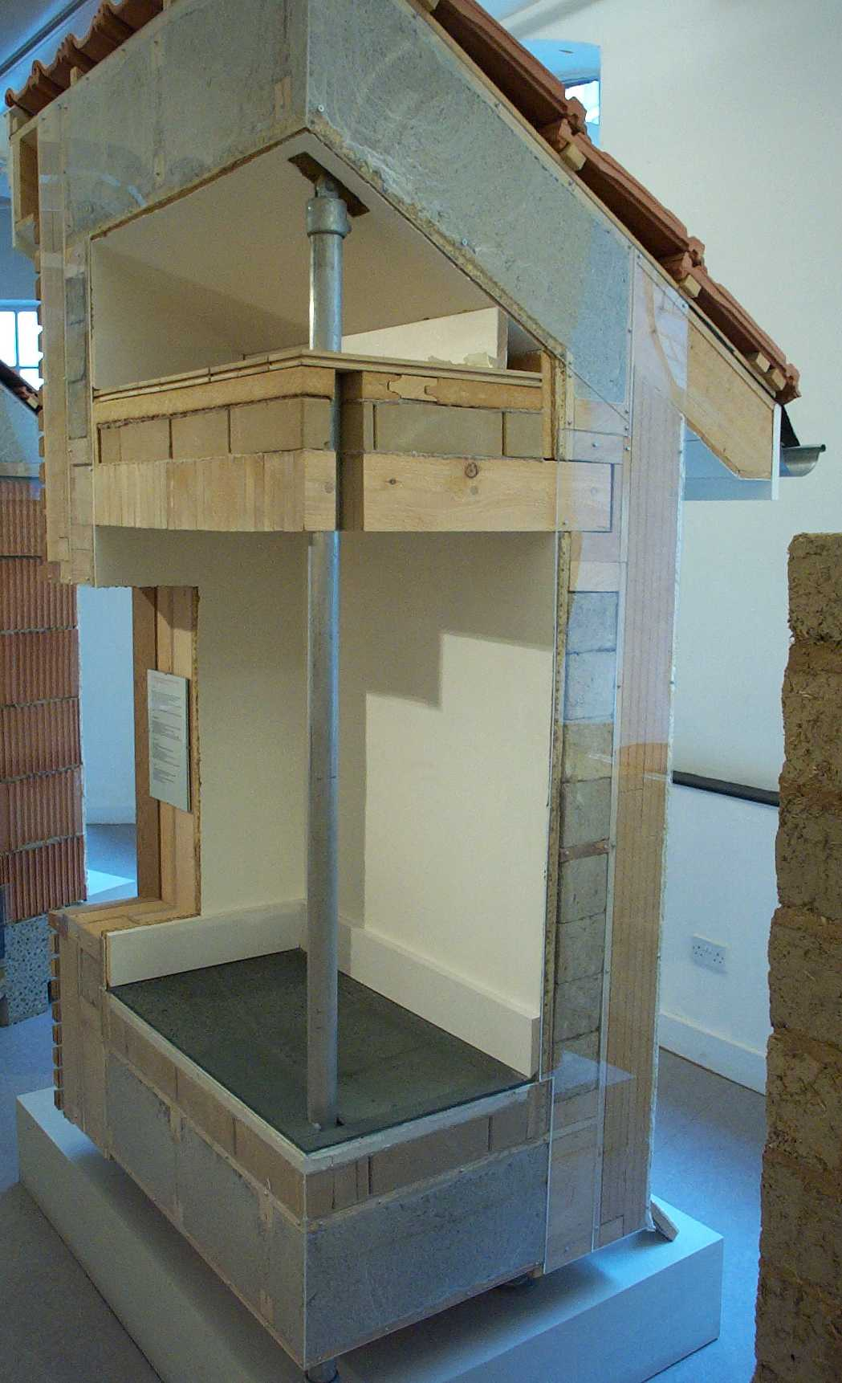

Thermal Mass
Thermal mass:
High thermal mass dense wood fibre insulation boards in walls and floors
Acoustic unfired clay bricks
in floor construction or fired
honeycomb
blocks in walls
and floors adds
thermal mass
Construction Resources Showrooms Southwark London

Slide 32
Timber Structure
Compound rafters
Cellulose insulation
Acoustic brick floor
Timber floor planks
Wood fibre insulation
Timber frame walls
Timber batten clad
Vapour balanced
construction
Construction Resources Showrooms Southwark London

Slide 33
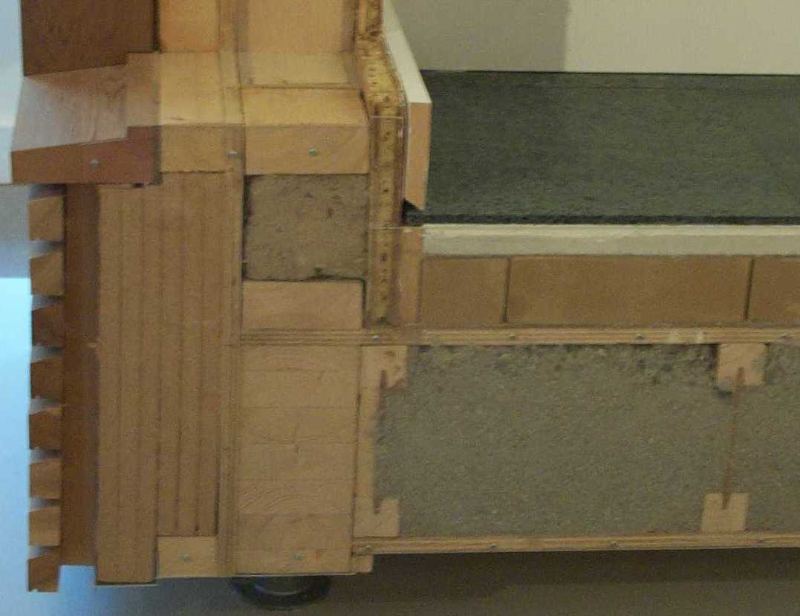

Slide 34
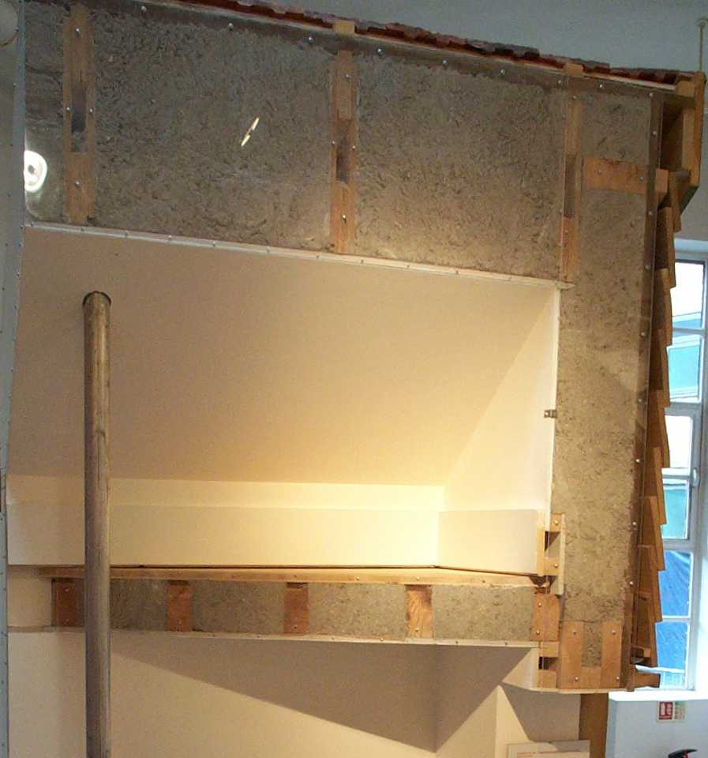

Slide 35
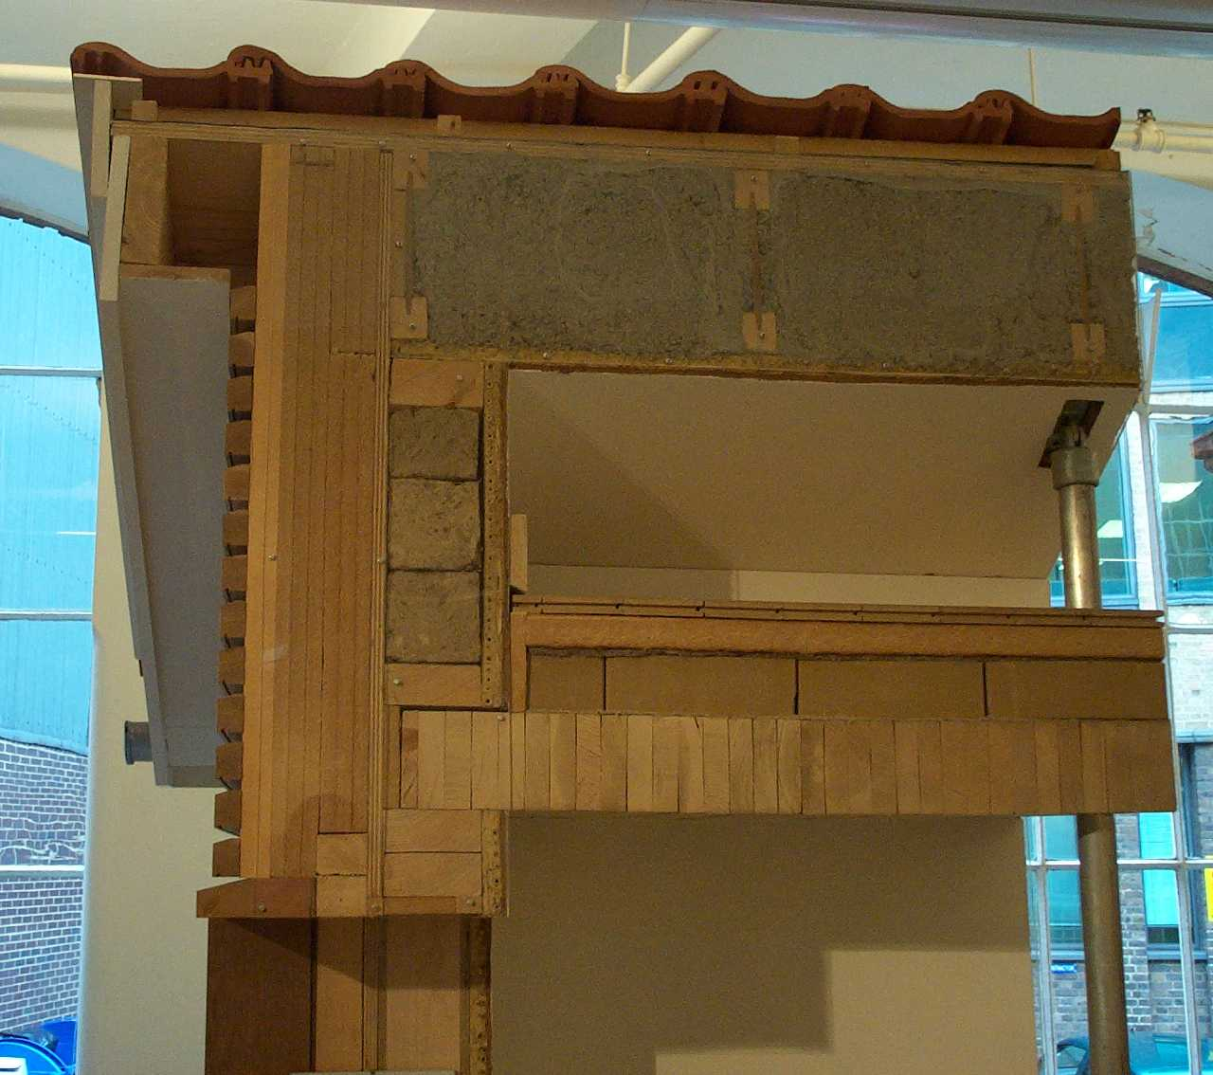

Slide 36
Green Walls:
Loadbearing Timber Blocks

Slide 37
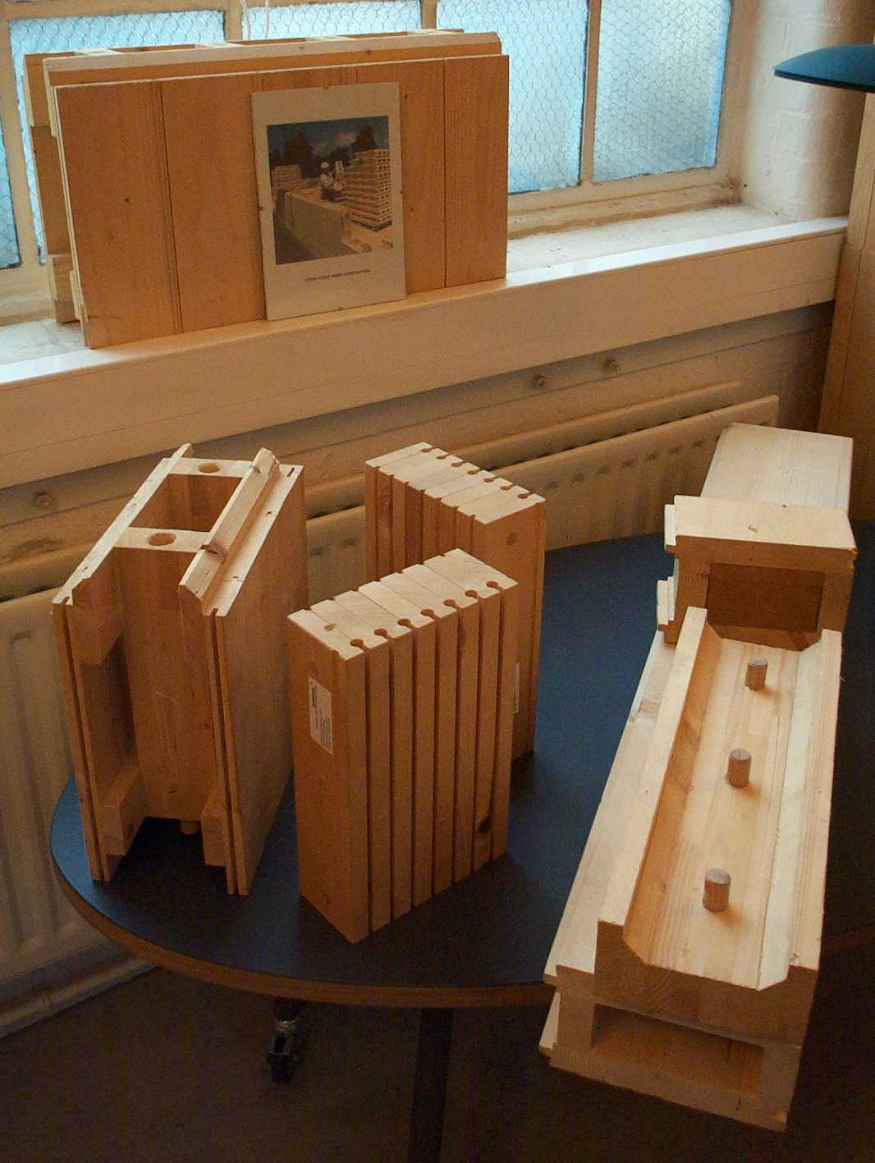
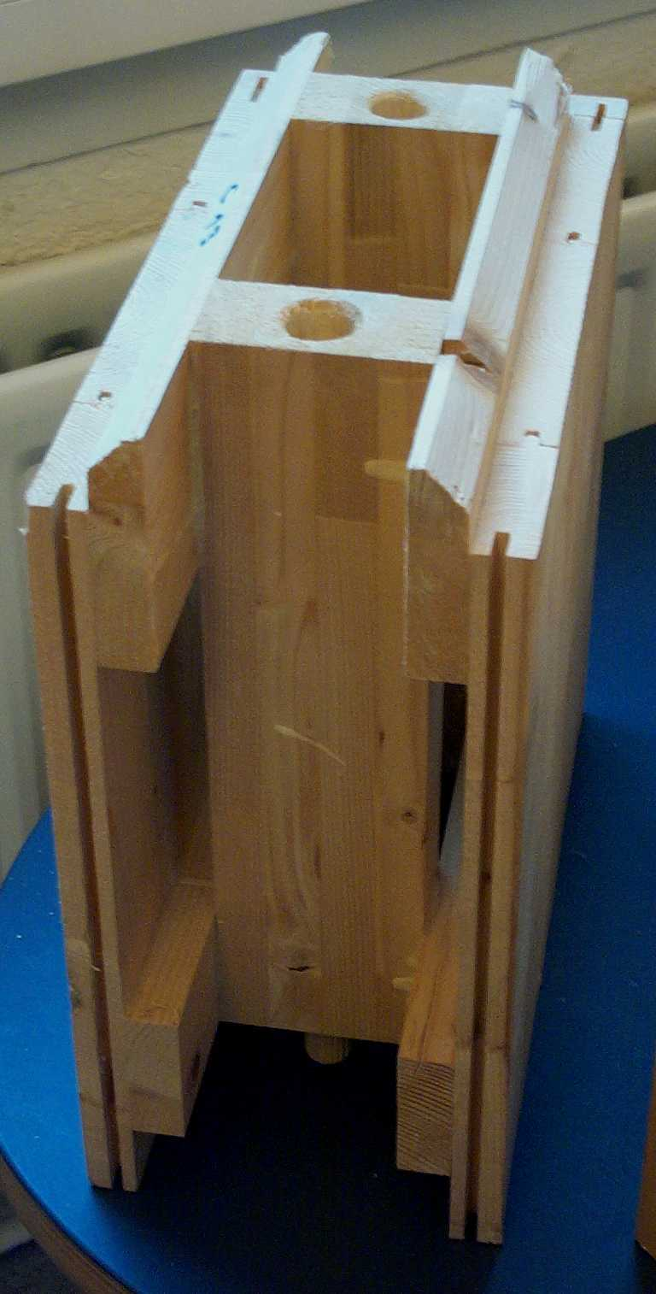
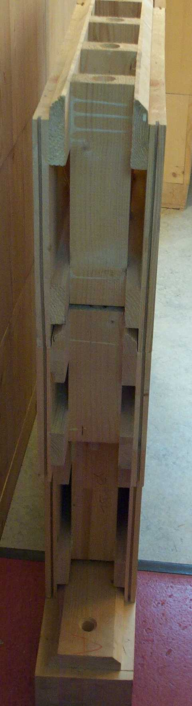
STEKO
Load-bearing timber blockwork
Construction Resources Showrooms Southwark London

Slide 38
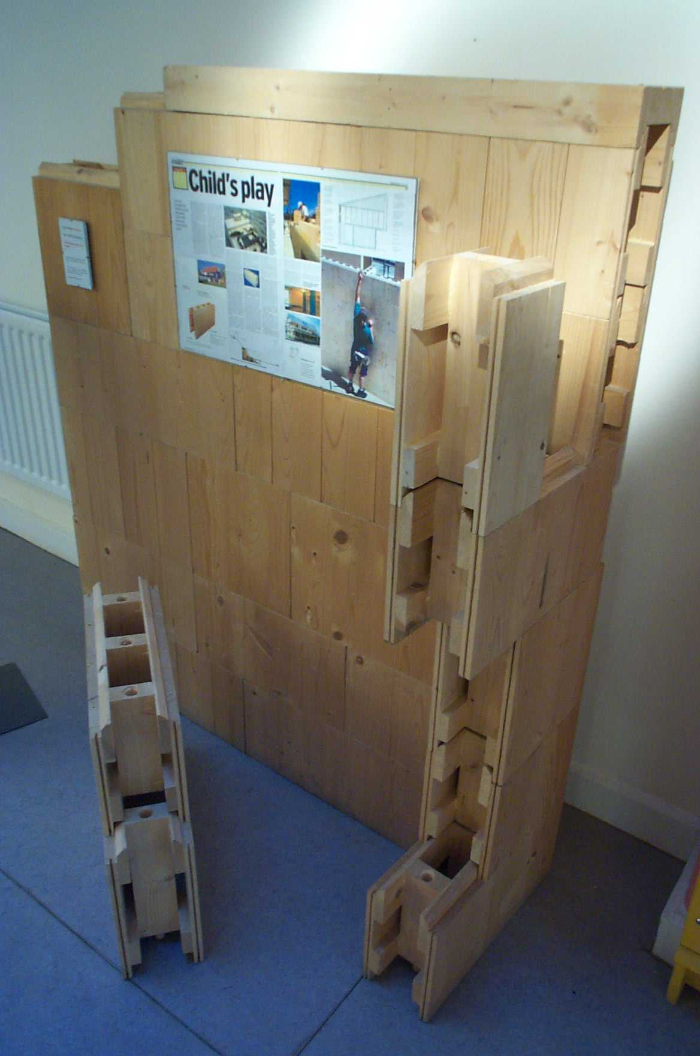
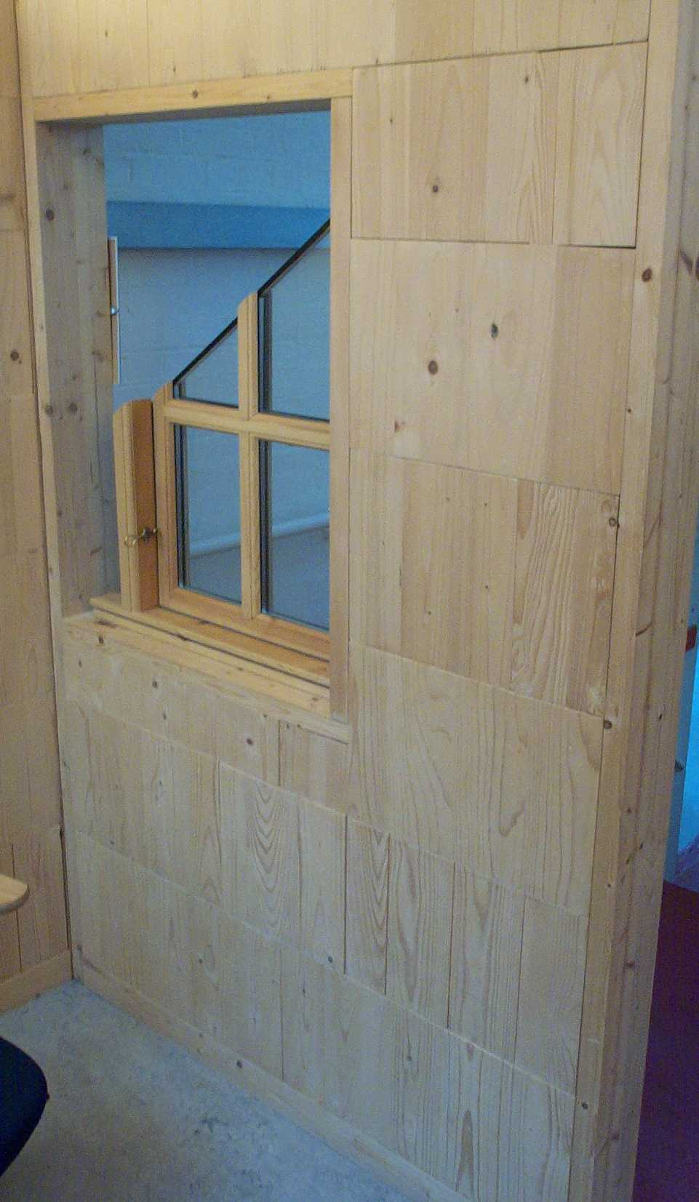
STEKO
Load-bearing timber blockwork

Slide 39
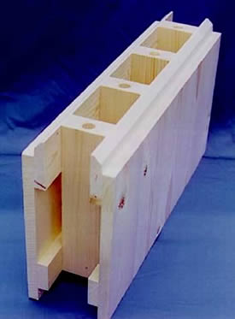
Steko “Lego for Self-builders”
Waste from plantation thinning
Carbon negative
  Carbon sequestration
Dry Construction
Self-build unskilled construction
Fast construction (3 day house)
No waste on site (designed)
Accommodates services
Accommodates thermal or acoustic insulation
Lightweight 6kg (children too)
Load-bearing (designed to 7 stories)
Internal and external walls
160 mm. modules

Slide 40
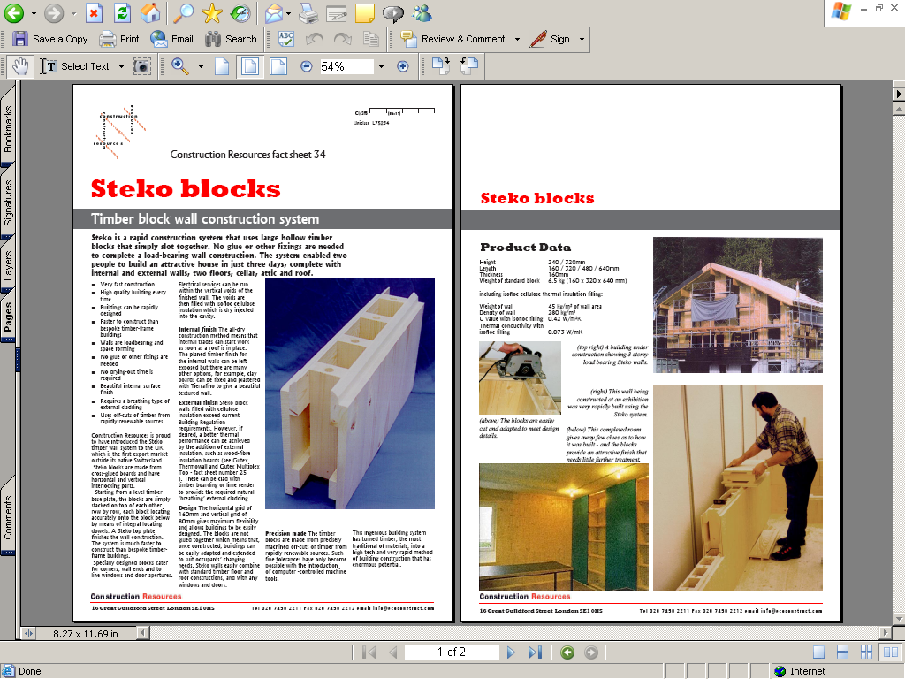

Slide 41
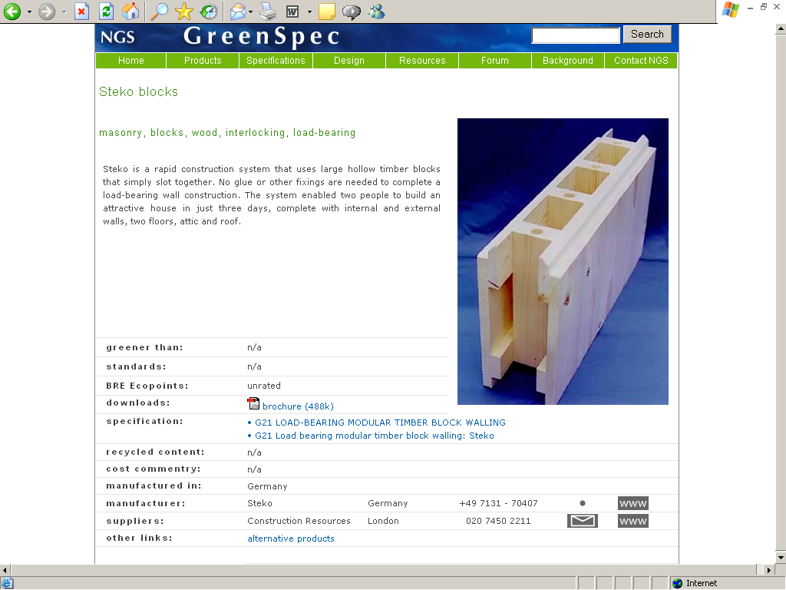

Slide 42
Cross Laminated Timber Panel (CLTP)
Low & High rise

Slide 43
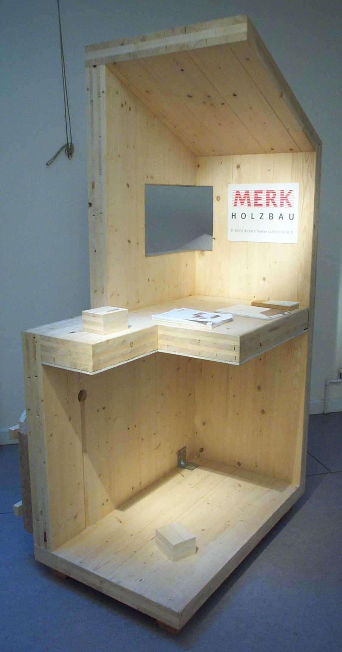
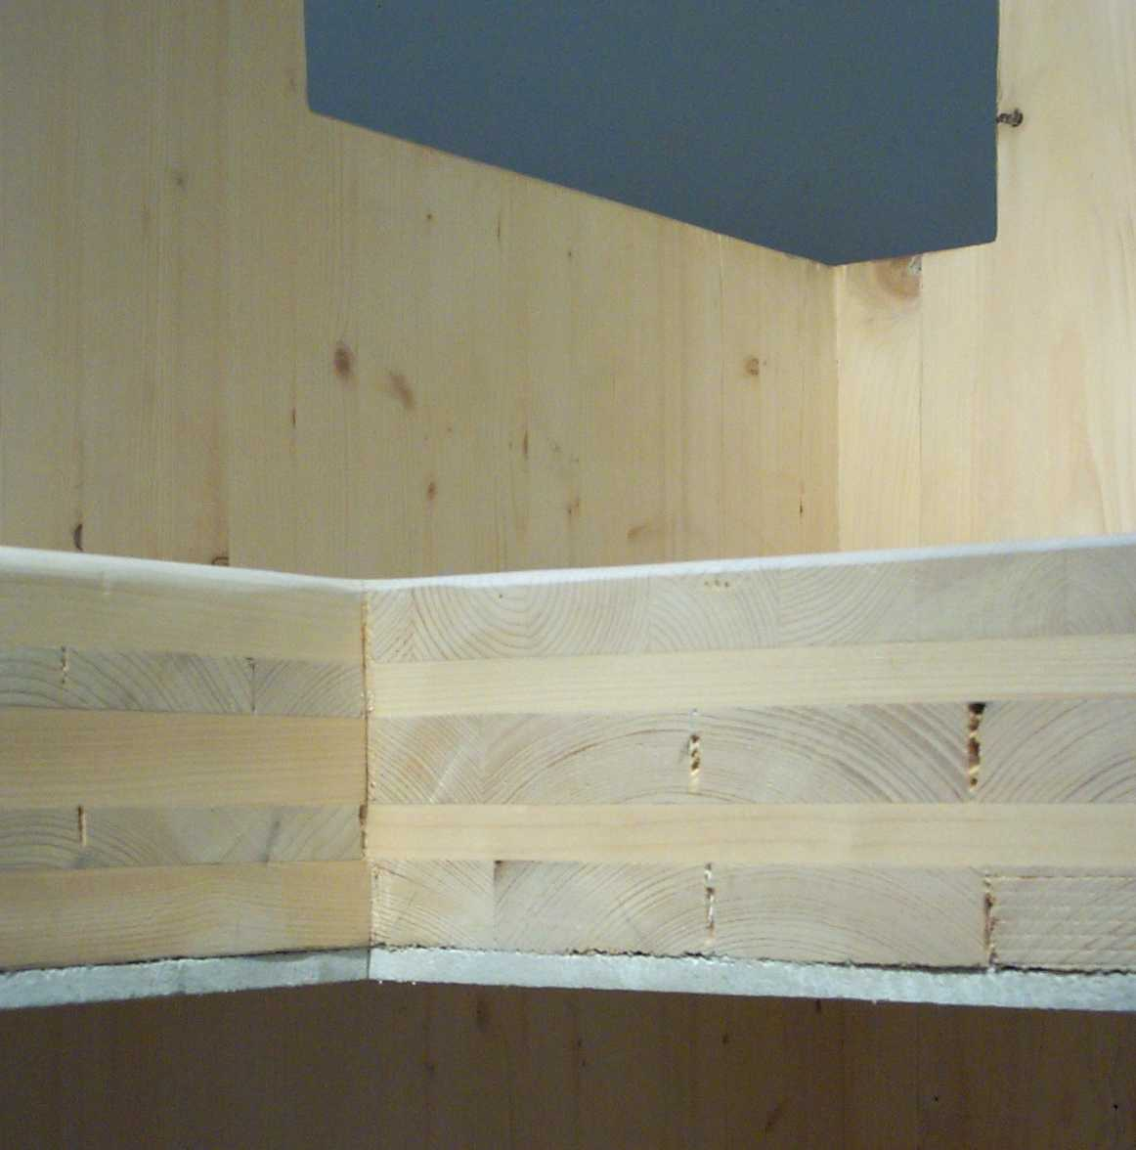
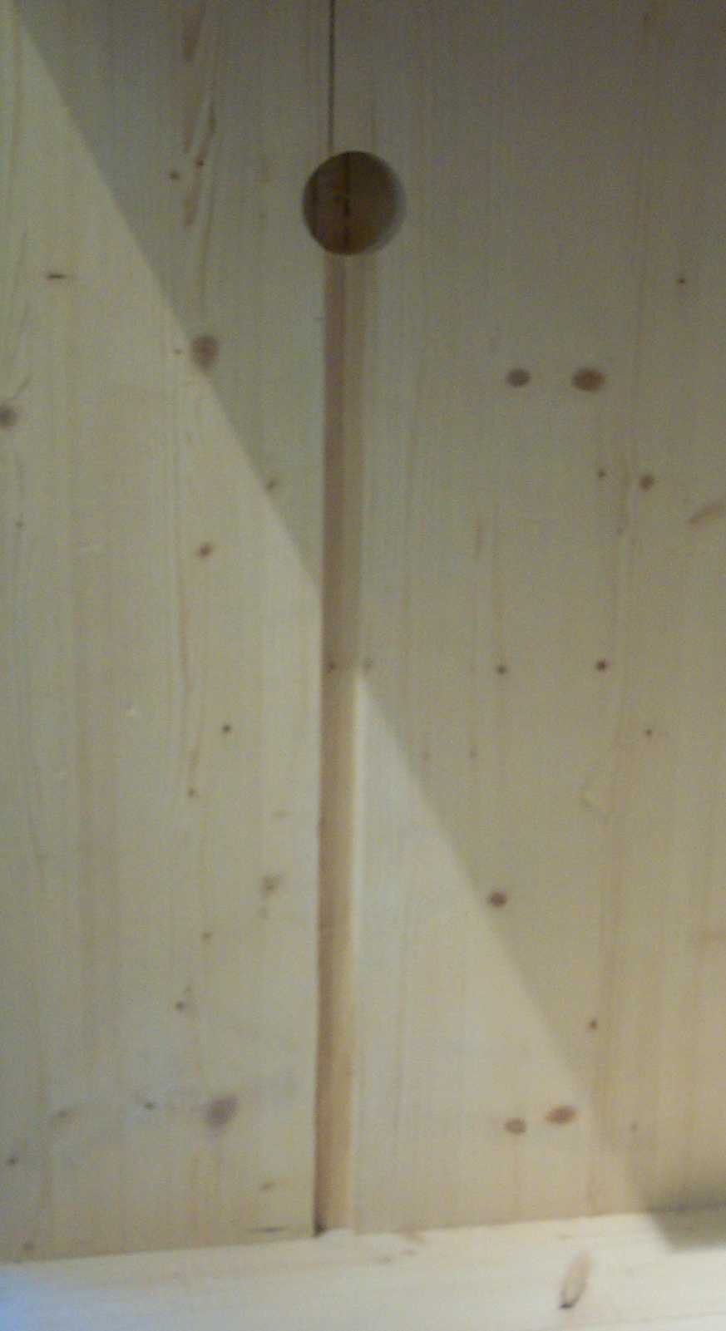
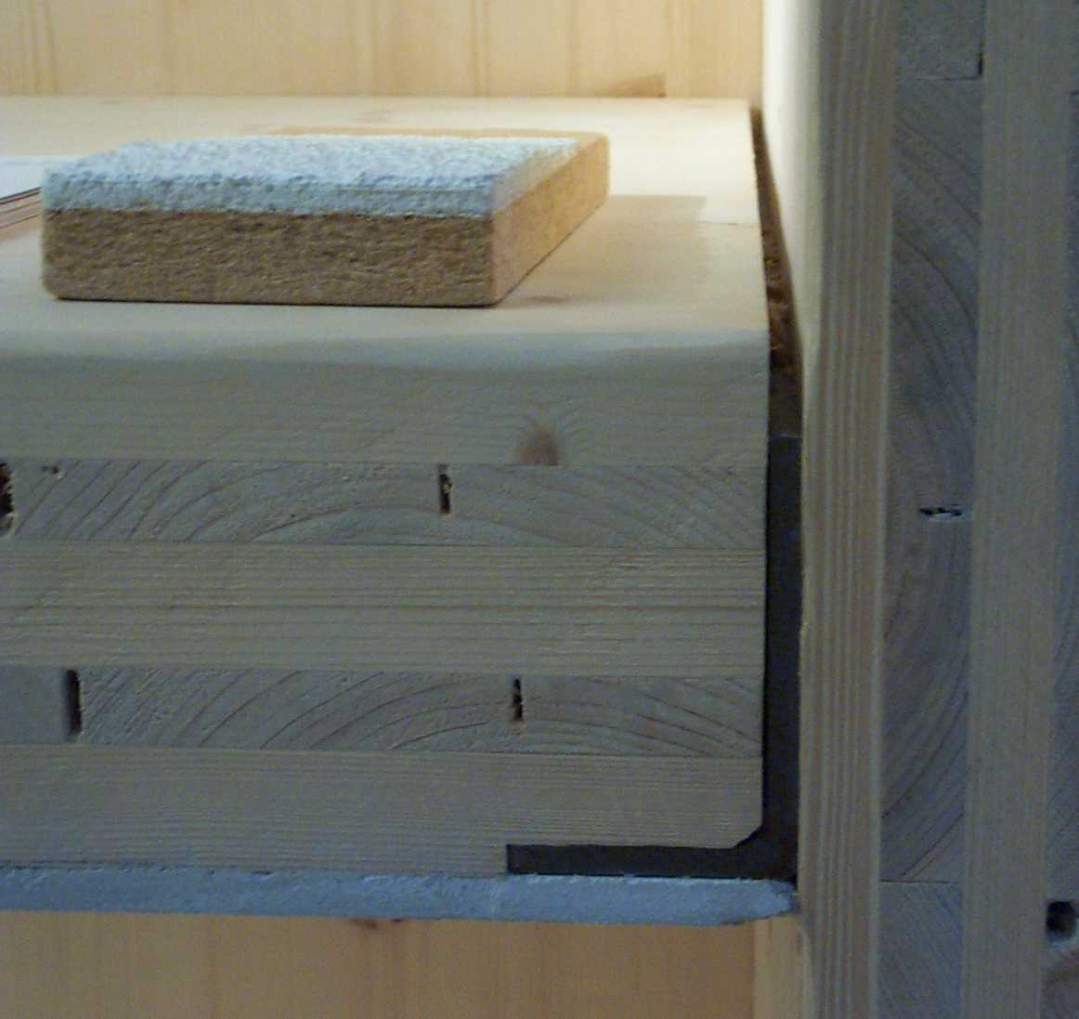
Cross Laminated timber
shear walls floors and roofs

Slide 44
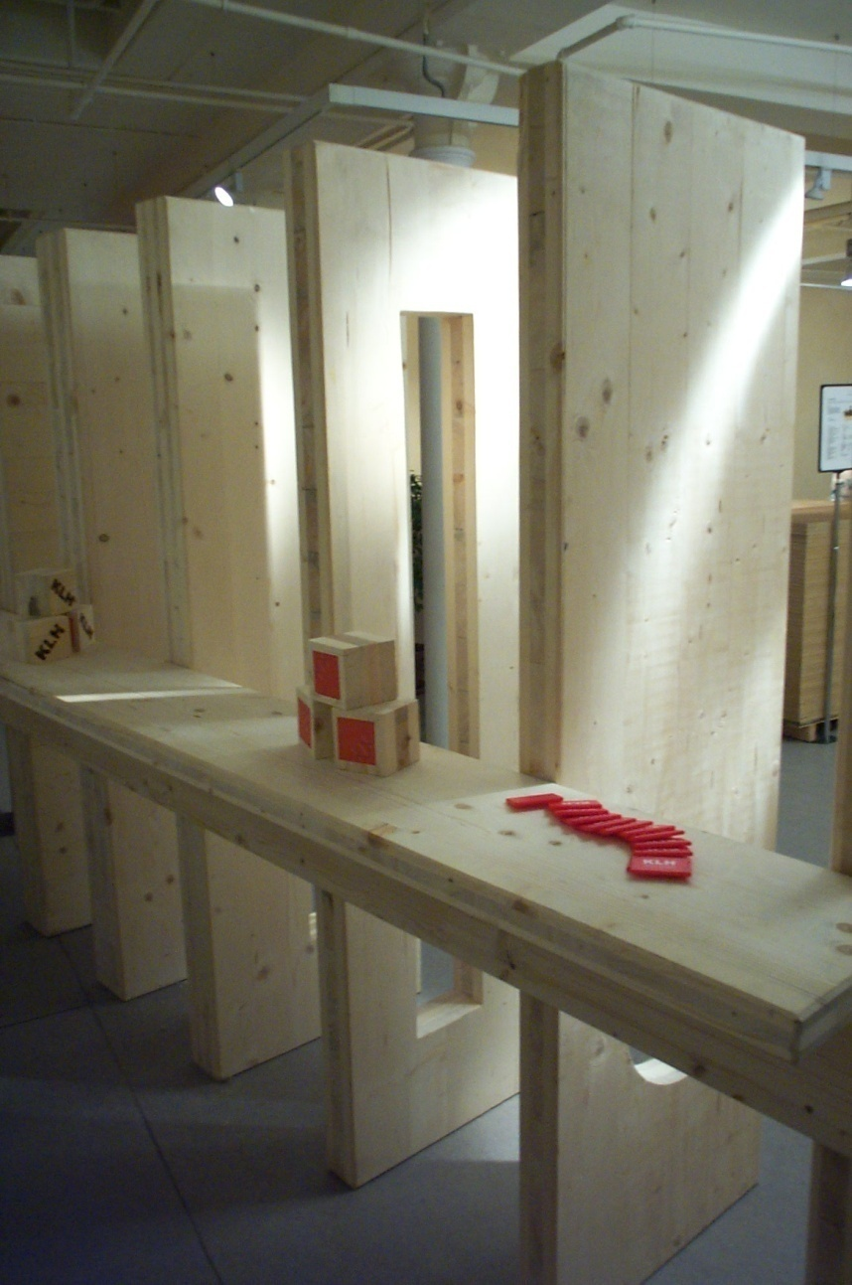
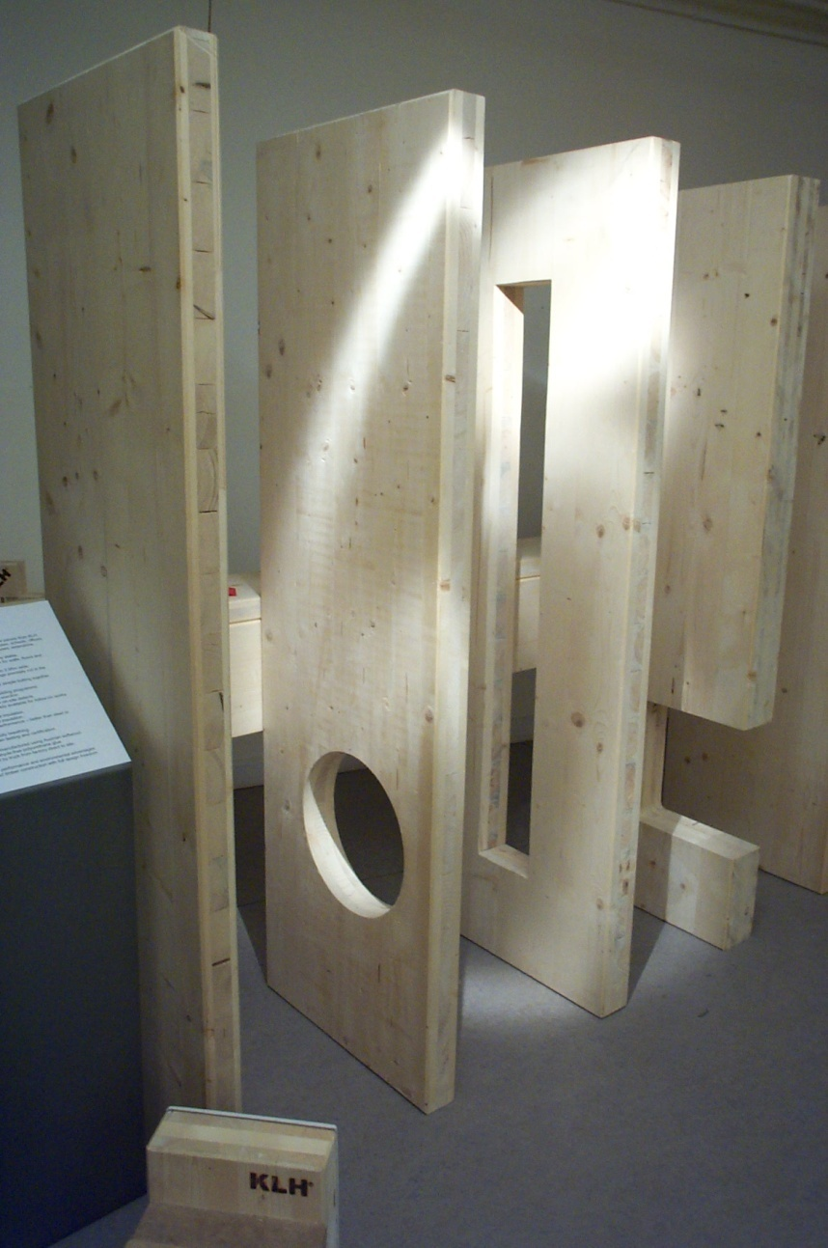
Cross Laminated timber
shear walls floors and roofs

Slide 45
Post Grenfell fire
Government Announced combustible materials no longer permitted in High rise Housing above 18m
2 Different interpretations
  Not in the external wall
    (replaced with LSF and Stone wool)
  Not at all
    Back to concrete
Sector challenging Government because timber and CLTP has predictable behaviour in fire
  Difficult to set CLTP alight
    Small sections easy
  Known charring rate thickness/minute
  Charring protects remainder of big sections

Slide 46
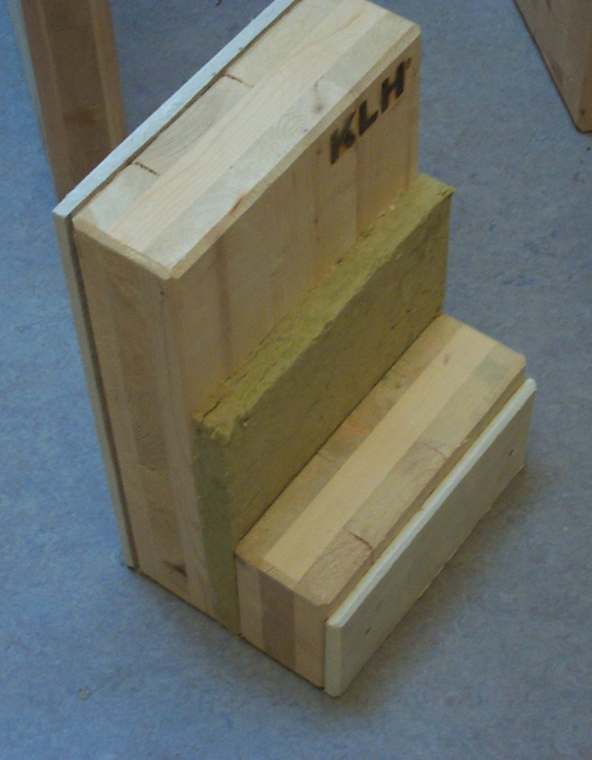
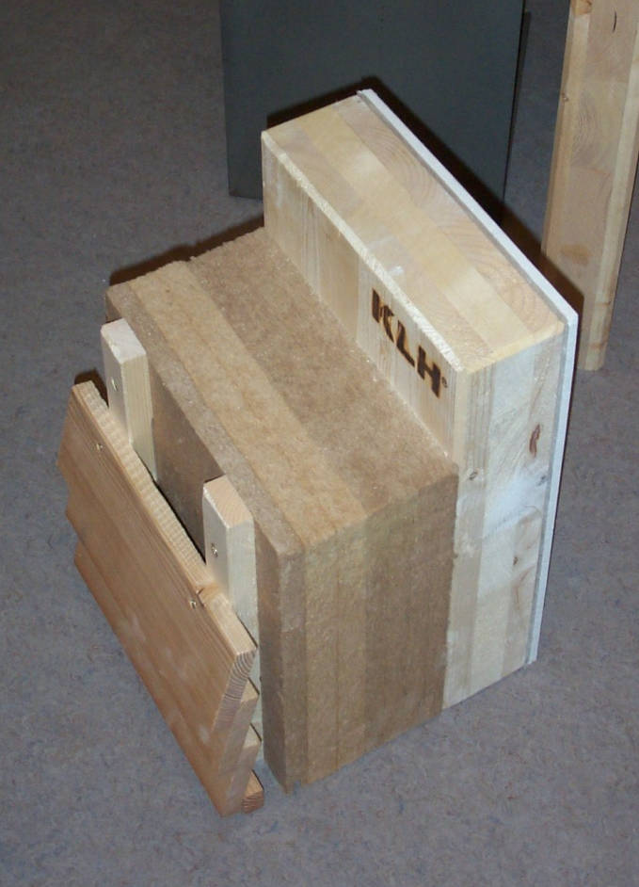
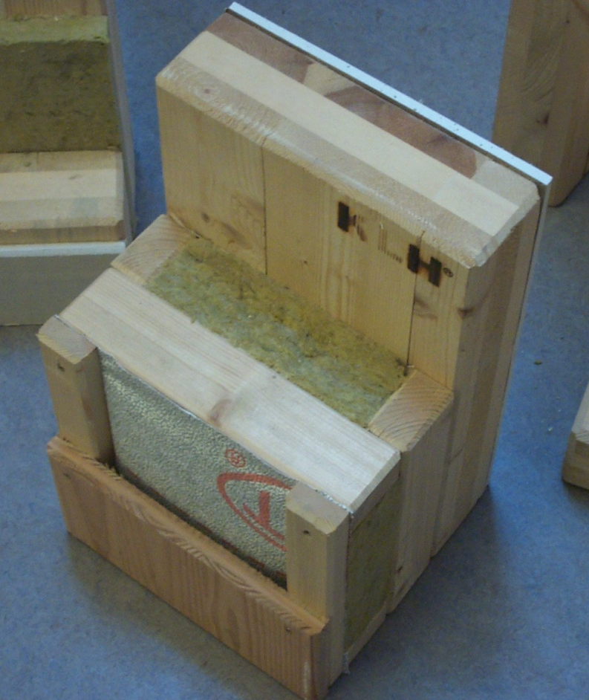
Cross Laminated timber walls

Slide 47
Post Grenfell fire
Government Announced combustible materials no longer permitted in High rise Housing above 18m
Stone wool e.g. Rockwool could be the only insulation player in the market (no more plastics)
I have challenged the dense wood fiber (DWF) insulation sector to do the tests to prove their insulation is up to the job of high rise housing
  Difficult to set DWF alight with blowtorch
  Some charring at surface
  Charring protects remainder of insulation
Expensive tests but informally Austrian manufacturers and UK suppliers progressing

Slide 48
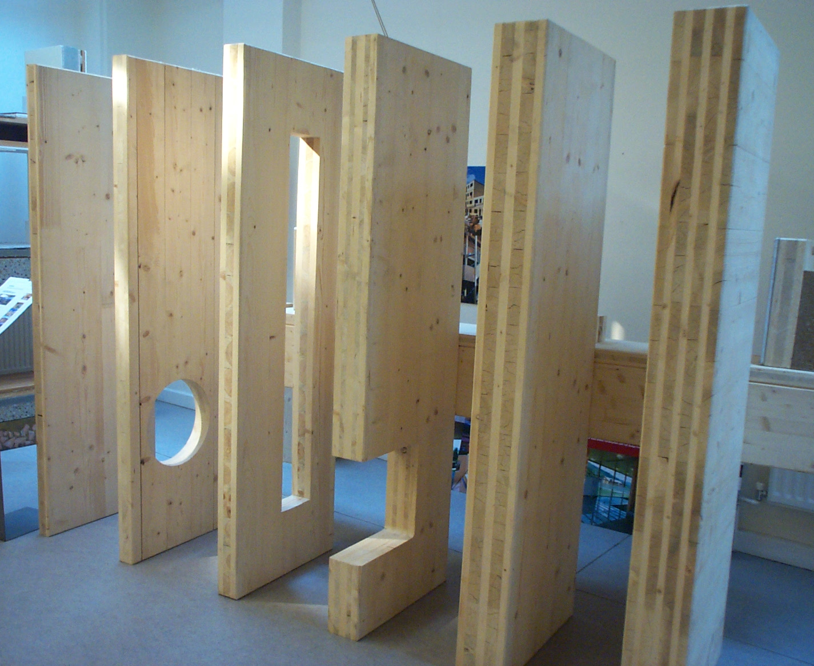
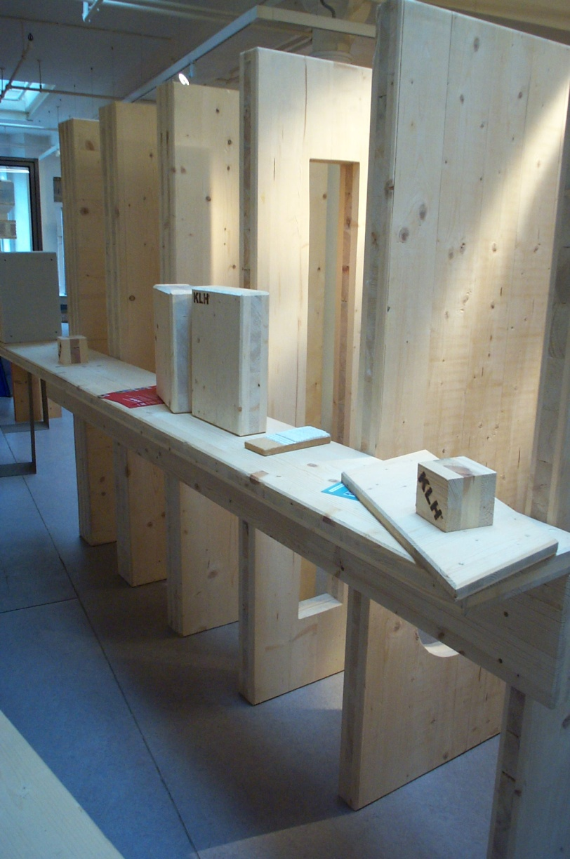
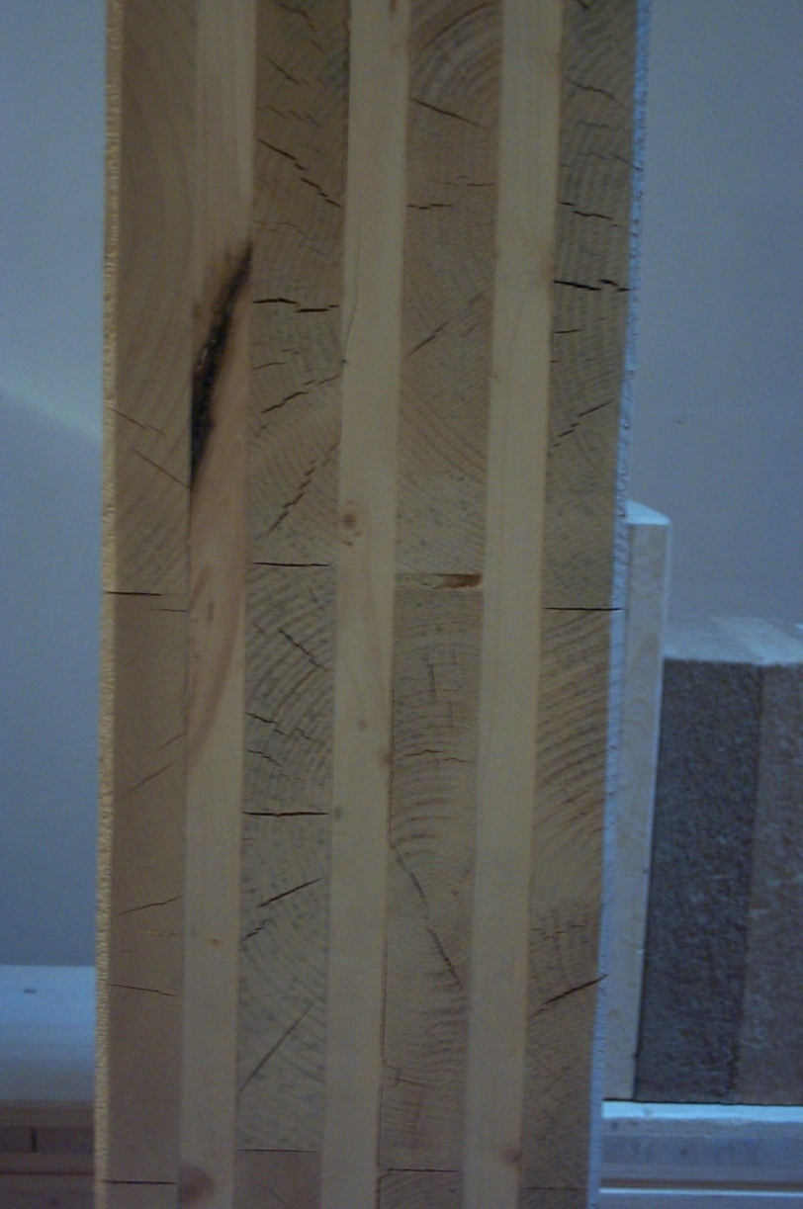
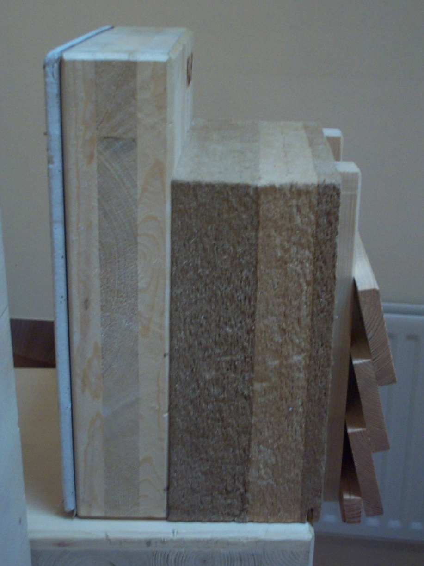
Cross Laminated timber shear walls

Slide 49
Green New Walls: Transparent

Slide 50
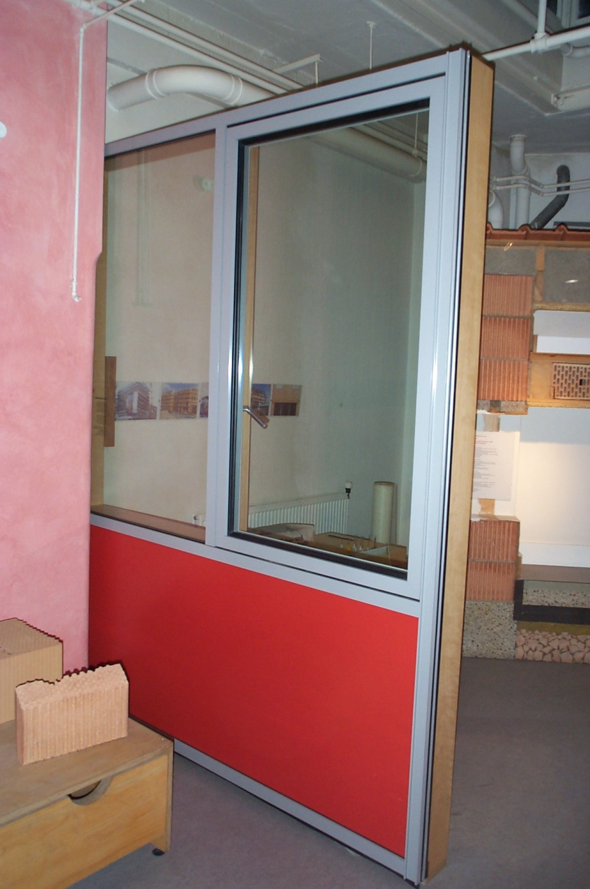
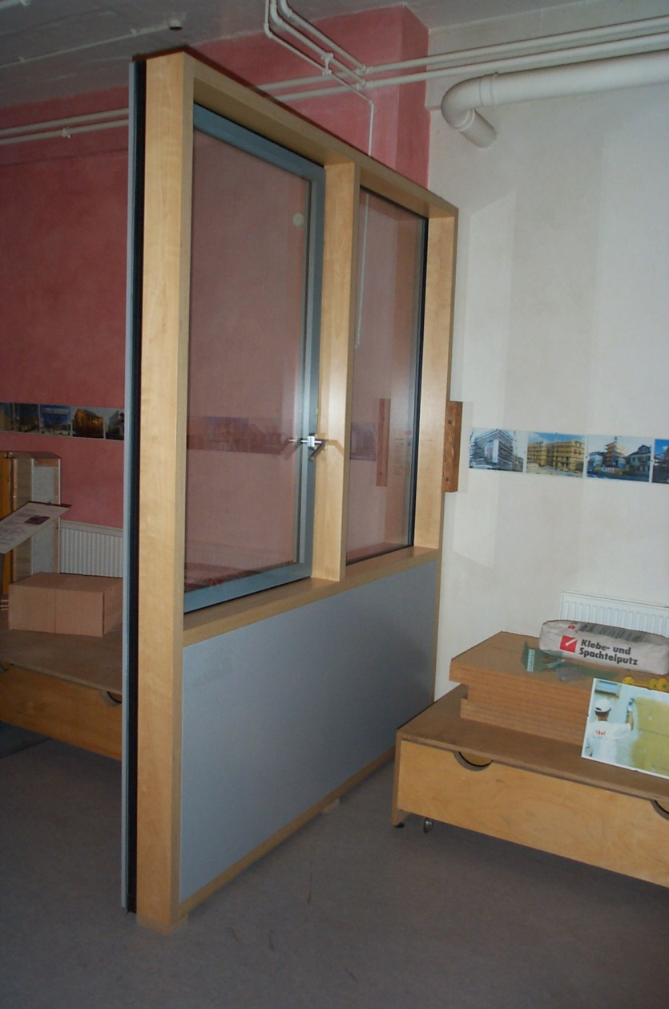
Timber Curtain Walling

Slide 51
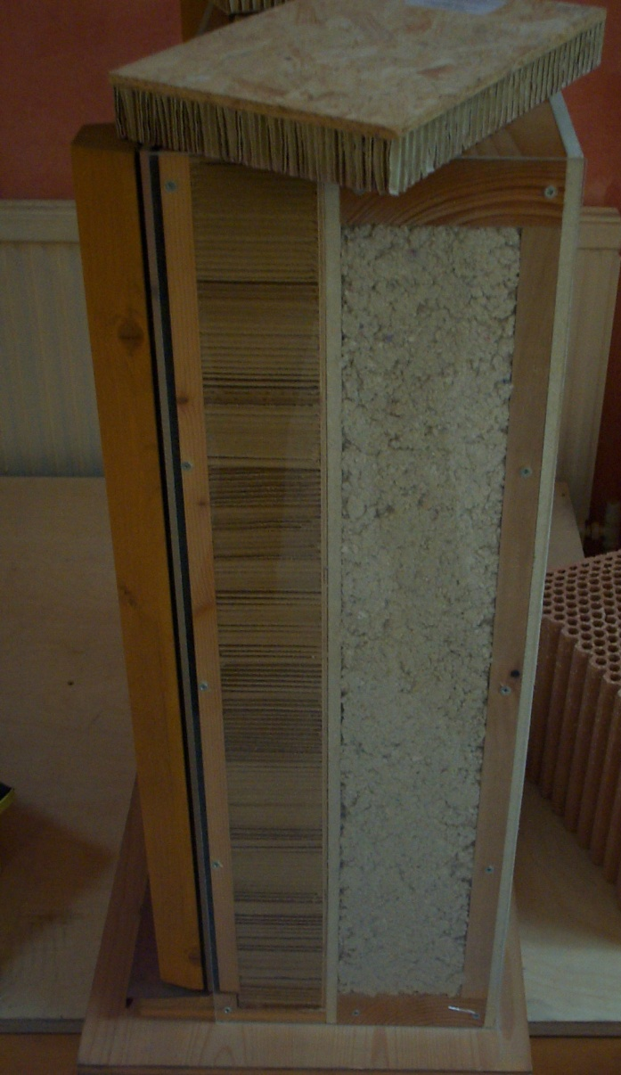
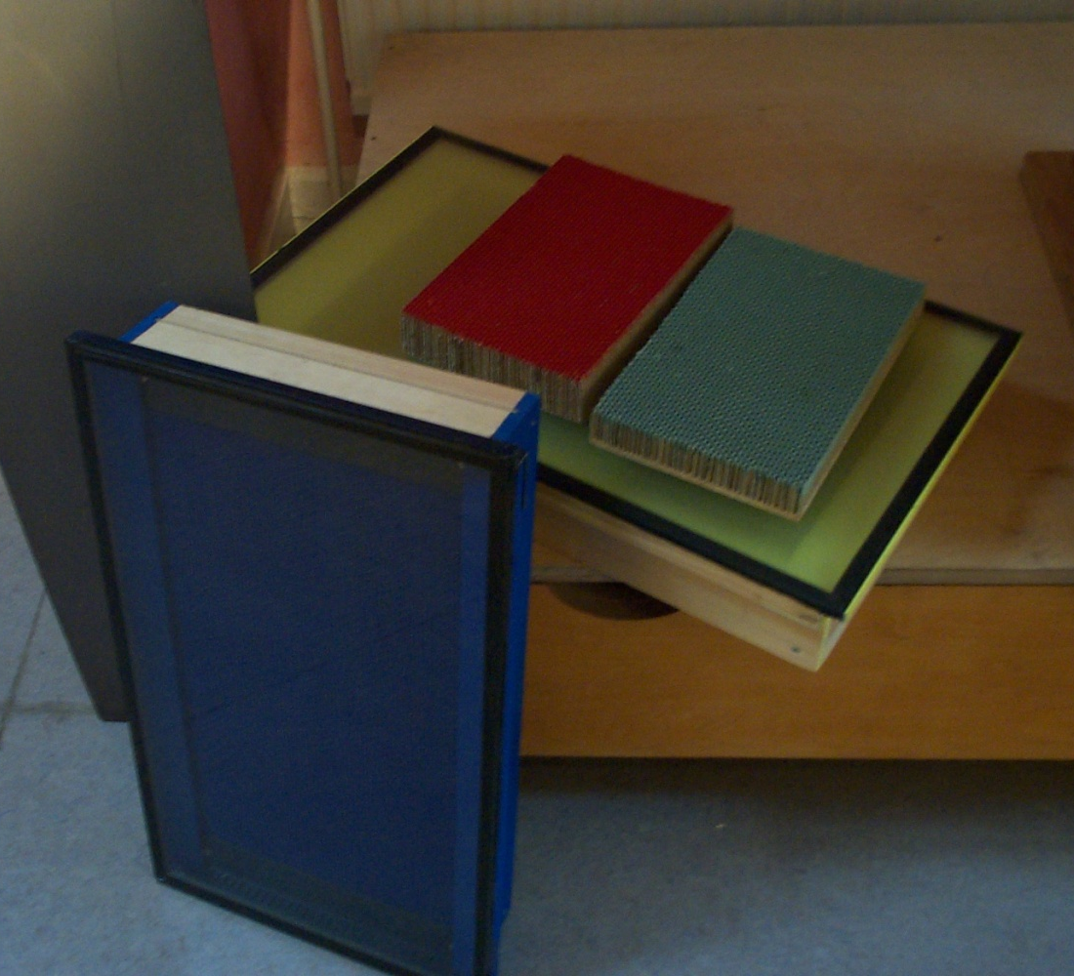
Solar Wall

Slide 52
Green
Wall Finishes

Slide 53
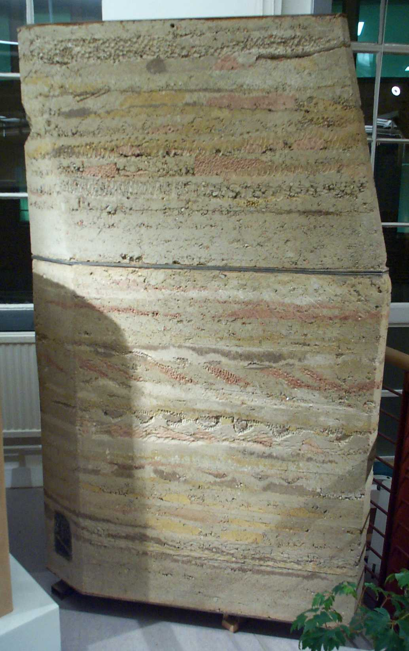
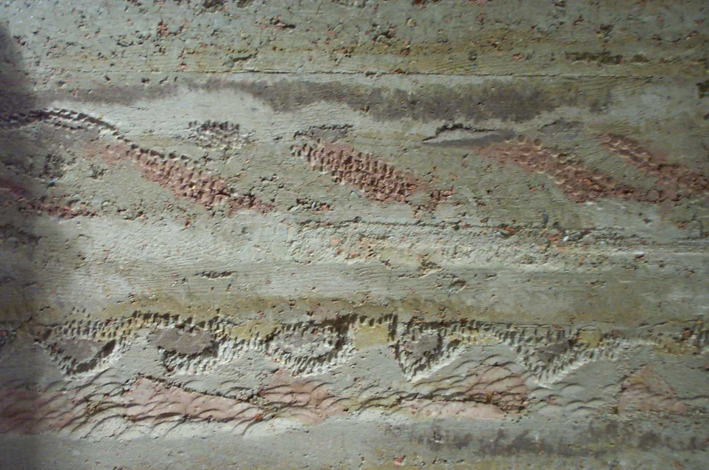
Rammed Earth Walls
any shape
many ingredients
colours & textures
thermal mass
Load-bearing
but dynamic

Slide 54
Rammed Earth Walls
Abundant and Natural
Recipe can be determined on site
Thermal, Acoustic & Moisture mass
Fire resistant
Load-bearing
Absorbs radiation, smells and moisture
Hygroscopic
Any shape
many ingredients, colours & textures
Sculptural & Artistic opportunities
Waste disposal back to earth
Recyclable & Reusable
Needs temporary formwork

Slide 55
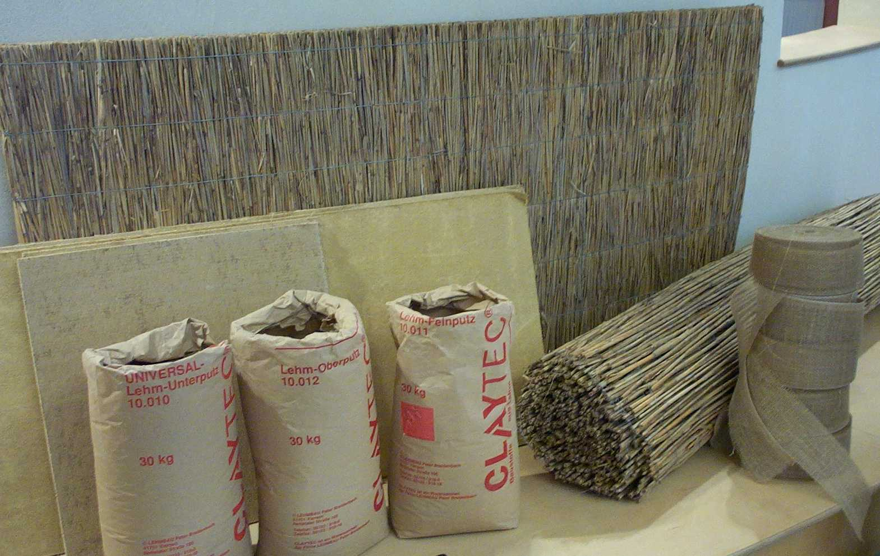
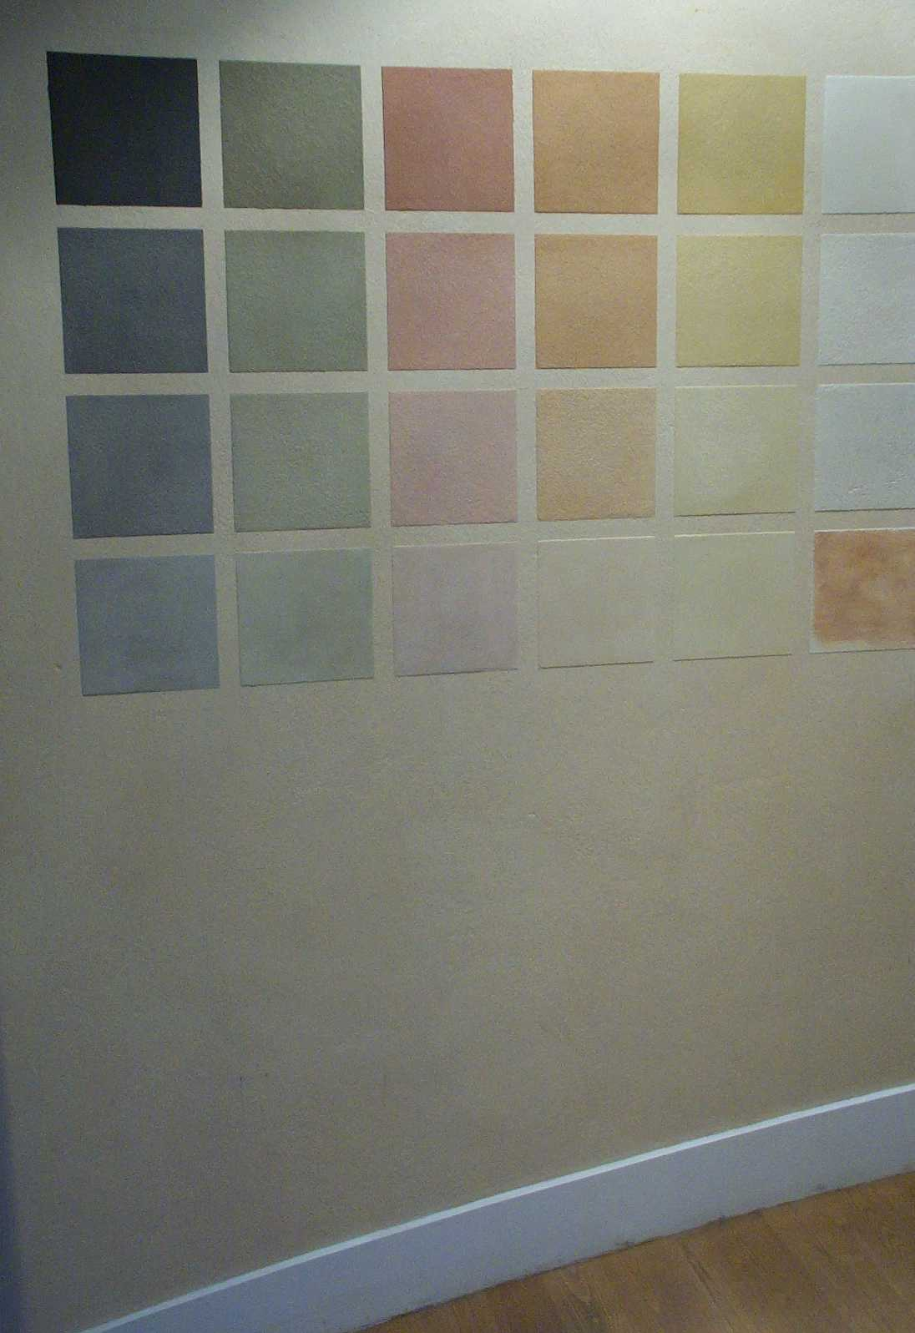
Clay boards & finishes
Clay Boards
Reed & Clay
Clay finishes
Construction Resources Showrooms Southwark London

Slide 56
Clay Finishes
Clay Boards: Reed & Clay,
Insitu clay on reed
Clay finish
Dry and harden but do not set
No time limits
Easy repairs
Less skill required
Construction Resources Showrooms Southwark London

Slide 57
Clay Finishes
Can sustain high humidity where gypsum/paper will harbour mould
  Hygroscopic
  Moisture Mass
  Condensation avoidance
  Mould avoidance
Thermal mass
  High density
  Large surface area
Electromagnetic radiation absorption
Absorbs smells
Construction Resources Showrooms Southwark London

Slide 58
Clay finishes
Mineral based dies
Non-fade
Bond to background
No flaking
Long life
Durable
Properties of clay plaster
Vapour permeable
Construction Resources Showrooms Southwark London

Slide 59
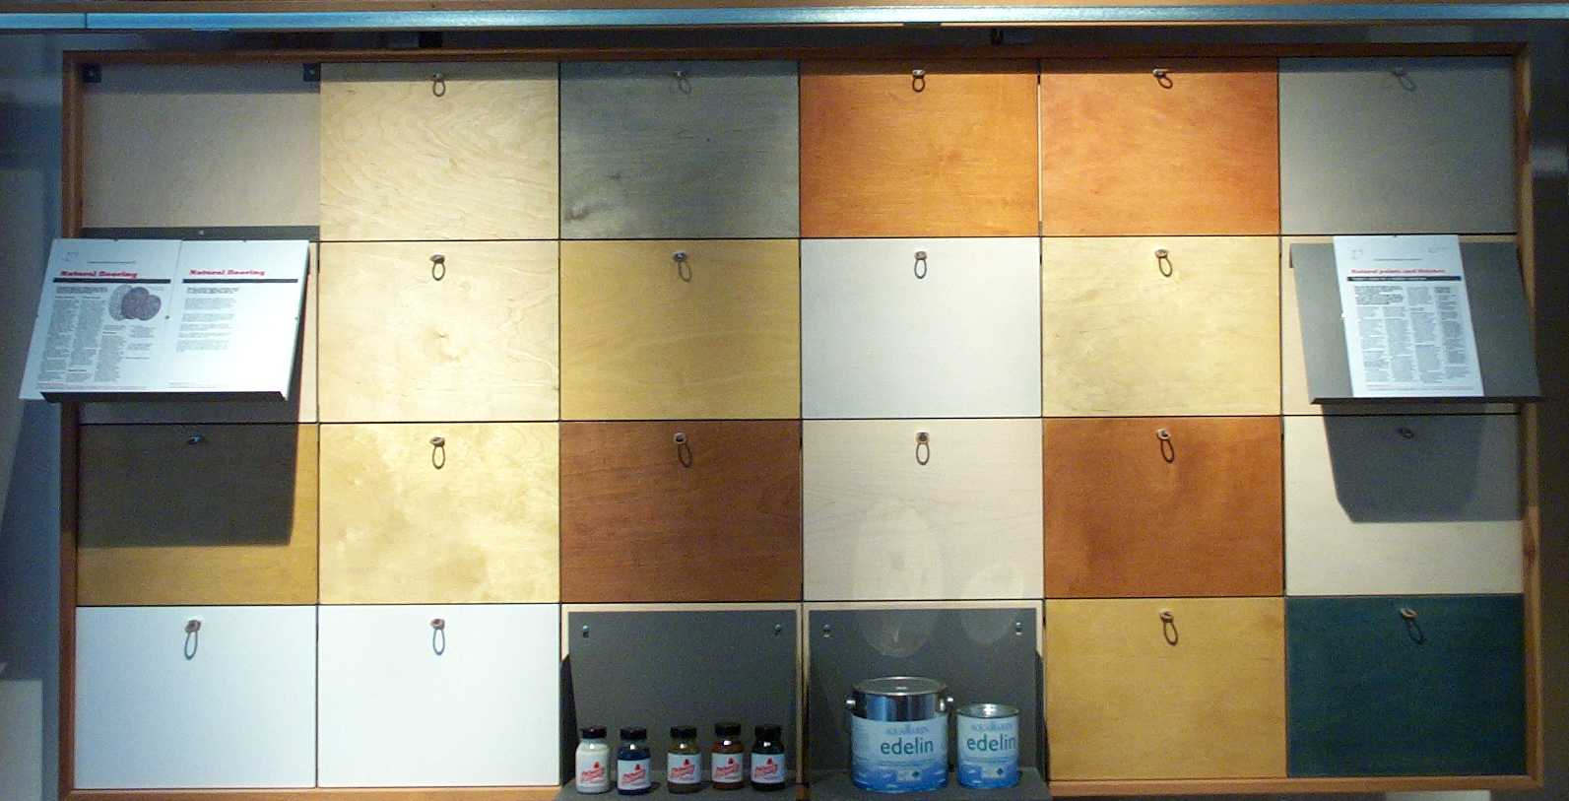
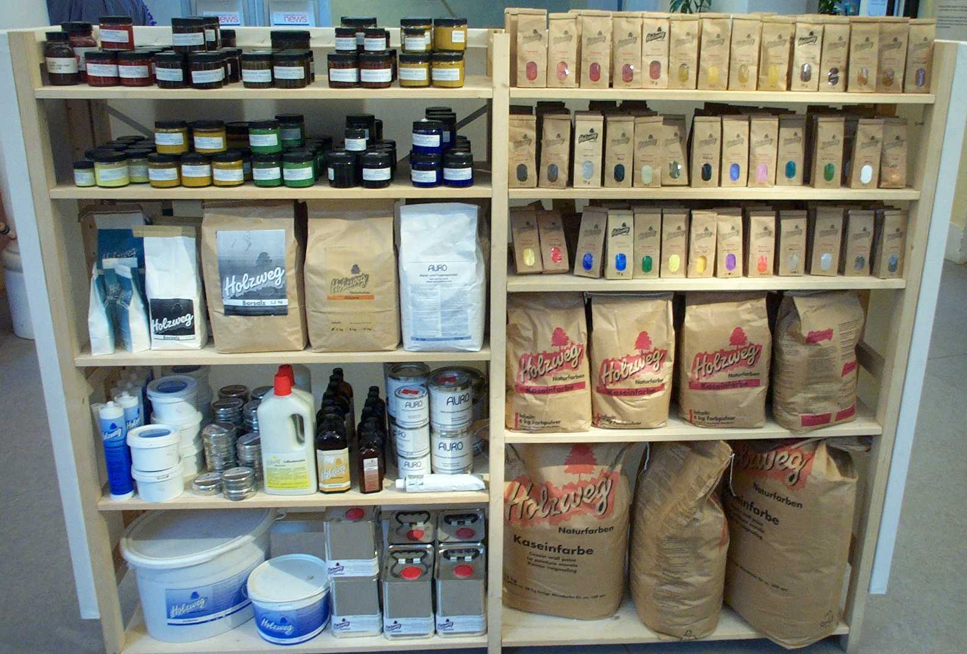
Paints & Stains
Natural
ingredient
Paints
Stains
Oils
Waxes
Polishes
Sealers
Construction Resources Showrooms Southwark London

Slide 60
Natural Paints
No synthetics
  VOCs if any are natural
No poisons
No chemical concoctions
  No unexplored impacts or reactions
No pollutants
  Healthy career possible
No Hazardous waste
  Many compostable

Slide 61
Green Acoustic Construction

Slide 62
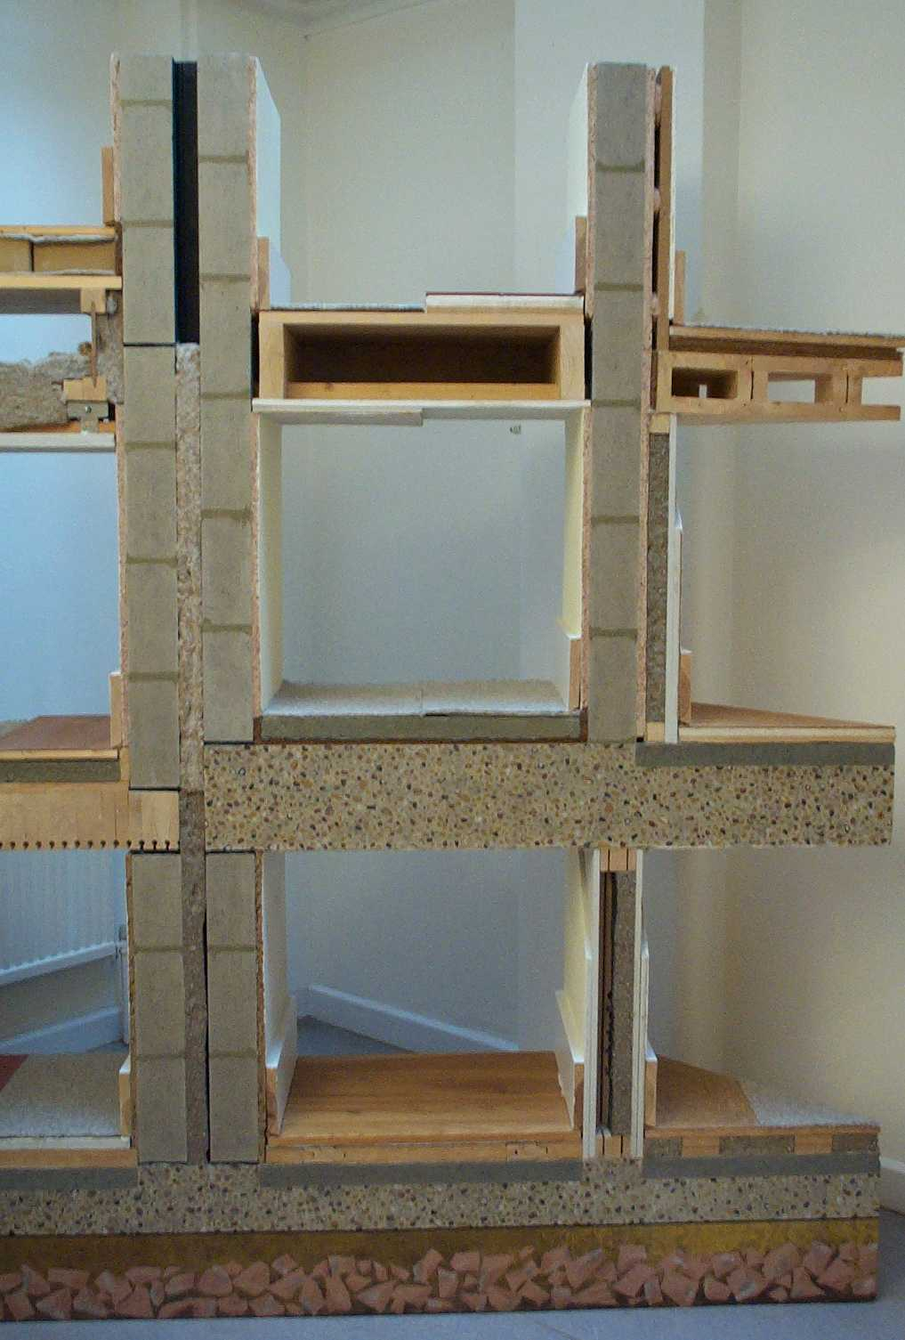
Different
Acoustic solutions to walls and floors
Cavity and solid walls and lightweight partitions

Slide 63
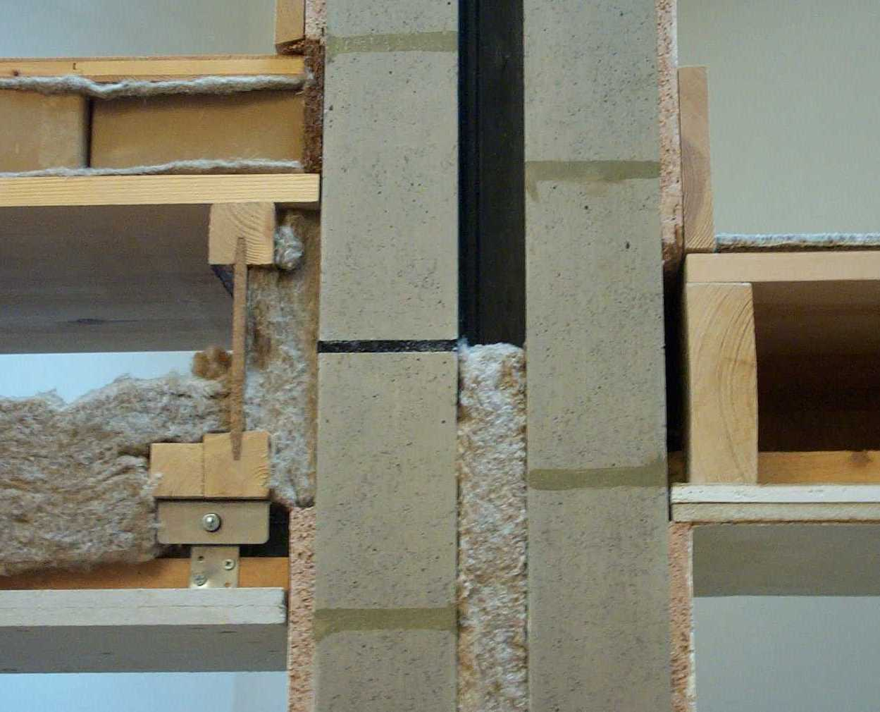
Acoustic Separating Floor
Floor board/Sheet
Isolation felt
Acoustic massive unfired clay bricks laid loose
Perimeter coconut fibre upstand
Isolation felt
Floor deck/sheet
I-Joist stiff floor structure
Acoustic insulation in void
Acoustic insulation at floor edge
Isolation suspension fixing
Dense Cellulose fibre reinforced gypsum board ceiling

Slide 64
Acoustic Party Wall
Blockwork cavity wall
Isolation rubber strip in place of mortar positioned mid floor depth to minimise flanking sound
Airtight plaster on both faces of room walls
Acoustic insulation in party wall cavity, extends into floor zone

Slide 65
Acoustic Intermediate Floor
Carpet
Cork/rubber crumb or wood fibre sheet acoustic underlayment
Or Rubber sheet
Floor board/Sheet
Softwood joists
Close to party wall but spaced off with wedges
Noggins to support ceiling joints
2 layers dense cellulose fibre reinforced gypsum board ceiling

Slide 66
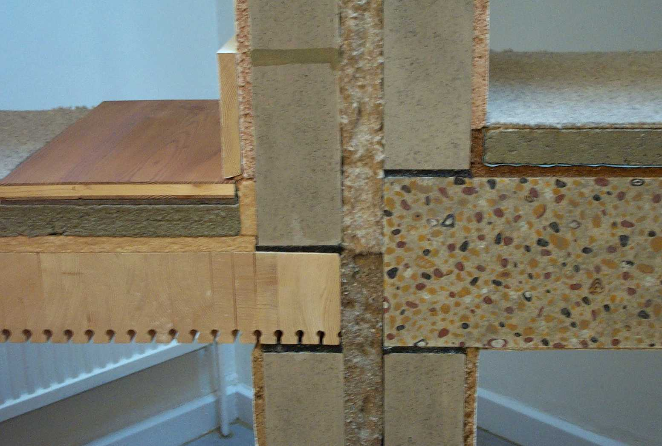
Intermediate Floor
Veneered timber panel floor boarding
wood fibre sheet acoustic underlay
wood fibre board acoustic/thermal insulation
wood fibre sheet acoustic underlayment and upstand
Stacked wood floor with acoustic absorbent slotted soffit
Isolation rubber strip in place of mortar positioned below and above solid timber floor to minimise vibrations transfer from floor to wall and minimise flanking sound

Slide 67
Intermediate Wall
Blockwork cavity wall
Isolation rubber strip in place of mortar positioned below and above solid timber and insitu concrete floors to minimise vibrations transfer from floor to wall and minimise flanking sound
Insulation in cavity to minimise flanking sound

Slide 68
Intermediate Floor
Carpet
Screed could contain recycled aggregates and GGBS cement
Damp and vapour proof membrane
coconut fibre sheet acoustic underlayment and upstand
Insitu concrete floor with fairfaced soffit exposing thermal mass
Isolation rubber strip in place of mortar positioned below and above insitu concrete floor to minimise vibrations transfer from floor to wall and minimise flanking sound

Slide 69
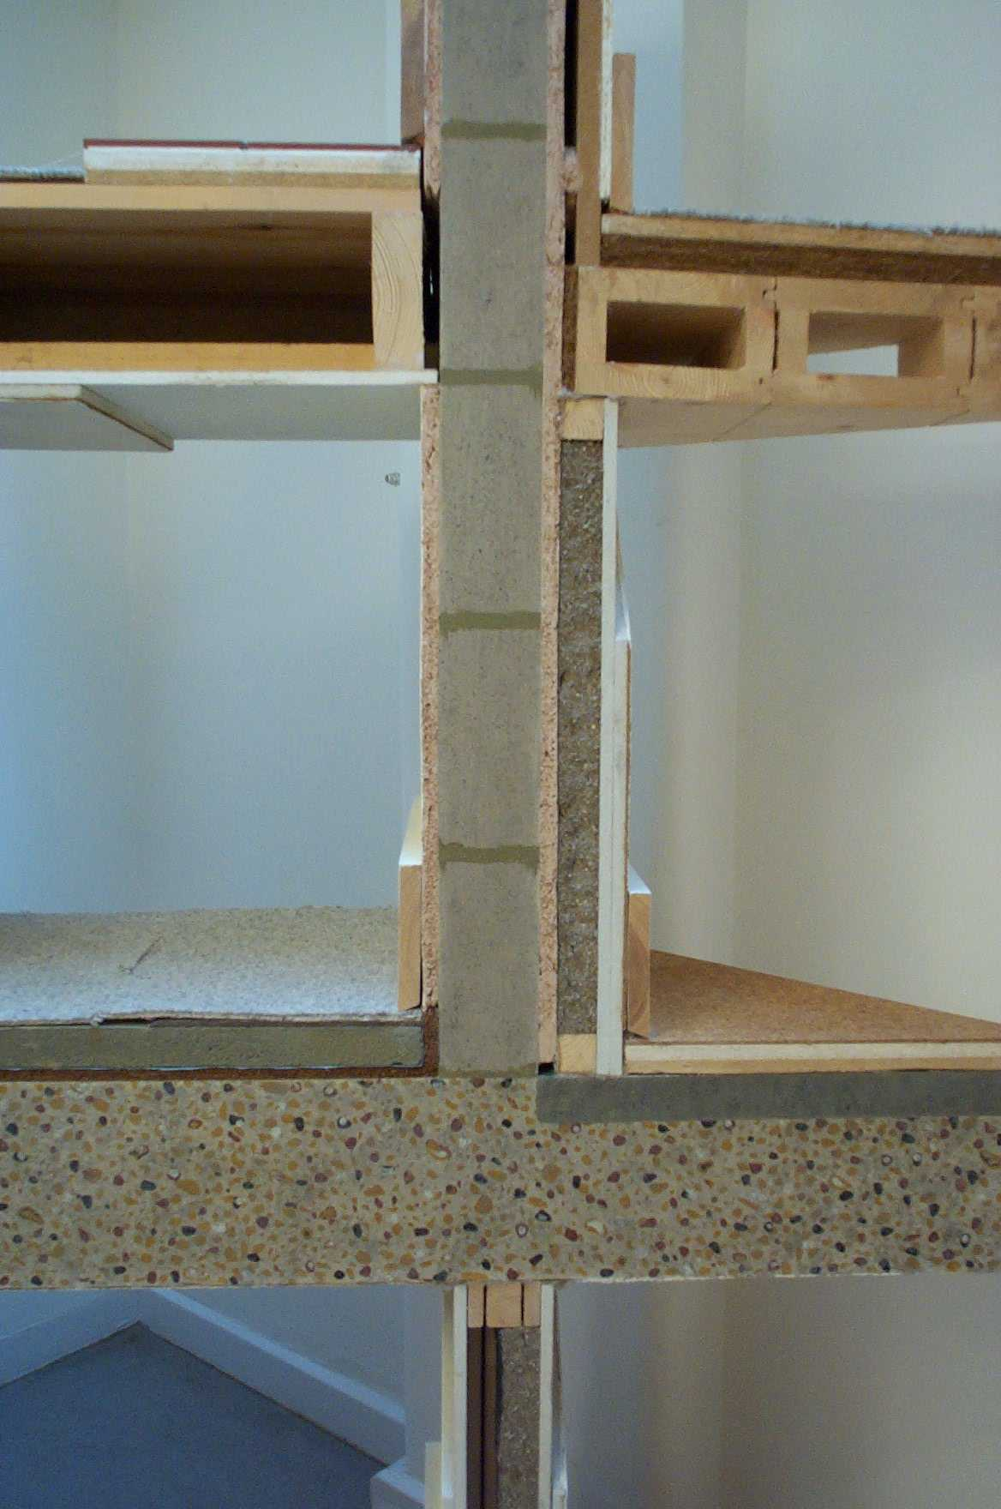
Acoustic Intermediate Floor
Ceramic floor tiles
2 layers of underlayment
Floor board/Sheet
Softwood joists
Close to party wall but spaced off with wedges
Noggins to support ceiling board joints
2 layers dense cellulose fibre reinforced gypsum board ceiling

Slide 70
Acoustic Internal partition
Single leaf blockwork
Plastered & Skirting
Parge coated for airtightness
Dense wood fibre board drylined on dabs
Plaster skim & Skirting
Battens acoustic insulation between
Dense cellulose fibre reinforced gypsum board

Slide 71
Acoustic Intermediate Floor
Carpet
Underlayment
Floating Floor board/Sheet
Acoustic insulation
interlocking Hollow timber beam floor
Acoustic insulation at wall abutment
Exposed soffit

Slide 72
Acoustic Suspended Floor
Carpet
Screed could contain recycled aggregates and GGBS cement
Damp and vapour proof membrane
coconut fibre sheet acoustic underlayment and upstand
Insitu concrete floor with fairfaced soffit

Slide 73
Acoustic Partition (below)
Multi layered timber framing acoustic isolation
dense cellulose fibre acoustic insulation between battens
dense cellulose fibre reinforced gypsum board

Slide 74
Acoustic Suspended Floor
Carpet
2 layers of underlayment dense cellulose fibre reinforced gypsum board
Monolithic topping could contain recycled aggregates and GGBS cement
Insitu concrete floor with fairfaced soffit
Acoustic bridge through partition

Slide 75
Victorian Building
Green Energy Upgrade

Slide 76
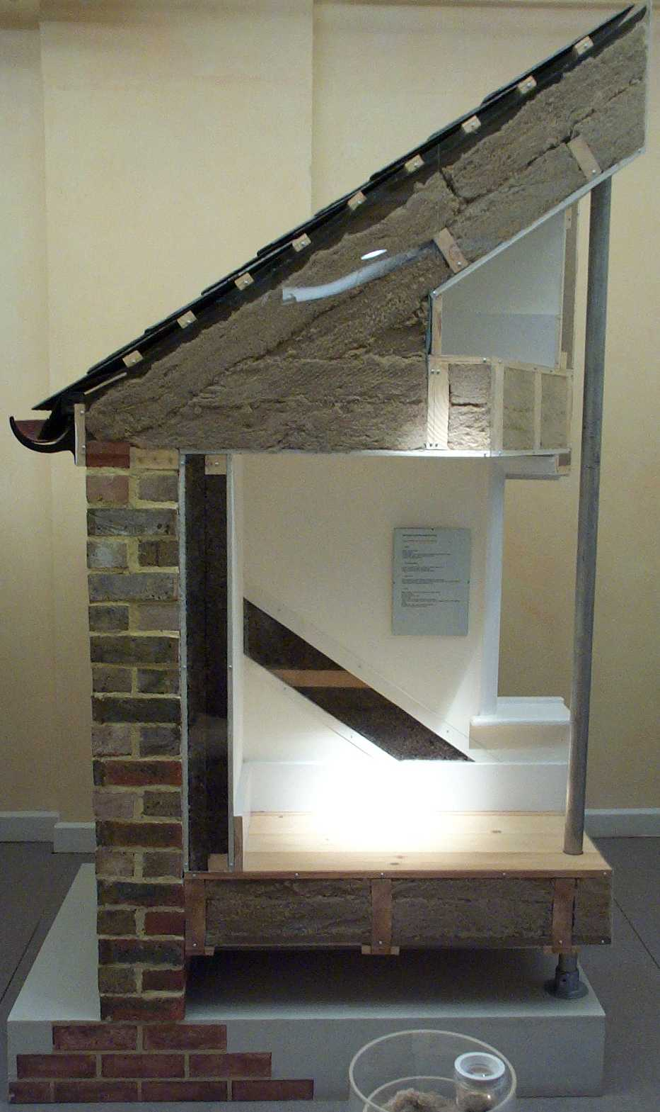
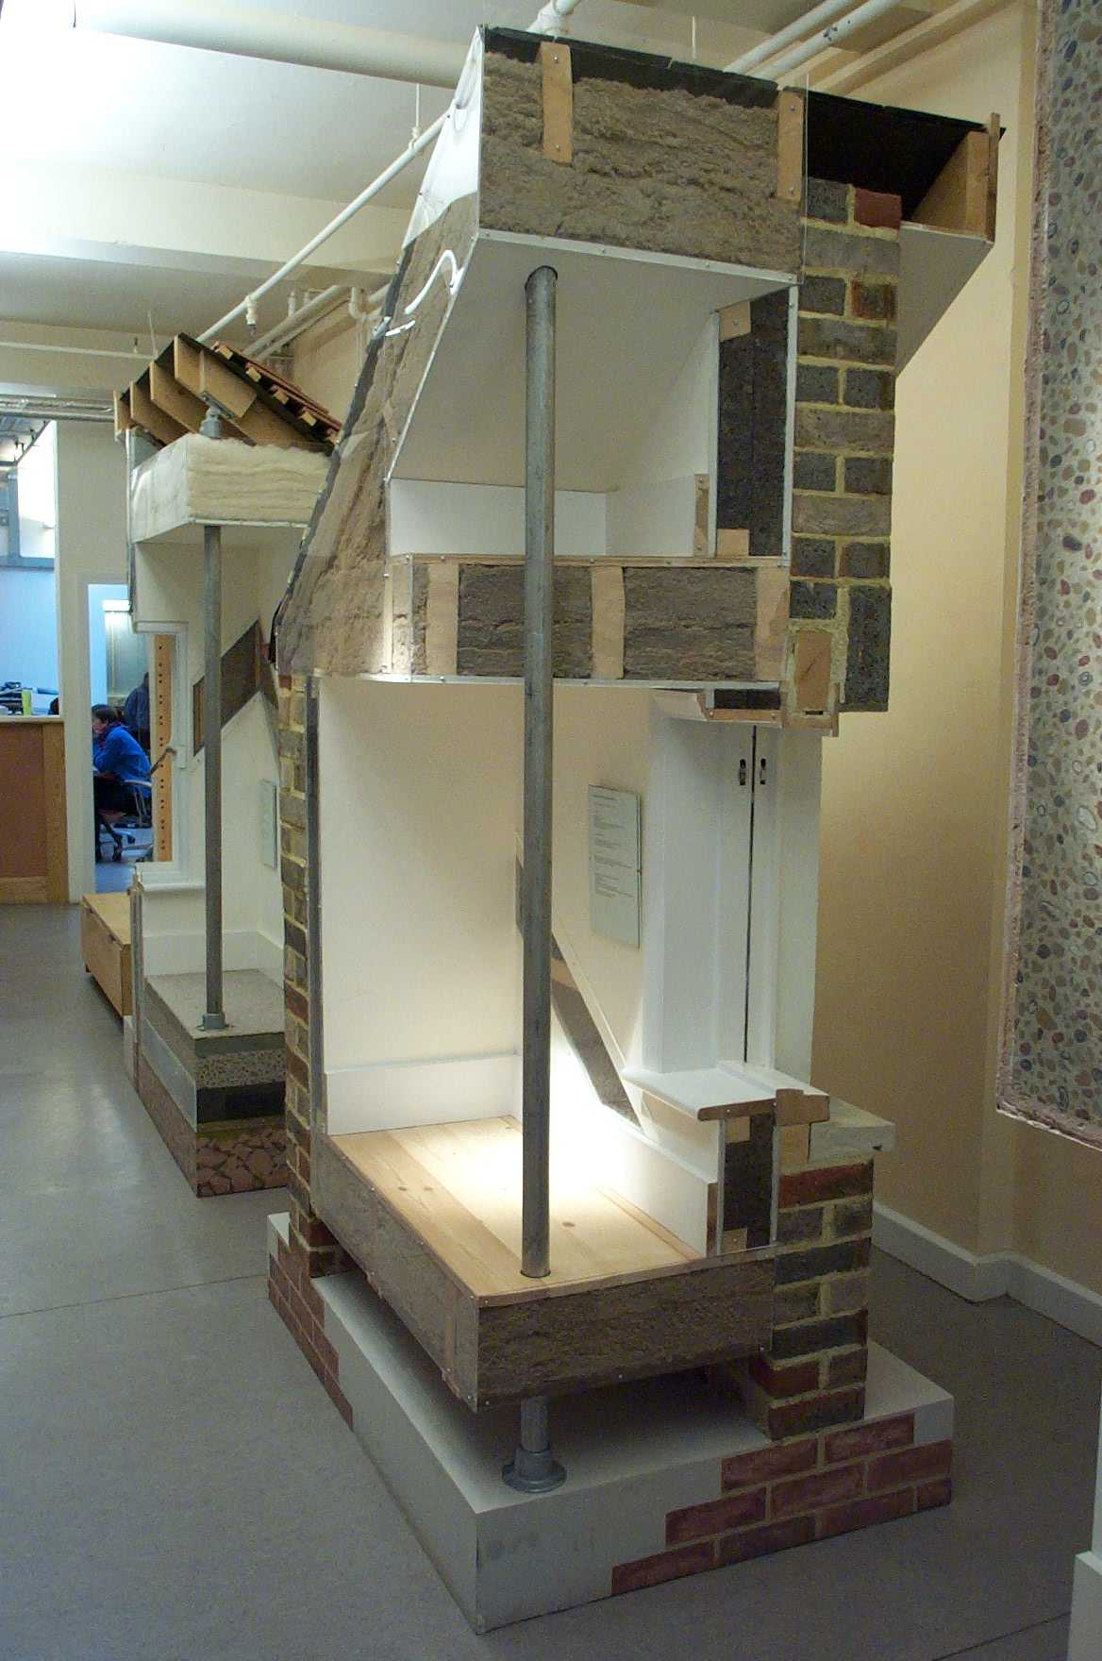
Solid Wall Construction
9 in brick wall
Plastered internally
Cork insulation
In two layers
cross battens
To reduce thermal
Bridge through battens
Drylined
Skirting
Eco Energy Refurbishment

Slide 77
Pitched roof Construction
Existing rafter zone insulated leaving 50 mm. ventilation zone
Cross battens applied below rafters, batten zone insulated
Plasterboard ceilings added
Eco Energy Refurbishment

Slide 78
Suspended Ground Floor
Battens to sided of floor joists
Board on battens
Insulation onto boards
Existing floor joist zone insulated
Eco Energy Refurbishment

Slide 79
Suspended Upper Floor
Ceiling joists upgraded to floor joist
Joist zone insulated
Floor boards added
Ceiling linings
Eco Energy Refurbishment

Slide 80
Aerogels
Minerals e.g. Silica in solution
Remove the water and you have microscopic air cells held together by the mineral
Higher performance than the best foamed plastics (k value)
Used attached to boards or in a board sandwich
Wall and floor linings
Used in DGSU translucent GRP glazing

Slide 81
20th C Building
Green Energy Upgrade

Slide 82
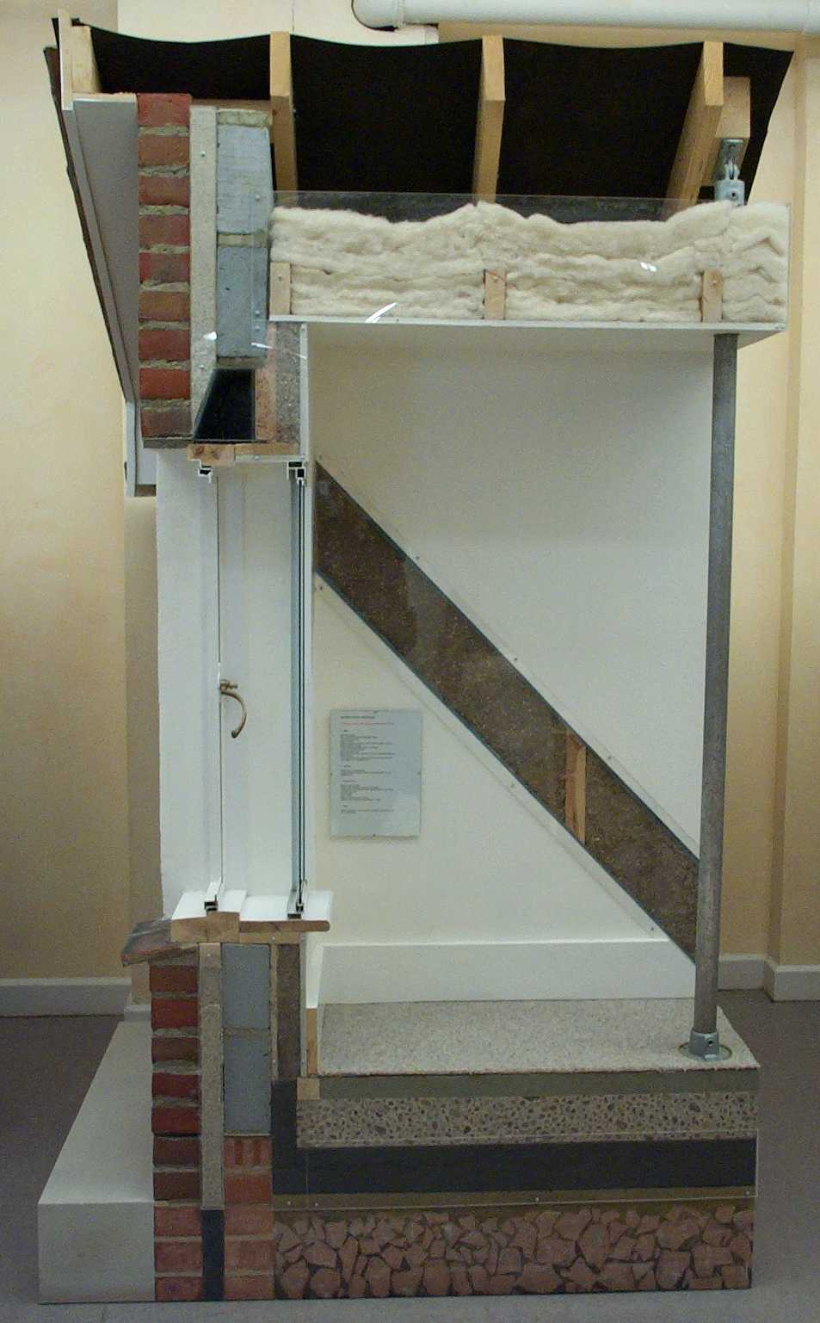

Cavity Wall Construction
Existing masonry cavity wall,
Brick outer leaf, block inner leaf,
Steel lintel thermal bridge plastered internally;
Insulate cavity
Internal insulation
Wrap lintel
Plasterboard dry lining
Eco Energy Refurbishment

Slide 83
Pitched Roof Attic
Existing ceiling joists zone insulated
Insulation laid over ceiling joists at right angles
Eco Energy Refurbishment

Slide 84
Ground floor
Take up existing floor
Lay new DPM
Loadbearing Insulation on DPM
Insulation upstand around perimeter
New eco-concrete floor,
Eco-concrete screed
High density insulation board
Floor finish
Eco Energy Refurbishment

Slide 85


1960’s insitu concrete tower refurbishment
External walls
Eco Energy Refurbishment

Slide 86
1960’s insitu concrete tower refurbishment
Flat roof gutter
Eco Energy Refurbishment

Slide 87
2015
If we have not made significant changes by 2015
2050 is melt down day
The one planet will survive
Unable to support humans living a three planet lifestyle
  UK average citizen

Slide 88
Another GBE CPD/Lecture to download
And https://greenbuildingencyclopaedia.uk

Slide 89
Sampler
This is a cut down version of the original file to give you a sample of the whole
It’s the front end of the file with the middle and rear end deleted
Go to https://GreenBuildingEncyclopaedia.uk
to down load the whole file
You will find a large number of other files there too

Slide 90
Feedback
These files are created by generalists with a big dollop of green flavour
These files are updated from time to time
We are not experts so from time to time these file may get out of date or may be wrong.
If you feel that we have got it wrong please let us know so we can put it right

Slide 91
© GBE 2003 - 2019
Brian Murphy BSc Dip Arch (Hons+Dist)
  Technician and Architect by Training
  Specification Writer by Choice
  Environmentalist by Actions
Greening up my act since 1999
Founded National Green Specification 2001
Launched www.greenspec.co.uk 2003
Created: GBE at https://greenbuildingencyclopaedia.uk 2015
E BrianSpecMan@icloud.com
Twitter: http://twitter.com/brianspecman
LinkedIn: BrianSpecMan
Facebook: http://www.facebook.com/brianspecman
Slide Share:
Pinterest: Brian Murphy • GBE Green Building Encyclopaedia

